Slide 1
Nigeria HPN Multi-Activity Evaluation
Ebonyi Results Review Meeting
July 21, 2022

Slide 2

Meeting objectives
01
Share highlights from the Ebonyi state findings of the Nigeria health, population, and nutrition (HPN) multi-activity evaluation.
02
Facilitate use of findings for state annual operational planning processes and for the annual Activity work planning process.
03
Increase awareness of how to access detailed results of the evaluation for ongoing program decision-making.

Slide 3
Agenda
9:20 – 10:05 am | Use of health services, health facility readiness, and provider knowledge, attitudes and practice: Ebonyi baseline findings.
10:05 – 10:35 am | Sustainability of HPN activities: Ebonyi baseline findings
10:35 – 10:50 am | Break
10:50 – 11:15 am | Coordination and collaboration: Ebonyi
11:15 – 11:50 am | Open Discussion – how can we use these findings for upcoming operational and work-planning processes?
11.50 – 12.00 pm | Wrap up and closing

Slide 4
Use of health services, health facility readiness, and provider knowledge, attitudes and practice
Ebonyi baseline quantitative findings

Slide 5
Assessing the effectiveness of HPN Activities on the use of health services
Preliminary DHIS2 analysis
Notes:
We will focus our review of quantitative evaluation baseline findings on preliminary DHIS2 analysis of service delivery outcomes.

Slide 6
Data Source and Sample
Health facility-level data from Nigeria District Health Information Software 2 (DHIS2)
Monthly data from January 2017–March 2022 (63 time periods)
Exclusion criteria for preliminary analysis: ‘hospital’ or ‘private’ in facility name
Preliminary analytical sample: 688 Ebonyi facilities
Notes:
Our first round of DHIS2 analyses used monthly DHIS2 health facility-level data from January 2017 through March 2022. We excluded from analysis those facilities that contained ‘hospital’ or ‘private’ in the facility name. The number of public primary health care facilities that met study eligibility criteria in Ebonyi was 688 facilities.
NOTES TO SPEAKER:
- We have to assume the preliminary analytical sample only contains public facilities because we didn’t have a variable for public/private and didn’t have a facility type variable, so had to rely on information in the facility name.

Slide 7
Initial service delivery outcomes of interest
Malaria (under 5 years)
  Persons presenting with fever & tested by RDT
  Persons with confirmed uncomplicated malaria
  Persons with confirmed uncomplicated malaria treated with ACT
Descriptive comparison of trends over time
Antenatal Care
  1st ANC visit
  IPTp1
Family Planning
  New acceptors (female)
Notes:
We selected key indicators in pediatric malaria, antenatal care, and family planning service areas as initial service delivery outcomes of interest. For each indicator we examined reporting rates and monthly case volumes to understand trends over time.
Malaria indicators include persons under five years of age who: (1) presented with a fever and were tested by RDT; (2) had confirmed uncomplicated malaria; and (3) had confirmed uncomplicated malaria and treated with ACT. We will be conducting a cascade analysis of malaria services – from clients presenting with fever through clients diagnosed and treated – as a next step.
ANC and FP indicators include (1) first ANC visit for all gestational ages; (2) receipt of IPTp1; and (3) new female FP acceptors.

Slide 8
Preliminary Analytical Approach
DHIS2 data review: High rates of missing data at the facility-month level led to decision to analyze mean cases per month per facility at the state level as the main outcome.
Question
Indicator
Example calculation
How does facility-level reporting of health service delivery change over time?
% of facilities reporting service delivery indicator by month
# Ebonyi facilities reporting # persons presenting with fever and tested by RDT in October 2021
Total # Ebonyi facilities
How do state-level service delivery volumes change over time?
State-level average number of cases or clients per facility by month
Total # persons presenting with fever and tested by RDT in October 2021 across all Ebonyi facilities
# Ebonyi facilities that reported # persons presenting with fever and tested by RDT in October 2021
Notes:
Given high rates of missing data at the facility-month level, we analyze mean cases per month per facility at the state level as the main outcome.
In order to understand how facility-level reporting of malaria, ANC, and FP service delivery changes over time we graph the percentage of facilities reporting the service delivery indicator by month. This is calculated as the total number of facilities in the state that reported the indicator that month divided by the total number of facilities in the state.
In order to understand how state-level service delivery volumes change over time we graph the state-level average number of cases per facility by month. For example, a graph for Ebonyi of first ANC visit client volume would be developed by dividing the total number of October 2021 ANC1 clients across all Ebonyi facilities by the number of Ebonyi facilities that reported on ANC1 in October 2021.

Slide 9
Key findings
Facility DHIS2 reporting rates
Increased for all malaria indicators, IPTp1, and new FP acceptors
Relatively stable for first ANC visit
State-level average number of cases/clients per facility
Patients under-five tested, diagnosed, and treated for malaria declining since late 2019
First ANC visit and IPTp1 client loads relatively stable
New FP acceptors fluctuates over time
Notes:
Key findings from the evaluation’s preliminary analysis of DHIS2 data are shown here.
First, we find that facility-level DHIS2 reporting rates have increased over the study period for all malaria indicators, IPTp1, and new family planning acceptors. Reporting for the first ANC visit has been relatively stable.
Second, we find that state-level average case volumes per facility have declined for malaria testing, diagnosis, and treatment since late 2019. Client loads for first ANC visit and IPTp1 have been relatively stable, and client loads for new female family planning acceptors have fluctuated.

Slide 10
DHIS2 under-5 malaria reporting
Facility reporting rates have increased over time for all malaria indicators.
% Facilities reporting malaria indicators by month, Ebonyi
Fever tested by RDT
Confirmed uncomplicated malaria
Confirmed uncomplicated malaria treated with ACT
Notes:
This graph presents the monthly percentage of facilities that reported the number of under-five patients for each malaria indicator in DHIS2: presenting with fever and tested by RDT; confirmed uncomplicated malaria; and confirmed uncomplicated malaria treated with ACT.
The percentage of facilities reporting all malaria indicators has increased over time. Reporting rates are equal for confirmed uncomplicated malaria and confirmed uncomplicated malaria treated with ACT. Reporting rates for fever cases tested by RDT are typically slightly higher than those for confirmed cases or treated cases. Reporting rates are equal for confirmed uncomplicated malaria and confirmed uncomplicated malaria treated with ACT.

Slide 11
Under-5 malaria service utilization
Case loads have been declining since late 2019. Nearly all confirmed malaria cases are treated with ACT.
State-level average number of cases per facility by month, Ebonyi
Fever tested by RDT
Confirmed uncomplicated malaria
Confirmed uncomplicated malaria treated with ACT
Notes:
This graph presents the monthly average number of cases per facility at the state level for the three pediatric malaria indicators of interest.
We observe some seasonality at the start of the study period, and beginning in late 2019 the average number of under-five patients with fever tested by RDT, confirmed to have uncomplicated malaria, and treated with ACT declined. While case loads appear to have begun trending upwards again in the first quarter of 2021, they have not yet reached levels observed at the start of the study period in January 2017.
We also observe that nearly all cases of confirmed uncomplicated malaria are reported to be treated with ACT.

Slide 12
DHIS2 ANC and FP reporting
Reporting rates for the first ANC visit have remained stable over time under 60%, and IPTp1 and new FP acceptor reporting rates have increased.
% Facilities reporting ANC and FP indicators by month, Ebonyi
1st ANC visit
IPTp1
New FP acceptors
Notes:
On this slide we present the monthly percentage of facilities that reported ANC and family planning indicators of interest:
First antenatal visit attendance among pregnant women of all gestational ages
Pregnant women who received first dose of malaria intermittent preventive treatment
New female family planning acceptors
While the percentage of facilities reporting numbers of clients attending the first ANC visit has remained relatively stable throughout the study period, we observe improved reporting rates for both IPTp1 and new family planning clients.

Slide 13
ANC and FP service utilization
ANC1 and IPTp1 client loads relatively stable over time with some observed seasonality. New FP acceptor client loads have fluctuated over the study period.
State-level average number of clients per facility by month, Ebonyi
1st ANC visit
IPTp1
New FP acceptors
Notes:
Lastly, this graph presents the monthly average number of clients per facility at the state level for ANC, IPTp, and FP indicators of interest.
There appears to be some seasonality in first ANC visit and receipt of IPTp1; otherwise, client loads for these indicators have been relatively stable throughout the study period. The mean number of new FP users has fluctuated over time.

Slide 14
Next steps for DHIS2 analysis
  Exclusion of facilities not providing services of interest
  True zero values vs. missing data
  Examination of outliers
Further data quality review
  Malaria service cascade
  Expanded indicator list
  Triangulation with population-based data
  Classification of facilities by intervention intensity
  Modelling
Additional analyses
Periodic result updates
  Refreshing DHIS2 data every 6 months
Notes:
The next steps of the evaluation’s ongoing DHIS2 analysis component include further data quality review and checks, additional analyses, and periodically updating results.
Immediate next steps in data quality review and data processing include examining patterns in missing data to understand which facilities do not provide a service of interest, are reporting zero cases in a particular month, or have missing data for a particular month. Missing data and outliers will then be treated by imputation as appropriate.
We will also present pediatric malaria indicators in a malaria service cascade format. Additional indicators will be analyzed based on data availability and quality, including malaria test positivity rates, IPTp3, disaggregation of the first ANC visit by pre/post 20 weeks gestational age, receipt of 4 or more ANC visits, and use of modern contraceptive methods.
We also plan to triangulate DHIS2 service delivery results with population-based data, for example the forthcoming MIS and MICS surveys.
Future analyses will attempt to classify health facilities by intervention intensity, and we are also interested in using the interrupted time series approach to estimate program effects on service delivery and/or understand COVID effects.
Lastly, we will pull new DHIS2 data every six months to track reporting rates, data quality, and service delivery volumes over time.

Slide 15
Assessing the effectiveness of HPN activities on health facility readiness
Evaluation baseline health facility assessment (HFA) results

Slide 16
Data Source and Sample
HFA data collected by IHP in Ebonyi between June 10 – July 5, 2021
Additional HFA data was collected by D4I at health facilities between July 5 – August 12, 2021
Evaluation analytical sample: 120 Ebonyi facilities
  100% primary health centers
  77% rural settings

Slide 17
HFA results:
A. General service readiness

Slide 18
General Service Readiness
71% of facilities have all essential medicines available. The mean percentage of essential medicines available at a facility is 81%.
Percentage of Ebonyi health facilities that have essential medicines available (N=120)
Hormonal contraceptives (oral, injectable, and/or implants)
Paracetamol tab/cap
Artemisinin-based combination therapy (ACT)
Folic acid tab/cap

Slide 19
General Service Readiness
63% of facilities have all basic consumables available. The mean percentage of basic consumables available at a facility is 91%.
Percentage of Ebonyi health facilities that have basic consumables available (N=120)
Male condoms
Single use syringes
Examination gloves, latex, single use
Sterile gauze swabs
Alcohol swabs

Slide 20
HFA results:
B. Malaria service availability and readiness

Slide 21
Key findings: Malaria service availability and readiness
100% of facilities in Ebonyi provide malaria rapid diagnostic testing and treatment services
On average, facilities have 77% of the items needed to provide malaria services
  Only 72% facilities have malaria guidelines available and only 41% have IPTp guidelines available

Slide 22
Malaria Service Availability
98% of facilities provide malaria diagnosis by testing: 98% offer RDT, 16% clinical, and 3% microscopy
Percentage of Ebonyi health facilities that offer specific malaria diagnostic services (N=120)
Malaria diagnosis by testing
Malaria diagnosis by RDT
Malaria diagnosis by clinical symptoms and signs
Malaria diagnosis by microscopy

Slide 23
Malaria Service Readiness
99% of facilities have staff trained to diagnosis and treat malaria. However, only 72% of facilities had malaria diagnosis and treatment guidelines available.
Percentage of Ebonyi health facilities that are ready to provide Malaria services today (among facilities providing malaria services) (N=120)
Staff trained in malaria diagnosis and treatment
Malaria diagnostic testing capacity
Guidelines for diagnosis and treatment of malaria

Slide 24
Malaria/ANC Service Readiness - IPTp
88% of facilities offer IPTp. Among those facilities offering IPTp services, only 76% had staff trained in IPTp and 41% had IPTp guidelines available.
Percentage of Ebonyi health facilities ready to provide IPTp care (among facilities providing IPTp) (N=119)
Facility has guidelines on IPTp
Facility has staff trained in IPTp
Facility has IPT medicines

Slide 25
Malaria Service Readiness
On average, facilities had 77% of all malaria staff/guidelines, diagnostic, and medicines/commodities items available; only 7.5% of facilities had all items.
Mean percentage of items available to provide malaria services today (among facilities providing malaria services) (N=120)
Mean % of malaria diagnostic items
Mean % of malaria staff and guidelines items
Mean % of malaria medicines and commodities items
Mean % of all malaria items at facilities
Notes:
Malaria diagnostic items: RDT kits, smear kits, microscopy
Malaria staff and guideline items: guidelines for diagnosis and treatment, guidelines for IPTp, staff trained in malaria diagnosis and treatment, staff trained in IPTp
Malaria medicines and commodities: first-line antimalarials, paracetamol tab/cap, sulphadoxine-pyrimethamine (SP) tab/cap, ITN or ITN vouchers
All malaria items: medicines and commodities, diagnostic items, staff and guidelines

Slide 26
Malaria Service Readiness - Stockouts
During the previous 4 weeks, 1 in 5 facilities experienced RDT stock outs and 1 in 5 experienced 1st line antimalarial stock outs.
Percentage of Ebonyi health facilities that experience stock outs by type and length
RDTs
1st line antimalarials
● Less than 7 days | ● 7-14 days | ● More than 14 days

Slide 27
HFA results:
C. Antenatal care and family planning service availability and readiness

Slide 28
Key findings: Antenatal care and family planning availability and readiness
At least 95% facilities in Ebonyi provide any ANC and FP services
Generally low ANC service readiness (51% items available)
Moderately high FP service readiness (83% items available)
  92% facilities have at least 3 modern methods available

Slide 29
ANC Service Availability
99% of facilities offer antenatal care services.
Percentage of Ebonyi health facilities that offer specific ANC service (N=120)
ANC services
Folic acid supplementation
Iron supplementation
Monitoring for hypertensive disorder of pregnancy
Tetanus toxoid vaccination
IPTp
Routine checks for urine protein

Slide 30
ANC Service Readiness
On average, facilities had 51% of all ANC items available; no facility had all ANC items.
Mean percentage of items available to provide ANC services today (among facilities providing ANC services) (N=119)
Mean % of ANC diagnostic items at facilities
Mean % of ANC medicines and commodities items at facilities
Mean % of ANC equipment items at facilities
Mean % of ANC staff and guidelines items at facilities
Mean % of all ANC items at facilities
Notes:
ANC Diagnostic items: haemoglobin testing capacity, urine dipstick-protein test
ANC medicines & commodities: insecticide treated nets (ITNs), IPT medicine, tetanus toxoid vaccine, iron tablets, folic acid tablets
ANC equipment: iron tablets, adult weighing scale, fetal stethoscope, blood pressure apparatus
ANC staff & guidelines: national guidelines on ANC, ANC check-lists and/or job-aids, staff trained in ANC, national guidelines on IPTp, IPTp checklists and/or job-aids, staff trained in IPTp
All ANC items: diagnostic items, medicines and commodities, equipment, staff and guidelines

Slide 31
FP Service Readiness
98% of facilities offer family planning services. On average, these facilities had 82% of all family planning items available.
Percentage of Ebonyi health facilities with the capacity to provide family planning services on the day of assessment (N=118)
Blood pressure apparatus
Staff trained in FP
Any modern methods available
3 or more modern methods available
Facility has all FP items

Slide 32
Assessing the effectiveness of HPN activities on providers’ knowledge, attitudes, and practices
Evaluation baseline provider survey results

Slide 33
Data Source and Sample
4 modules: Background, Training, Clinical Vignettes, and Provider Attitudes and Norms
Up to 5 providers/facility interviewed. Eligibility criteria included:
  Present at facility on day of survey
  Provide out-patient services
  See sick children, ANC, and/or family planning patients
Fieldwork: July 1 – August 12, 2021
Ebonyi provider survey sample size: 354 providers from 120 PHCs
Notes:
The provider instrument assessed malaria, child health, FP and ANC outcomes in the TOC related to quality of care; namely client-provider interactions and provider knowledge, attitudes, and practices.

Slide 34
Provider survey results:
A. Provider Background

Slide 35
Provider Demographics, Experience, and Tenure
The average provider in Ebonyi. . .
Female (92%)
41 years of age
16 years of education
Received technical qualifications/basic training 12 years ago
Nearly 30% were professional health workers
Has worked at current facility for 6-11 months (29%), with an average of 3 years
31% seconded
Notes:
We categorized doctors, registered nurses, midwives, nurse midwives, public health officers, and laboratory scientists as professional providers. The non-professional health worker cadre includes public health associates, laboratory technicians, environmental health officers, pharmacy and dental technicians, health information/medical records technicians, community health officers, community nurses and midwives, community health extension workers, nurse aids, and other health workers with no technical qualifications.
Nearly 30% of providers interviewed in Ebonyi were professional health care workers. In Ebonyi, registered nurses and registered nurse midwives comprised the majority of the professional health cadre. The vast majority of non-professional health workers were Community health extension workers, followed by JCHEW.
Professional includes: doctors, registered nurses, midwives, and nurse midwives, public health officers, and laboratory scientists
Non-professional includes: Public health associates, laboratory technicians, environmental health officers and associates, pharmacy technicians, dental technicians, health information/medical records technicians, community health officers, community nurses and midwives, CHEW (community health extension workers), JCHEW (junior community health extension workers), nurse aides, and health workers with no technical qualifications.

Slide 36
Services Provided
Nearly all clinicians provide malaria, child health, and antenatal care services.
Services health worker personally provides in current position at facility (N = 354)
Malaria
Child health services
Antenatal care
Family planning services
Notes:
The provider survey focused on four major clinical care areas: malaria, child health services, antenatal care, and family planning.
At nearly all facilities we interviewed all providers performing services at the clinic on the day of the interview. In Eboyni the same health workers are likely to be performing multiple care types

Slide 37
Provider survey results:
B. Training

Slide 38
General Training
81% of health workers reported receiving training in any of the specified general topics.
Percent of health workers who received training on general topics (N = 354)
Safe injection practices
Approximately 2 out of 3 providers reported receiving training on safe injection practices, standard precautions, and HMIS/reporting
Roughly 1 in 3 providers reported receiving training on GBV
General training typically received within past 2 years
Standard precautions
HMIS/reporting
GBV
■ Past 24 mos. | ■ 2+ yrs.
Notes:
81% of providers in Ebonyi reported having ever received training in any of the specified general topics – safe injection practices, standard precautions around hygiene and injury prevention, health management information systems or reporting requirements, and gender-based violence.
The total length of each bar represents the percentage of health workers who ever received training; the dark shading indicates training was in the past two years and light shading indicates over two years ago.

Slide 39
Malaria
99% of respondents personally diagnose and/or treat malaria. 79% of these health workers reported receiving training in any of the specified malaria topics.
Percent of malaria providers who received training on malaria topics (N = 352)
mRDT performance
Malaria training levels higher than child health, family planning (FP), and antenatal care (ANC) service trainings
Diagnosing malaria in children
Case mgmt/tx of malaria during pregnancy
IPT of malaria in pregnancy
■ Past 24 mos. | ■ 2+ yrs.
Notes:
OLD NOTES
Service area-specific training analysis was restricted to those providers who personally provide the service in their current position at the sampled facility. This corresponds to the service area slide we reviewed at the end of the background section.
Nearly all providers in Ebonyi and Kebbi and 87% in Zamfara provide malaria services in their current position. Again we see high training levels in Kebbi, particularly recent training in the past two years, and overall higher training levels in Zamfara.
Malaria training levels are high across the three states compared to the other health service areas – child health, family planning, and antenatal care.
P-values for 3 training categories (never, 2+ years, past 24 months)
Diagnosing malaria in children 0.000
mRDT performance 0.000
Case management/treatment of malaria during pregnancy 0.000
IPT of malaria in pregnancy 0.000
Similar findings as general training – K and Z are higher, recent highest in K

Slide 40
Antenatal Care
98% of respondents provide ANC services. 77% of these health workers reported receiving training in any of the specified ANC topics.
Percent of ANC providers who received training on ANC topics (N = 347)
IPT of malaria during pregnancy
Male engagement and partner communication training low in Ebonyi
Counseling for ANC
Pregnancy comp. and mgmt.
ANC screening
Nutritional assessment of preg. women
Male engagement in ANC
Partner communication in birth planning
■ Past 24 mos. | ■ 2+ yrs.
Notes:
OLD NOTES
Lastly, we asked about antenatal care service training on IPT of malaria during pregnancy, ANC screening and counseling, identification and management of pregnancy complications, nutritional assessment of pregnant women, male engagement in ANC, and partner communication around birth planning.
Recall that nearly all Ebonyi health workers provide ANC services, compared with just over 60% in Kebbi and about a third in Zamfara. While there is low ANC service provision in Zamfara, the providers tend to have moderate-high levels of training.
Again we find that most ANC-specific training in Kebbi is recent, and occurred over two years ago in Zamfara. Similar to family planning training we find that training specific to male engagement and partner communication in ANC and birth planning are low.
P-values for 3 training categories (never, 2+ years, past 24 months)
ANC screening 0.000
Counseling for ANC 0.000
Complications of pregnancy and their management 0.000
Nutritional assessment of the pregnant woman 0.000
IPT of malaria during pregnancy 0.008
Partner communication in birth planning 0.000
Male engagement in ANC 0.000

Slide 41
Family Planning
76% of respondents provide FP services. 65% of these health workers reported receiving training in any of the specified FP topics.
Percent of FP providers who received training on FP topics (N = 269)
General counseling for FP
Male engagement and partner communication low
Implant insertion/removal
Clinical mgmt of FP methods
Post-partum FP
IUCD insertion/removal
Male engagement in FP
Partner communication for FP
■ Past 24 mos. | ■ 2+ yrs.
Notes:
Old notes
Family planning service provision was lowest across the three states, as was family planning-specific training among providers. Only 65% of family planning providers in Ebonyi and 81 to 84% in Zamfara and Kebbi received training in the specific family planning services mentioned – general counseling, implant and IUD insertion and removal, clinical management of methods, postpartum family planning, and male engagement.
The large majority of family planning training in Kebbi has occurred within the past two years, compared to a majority in Zamfara over two years ago. This aligns with partner efforts in the two states, particularly the disease-focused approach in Zamfara.
Training specific to male engagement and partner communication for family planning are low in Ebonyi and Zamfara.
P-values for 3 training categories (never, 2+ years, past 24 months)
General counseling for family planning 0.000
IUCD insertion and/or removal 0.000
Implant insertion and/or removal 0.000
Clinical management of FP methods, including managing side effects 0.000
Post-partum family planning 0.000
Partner communication for family planning 0.000
Male engagement in family planning 0.000
Other 0.003

Slide 42
Provider survey results:
C. Attitudes and Norms

Slide 43
Provider Attitudes and Norms
Are provider attitudes different from perceived professional community norms among other providers in LGA?
  Topic 1. Malaria, ANC, and FP attitudes, practices, and norms
  Topic 2. Gender attitudes and gender-sensitive quality of care norms
Notes:
We wanted to understand provider attitudes toward malaria, antenatal care, and family planning practices, and are also interested to learn if provider attitudes differ from their perceptions of professional community norms. We first asked providers to describe how strongly they agree or disagree with statements about malaria case management, family planning, and ANC service provision, then asked them to describe how often they thought other providers in their LGA performed the activities .
In addition to asking them about service-specific care, we asked clinicians to respond to a series of statements related to RMNH service provision and quality of care to develop a provider gender attitude score. We also asked them about their perceptions of gender-sensitive community quality of care in their LGA.
ANC questions adapted from Breakthrough Research’s Nigeria Behavioral Sentinel Survey baseline questionnaire
- White Johansson, Emily, Paul Hutchinson, Elizabeth Omoluabi, Akanni Akinyemi, Andrea Smith, J. Clint Welty, Udochisom Anaba, Dominique Meekers, Alejandra Leyton, Dele Abegunde, and Paul C. Hewett. 2020. "Behavioral Sentinel Surveillance Survey in Nigeria," Breakthrough RESEARCH Baseline Technical Report. Washington, DC: Population Council.

Slide 44
Key findings: Provider attitudes and LGA norms
Malaria case management attitudes and norms are generally positive at Evaluation baseline and align with corresponding community norms
ANC provider attitudes are universally positive at evaluation baseline
LGA norms on ANC also positive but slightly less so than provider attitudes
  Exception: LGA norms around mosquito net provision are less positive than corresponding provider norms
There is more variation in provider attitudes and LGA norms on family planning than on malaria case management and ANC
Provider attitudes on family planning are more progressive than LGA norms around offering contraceptives to women under 18, but less progressive around requiring partner consent for contraceptives

Slide 45
Key findings: Provider gender attitudes and LGA norms
Gender norms among providers and LGA norms are moderately gender equitable in Ebonyi
Almost all providers agreed or strongly agreed with statements expressing supportive LGA norms on couples’ communication and individual agency in family planning service provision
31% providers agreed or strongly agreed with the statement “the clinicians in this LGA believe that men’s only role in family planning should be to help select methods used by their female partner”

Slide 46
Provider survey results:
D. Clinical Vignettes

Slide 47
Child Health Vignette
99% providers eligible to respond. Average total (weighted) score for child health vignette is 56%.
Child health: Domain and weighted total scores
Key findings
99% of providers would perform mRDT
97% of providers would treat with ACT
Low counseling domain score driven by:
  5% of providers would disclose diagnosis
  31% of providers would counsel on avoiding drug resistance
Notes:
Very low prevalence of diagnosis disclosure (5% of providers)
Critical to counsel on avoiding drug resistance – only 31% of providers indicated they would discuss the importance of finishing medication as prescribed

Slide 48
ANC: Malaria in Pregnancy Vignette
96% providers eligible to respond. Average total (weighted) score for MIP vignette is 72%.
ANC-MIP: Domain and weighted total scores
Key findings
Vignette focuses on treatment of a woman presenting with malaria in pregnancy
Nearly universal malaria testing (96%) and treatment with ACT (91%)
Notes:
Limitation of this vignette is that it focuses on non-ANC and malaria testing/diagnosis/treatment. It does not follow standard MIP/IPTp protocol.

Slide 49
Family Planning Side Effects Vignette
68% providers eligible to respond. Average total (weighted) score for FP-SE vignette is 49%.
FP-SE: Domain and weighted total scores
Key findings
24% of providers would not offer counseling on another FP method
  Most common reason is that side effects are normal
Most providers focus counseling on the methods available at the PHC on day of visit
Nearly 70% of providers would refer the client to another clinic if her preferred method is unavailable

Slide 50
Post-partum Family Planning Vignette
68% providers eligible to respond. Average total (weighted) score for PPFP vignette is 54%.
PPFP: Domain and weighted total scores
Key findings
94% of providers would counsel the client in choosing a post-partum contraceptive method
27% of providers would counsel on FP methods that can be used during breastfeeding
21% of providers would counsel on birth planning to get FP at time of delivery

Slide 51
Male Engagement in Family Planning Vignette Content
68% providers eligible to respond. Average total (weighted) score for MEFP vignette content is 14%.
MEFP: Domain and weighted total scores
Key findings
Male engagement in family planning generally low across both FP vignettes

Slide 52
Gender-Based Violence Vignette Content
96% providers eligible to respond. Average total (weighted) score for GBV vignette content is 20%.
GBV: Domain and weighted total scores
Key findings
47% of providers would implement GBV screening
Fewer than 5% of providers diagnosed explicit GBV risk

Slide 53
Provider survey results:
Conclusions

Slide 54
Conclusions
Overall
Indicators related to malaria (training, attitudes and norms, vignettes) tend to be highly positive → not a lot of room for improvements over time
More variation in indicators for ANC, FP
Gender
Training on gender issues (GBV, male involvement in FP) low
Few providers screened for GBV in pre-eclampsia/GBV ANC vignette
Gender norms among providers are moderately gender equitable

Slide 55
Baseline findings on sustainability: Ebonyi
A. Methods

Slide 56
Defining sustainability
USAID defines sustainability:
In Ebonyi, IPs and government staff expressed similar perceptions:
“the capacity to maintain program services at a level that will provide ongoing prevention and treatment for a health problem after termination of major financial, managerial and technical assistance from an external donor.”¹
Ability of state to take over and continue approaches and strategies that IPs implemented after the IPs are no longer in the state.
– Ebonyi IP staff
Ability of state to continue implementing partners’ approaches when they are no longer in the state.
– Ebonyi SMOH staff
¹ Sustainability of Development Programs: A Compendium of Donor Experience. Washington, DC: US Agency for International Development; 1998
Notes:
For this assessment, we used USAID’s definition of ‘sustainability’ as follow: “Sustainability is the capacity to maintain program services at a level that will provide ongoing prevention and treatment for a health problem after termination of major financial, managerial and technical assistance from an external donor.”
Interviews with implementing partners and government staff indicated similar perception about sustainability.

Slide 57




Conceptual framework for sustainability assessment
Activities
Elements Influencing Sustainability
Institutionalization
Ultimate Outcomes
State MOU
State AOP
Program implementation
Strategic program planning
Program adaptability and alignment
Effective engagement and collaboration
Demonstrating program results
Transition
Increased capacity of State programs/structure
Increased sustainability of health systems and health outcomes
Increased capacity of State health promotion team and structures
Increased capacity of State FP/MNCH/PHC teams and structures
System/organizational capacity
Resource and funding stability
Leadership competence
State govt. staff involvement & integration
System flexibility to adapt to change
Effective coordination and collaboration
Routinization
Increased capacity of State EDDS teams & structures
Increased capacity of State malaria program and structures
Institutionalization
Improved information used for decision-making
Increased capacity at community level
Community embeddedness
Program-community partnership
Community leadership involvement
Community participation & accountability
Public health impacts
Improved patient HMIS quality and use
Strengthened Facility Management Committees (FMC)
System
feedback/response
Strengthened LMIS quality and use
Strengthened Ward Development Committees (WDC)
Enabling environment
Advocacy/communications
Political support and acceptance
Government and local policy alignment
BA-N
IHP
Learnings from early transition phase for continuous improvement
PMI-S
PSM
IHP (Kebbi), PMI-S (Zamfara), IHP/PMI-S (Ebonyi)
All activities
Notes:
A conceptual framework was developed to guide the sustainability assessment. Specifically, we hypothesize that by engaging government partners in health system strengthening interventions, the four implementing partners will make the interventions into a routine practice in the government health system, and then will gradually turn them into common practice within the government system. During the engagement and routinization process, the IPs will continue working with government partners to collect feedback and make adjustment as needed. Elements influencing sustainability were drawn from literature. Specifically, we look into 4 key domains: Program implementation, system/organizational capacity, community embeddedness and enabling environment.

Slide 58
Sustainability survey
Questionnaire was adapted by D4I from the Program Sustainability Assessment Tool (PSAT)*
Includes statements that characterize sustainable programs, organized into 12 domains across 3 functional areas
Likert-type response scale anchored by ‘to an extremely small extent’ (1) and ‘to an extremely large extent’ (7)
A total of 161 staff members (24% female, 76% male) from HPN stakeholder organizations in Ebonyi took part in the assessment February–March 2022
*Center for Public Health Systems Science (2021). Program Sustainability Assessment Tool (PSAT). Brown School of Public Health, Washington University in St. Louis. Retrieved from https://sustaintool.org/psat/ in June 2022. (available under a Creative Commons Attribution-Non-Commercial-Share-Alike license)

Slide 59
Qualitative interviews
Interview guides were developed for HPN Activity, State, and USAID respondents focusing on:
  Program implementation
  Collaboration/coordination
  System/organizational capacity
  Community embeddedness (BA-N only)
  Enabling environment
  Institutionalization
24 key informant interviews (KIIs) conducted at the Federal and state levels:
Participant | Sample size
 | Ebonyi | Kebbi | Zamfara | Abuja FCT
HPN Activity staff | 4 | 3 | 3 | 3
Government staff | 3 | 3 | 2 | 0
USAID | 0 | 0 | 0 | 3
TOTAL | 7 | 6 | 5 | 6

Slide 60
Baseline findings on sustainability: Ebonyi
B. Program implementation

Slide 61



What sustainability strategies are implementers using?
Communicate the purpose and goals of the sustainability plan with stakeholders at the beginning of the design process
Engage and support not only state-level stakeholders but also LGA- and grassroot-level leaders in the implementation process
Gender integration
Align interventions that include a sustainability plan alongside state’s annual operational plans
Co-locate activity office
within state Ministry of Health’s office complex
Commitment & engagement
Capacity
Integrate gender aspect in practice and interventions by including a gender focal person to facilitate gender incorporation into scope of activities

Slide 62
Key survey findings
Score are largely consistent across all measures on program implementation.
Average ratings were generally 5.5 (“to a large extent”) or higher for survey items in this domain.

Slide 63
Program adaptability and alignment scores
Scores are largely consistent across all measures
Notes:
Alignment of Activities’ approaches with priorities of government ministries & agencies was rated highest (at 6) for Program Adaptability and Alignment scores

Slide 64
Program adaptability and alignment
[The Activity] was able to share their plans with the agency, which have been factored into the agency’s annual operational plan.
[The Activities’] plan development have been going on in the state since the inception of [the Activities], thereby making implementation to be seamless, more so Activities’ work is integrated into the everyday operations of State Malaria Elimination Program (SMEP).
– Ebonyi SMOH staff
– Ebonyi SMOH staff
Notes:
Interviews with Ebonyi government staff and IPs also reflect the quantitative findings.

Slide 65
Effective engagement and collaboration scores
Scores are largely consistent across all measures
Notes:
Ability of Activities to work closely with government partners to explore and select best option for program implementation was rated highest (at 5.9, for Effective Engagement and Collaboration scores

Slide 66
How do Activities collaborate with state government?
Participate in planning and monitoring state government’s health plans (i.e., planning SMOH AOP & malaria AOP, and monitoring PHC MOU, etc.)
The way [the Activities] work is being integrated into the everyday operations of the State Malaria Elimination Program (SMEP). They are co-located in the same building thereby aiding them to hold weekly meetings where they exchange issues and have them addressed. At the end of every month, they jointly come up with monthly activity plans for the new month which also services as SMEP activity plan for the month. The activity plan also contains the malaria activities of all the IPs that are in the state.
– State SMOH staff
Provide technical support in health programming (i.e., tools for monitoring data quality, meetings for TWGs, coordination, and malaria AOP review, etc.)
Strengthen capacity on health programming and data use (i.e., training on malaria score chart development, end user verification, etc.)

Slide 67
Demonstrating program results scores
Scores are largely consistent across all measures
Notes:
Both “Activities’ capacity for quality implementation approach M&E” and “the association of Activities implementation with improvement of health outcomes” were rated highest (at 6) in Demonstrating Program Results scores.

Slide 68


Facilitators vs. barriers to program implementation
  Facilitators
  Barriers
IPs’ regular reviews of implementation approaches
Generation and use of data for activity planning, monitoring, and evaluation
Strategy to engage with local communities and agency in activity implementation
IPs’ flexibility to adjust and adapt to new changes in state or LGA context
Coordination and collaboration with other IPs in activity implementation
Some of IPs’ activities do not align well with mandate from the NPHCDA to the state
Low enrolment among poor rural women into BHCPF due to requirement on a national identification number
Shortage of community volunteers (CVs) due to the ‘non-payment’ nature of the volunteer work
Limited engagement of CVs as staff selected as supervisors are from a different community

Slide 69
Baseline findings on sustainability: Ebonyi
C. System/organizational capacity

Slide 70
Key survey findings: System/organizational capacity
Scores are markedly lower than for program implementation, with many item averages in the ‘small’ to ‘moderate’ range
Scores for items in the resource and funding stability domain are lowest, generally averaging below 4.0 (‘moderate’)
For state government leadership and state government staff involvement, rankings vary by item within the domain

Slide 71
Resource and funding stability scores
Scores are markedly lower in this domain, and lowest for this measure

Slide 72
Resource and funding stability
The State Malaria Elimination Program received more funding this year, but not beyond 15% of the entire annual or quarterly review. The funds released and allocated for the health sector are not adequate for implementation of their operations.
The government expenditure has evolved over the years, this is because the Logistics Management Coordination Unit’s monthly coordination meetings. Also, the bi-monthly data triangulation reporting are now being funded by the state, but with some other supports from [the Activities].
– Ebonyi SMOH staff
– Ebonyi Activity staff

Slide 73
State government leadership competence scores
Scores are lowest on this measure
Scores are highest on this measure

Slide 74
State government involvement & integration scores
Scores are highest on this measure
Scores are lowest on this measure

Slide 75
Baseline findings on sustainability: Ebonyi
D. Enabling environment

Slide 76
Key survey findings: Enabling environment
Scores are consistently high, with state averages mostly above 5.0 (‘to a large extent’) for survey items in this domain
Advocacy/communication measures score highest in this domain

Slide 77
Advocacy/communications scores
Scores are largely consistent across all measures
Notes:
Activities’ impact to increase community awareness of the health issue was rated highest in Advocacy/Communication scores

Slide 78
Advocacy & communications: Successes vs. challenges
One of the challenges that [the Activity] has experienced with advocacy is inadequate feedback or response from the state. For example, data communication…there has not been adequate feedback or response from the state on that.
– Ebonyi Activity staff
PMI-S
BA-N
Strategy used by Activities to obtain visibility includes having a meeting with the state commissioner for health and the use of traditional rulers and religious leaders.
– Ebonyi SMOH staff
IHP
PSM

Slide 79
Political support and acceptance scores
Scores are lower on these measures
Notes:
“Public support to the Activities” was rated highest (at 5.5) in political support and acceptance scores.

Slide 80
Political support and acceptance
The current state health leadership, particularly the state health commissioner, is very pro low-dose high-frequency (LDHF) trainings. He is a big champion of it. He communicated the vision of the training, how he is in support of it. Also, because some of the key state health officials, were part of the LDHF trainers at the facility level, they jointly take part in [the Activity]’s activities.
The government leadership are doing a great deal of a job in terms of supporting State Malaria Elimination Program (SMEP). For instance, when SMEP needed additional hands the government leadership obliged them, and any matter that has to do with SMEP which is what [the Activity] and the state are interested in, the government leadership works towards ensuring that it is achieved.
– Ebonyi Activity staff
– Ebonyi SMOH staff
Notes:
Interviews with Ebonyi government staff and IPs also reflect the quantitative findings.

Slide 81
Baseline findings on sustainability: Ebonyi
E. Fostering sustainability in practice

Slide 82
Fostering sustainability in Ebonyi
Organization of routine coordination meetings, data validation meetings, TWG meetings, and advocacy briefs for coordination, and advocacy for fundings for RMNCH+N and malaria
Gender-inclusive approaches including balance of male and female CVs and LGA supervisors, criminalization of female genital cutting
Data generation and use practice such as data management, quality assurance, analysis, triangulation, and validation
Practice writing reports and documenting implementation activities, including using report templates
Use of tools to implement RMNCH+N and malaria programs, including program report template and data quality monitoring tools
Engagement of community volunteers into community referrals for health services
PMI-S
IHP
BA-N
PSM
Notes:
From the key informant interview, we were able to draw out a list of specific practices that the four Activities have engaged and collaborated with state government ministries and agencies.

Slide 83
Collaboration and coordination

Slide 84



Steps in the organizational network analysis (ONA)
HPN Activity implementers each identified up to 10 collaborating organizations; implementers and collaborators completed the survey
At the start of the survey, each respondent named “the 10 main organizations that your organization coordinates with [for HPN Activities]” – some of these nominees were also respondents
Respondents were asked about resource and information exchange with each organization they nominated in step 2, and the responses were used to generate network data and diagrams
Notes:
(after looking at bullets)
From this survey data, we create an organizational network that can act as a model for thinking about some of the issues and open questions we've been discussing.
We used four different measures to answer questions about this model: density, reciprocity, efficiency, and centrality. While the first three will be useful to capture over-time and potentially between-state differences, we can use the last measure to identify organizations and relationships that tend to be the most important, and, by simulating changes to our network model, identify relationships that, if established, could potentially improve the ability of organizations to share information and resources with each other – even when they do not have a direct relationship.

Slide 85
Network density
How commonly do these organizations share resources or information (with any frequency)?
Low density
High density
Notes:
The first measure we look at is density, where we ask how common sharing relationships are in the network.

Slide 86
Network reciprocity
How many of the resource or information sharing relationships between these organizations are mutual?
Low reciprocity
High reciprocity
Notes:
The second is reciprocity: how many of the sharing relationships are mutual?

Slide 87
Network efficiency
How many steps are needed to share information or resources across these organizations?
Low efficiency
High efficiency
Notes:
Third, we looked at the average number of steps it takes to share resources and information between all organizations in the network.

Slide 88
Organization and relationship centrality
Example: D has information that E needs.
Organizations A & B are central
Relationships (D→A), (A→B), and (B→E) are central
…because they are on the shortest path.
B
C
A
E
D
Shortest path: D→A→B→E
F
Notes:
Finally, we will use centrality to identify the most important relationships and organizations in our network, in terms of the model we created from our survey data.
As an example, let us look at the hypothetical network here. In this example, lets say that organization D has information that organization E needs. Because D does not have a direct relationship to E, the information in question would need to pass through organizations A and B before it can reach E. Because organizations A and B are on what we call the "shortest path" between D and E, we expect it to be more important.
We can observe the same thing from looking at relationships D -> A, A->B, and B->E. They are all important because they are on the shortest path between organizations D and E.
Now expand this to all pairs of organizations – we can identify the most important organizations and relationships across the whole network by looking at which ones appear in the shortest paths betwene all organizations most often. This can give us insight into the organizations and relationships that are most critical for sharing information and resources, as well as hypothesize about what the establishment of new relationships would do to the network based on our model.

Slide 89

ONA is primarily a tool for discussion
Network Survey Limitations
  The survey only asked about selected kinds of networking
  The number of respondents and nominees was limited for practicality
  Different individuals representing the same organizations might have nominated different collaborators and answered other questions differently
Challenges with network modeling
  No standard exists for “good” results on network measures; observing changes over time can be more instructive
  Network characteristics involve trade-offs: efficiency versus resilience, costs associated with increasing the number of connections
  Networks are not a perfect model of the world – they can be used as a tool for thinking about and discussing practical activities.
Notes:
We have to keep in mind that Organizational Network Analysis involves the creation of a network "model" that doesn't necessarily reflect the real world exactly. There are limitations with both the survey and with modeling the world as a network.
(review the bullet points)

Slide 90
What questions does this ONA answer (and raise)?
Generally, is there a lot of resource and information exchange happening? Which organizations and relationships are most central to it?
  Ask: what did you expect to see, and how does this compare to what the analysis showed? What are the possible reasons for any differences?
Which potential relationships would have the largest positive effects on the efficiency of resource and information exchange?
  Ask: is higher efficiency important? Why? Are these relationships feasible?
Which potential relationships involving an HPN Activity implementer would increase the centrality of government organizations the most?
  Ask: is government centrality a good proxy for sustainability? What else might be?

Slide 91
Resource sharing
Resources: things bought with money or provided in-kind, e.g., medicines/commodities, meeting/office space, media time, etc.
“How often does your organization provide resources to (name)?”
“How often does your organization receive resources from (name)?”
Notes:
First, we look at results for resource sharing. For each organization that they nominated, we asked this question: [look at slides here]

Slide 92
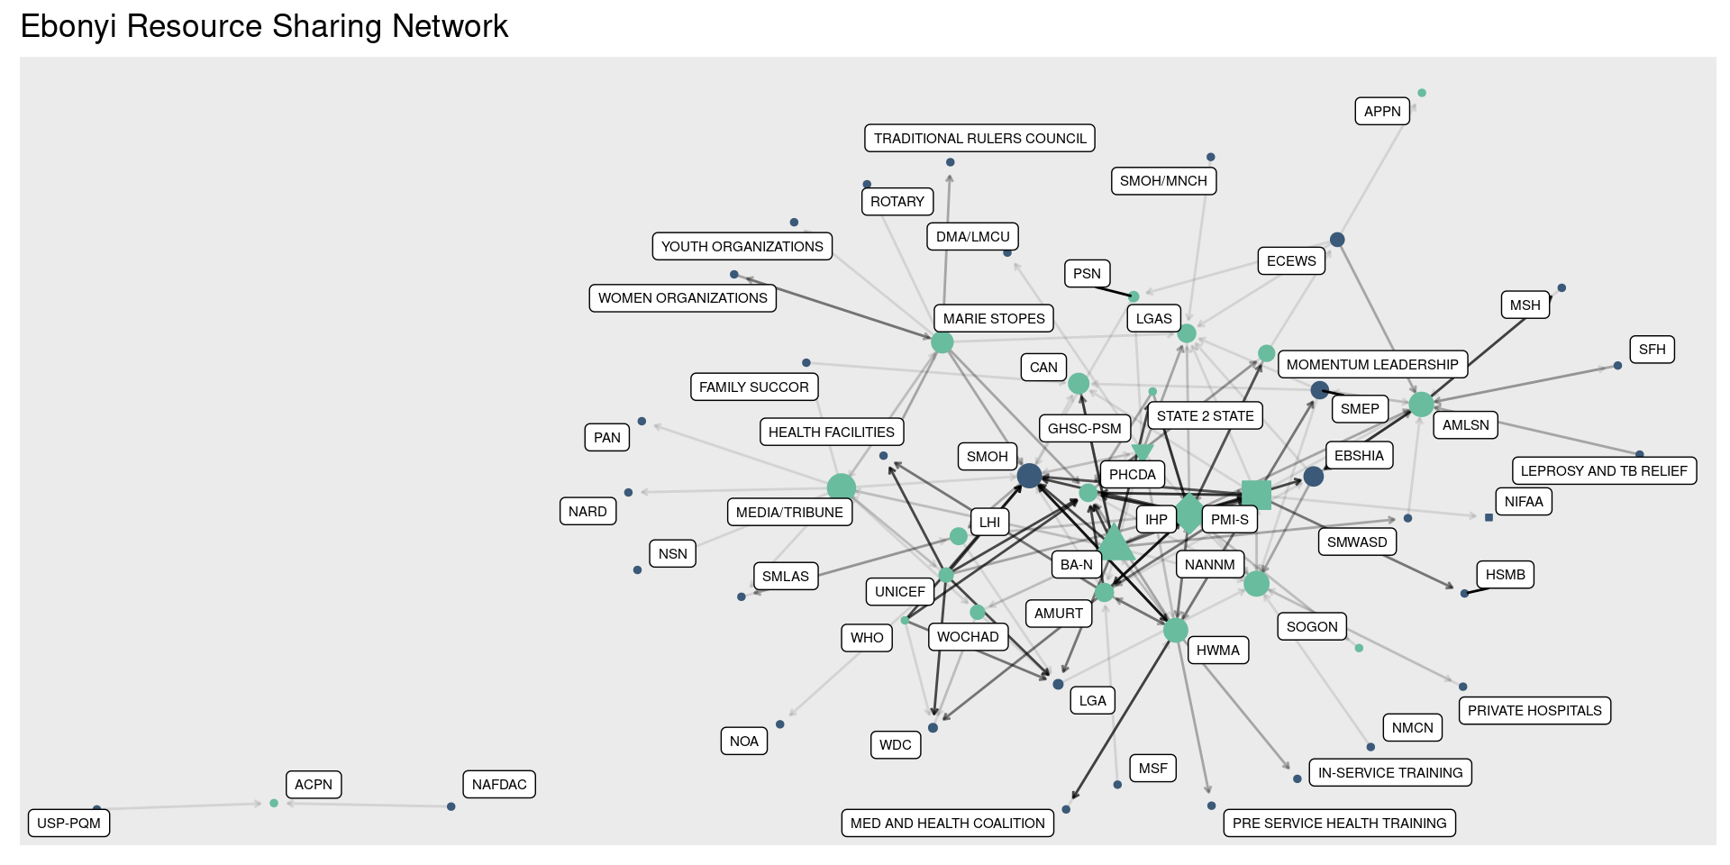
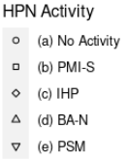

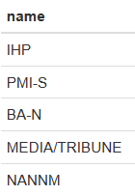
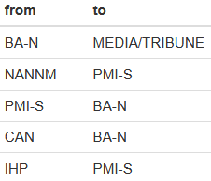
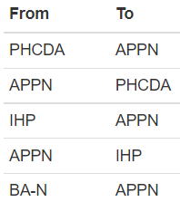
Most Central Organizations
Most Central Relationships
Relationships That Would Improve Overall Efficiency
Notes:
In this visualization the darker colored lines represent situations where the respondent said they collaborate more often. So, for instance, SMOH shares resources with HWMA frequently, whereas they share resources less often with LHI.
The most central organizations are IHP, PMI-S, BA-N, and Media/Tribune. The Media/Tribune is central because it connects important and central organizations like MSI, UNICEF, and WOCHAD.
We will talk more about the methodology on the next slide, but the rightmost table here lists the relationships that, if established, would increase overall efficiency of the network the most. The existing relationship between BA-N and Media/Tribune is especially helpful because it connects the organizations on the left side of the network here to the health activities and organizations that are highly central.
A relationship between APPN and PHCDA could be helpful because it could connect the left side of the network to connecting organizations like ECEWS, AMLSN, Momentum Leadership, and LGAS. A relationship between AMLSN and WHO would accomplish a similar end.

Slide 93
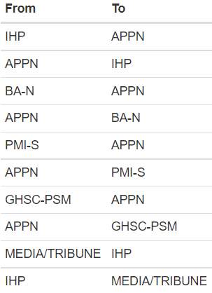
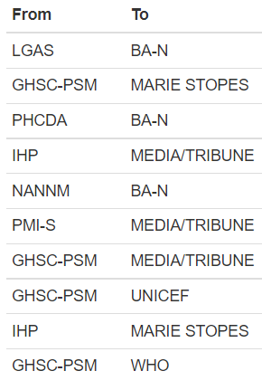
HPN Activity Relationships
That Would Improve Efficiency
HPN Activity Relationships
That Would Improve Government Centrality
Notes:
Now we looked closer at our network model to run a "simulation" where we tried to add a new relationship with an HPN Activity into the model and see how it affected two different measures: overall network efficiency, and government centrality.
As a reminder, the overall network efficiency captures the number of steps that it takes to share information/resources between all organizations in the network, even if they are not connected – like our example of organizations D and E from before. A higher efficiency means fewer steps between organizations in the network.
The second measure is government centrality – for this measure, we identified the average centrality of government organizations in the network. We did this because government agencies have the potential to play an important role in sustainability.
We tried adding every possible relationship with an HPN activity to the network model, and identified the relationships that would improve these measures the most.
Here we can see that the relationship between IHP and APPN in either direction would have the biggest impact on efficiency, followed by a connection between APPN and BA-N, PMI-S, and GHSC-PSM. We see this result because APPN tends to sit on the edge of the network, and establishing a relationship there could potentially connect organizations on the top-right of the network here with the more core HPN Activities.
We can see that relationships between LGAS and BA-N could be the most valuable for increasing government centrality, followed by the other relationships listed there.

Slide 94
Summary points
Media Tribune and the Association of Nigeria Nurses and Midwives, along with HPN Activity IPs, appear highly central to resource exchange
New resource sharing relationships involving the Association of Private Practicing Nurses and the State Primary Healthcare Development Agency could increase network efficiency
New resource sharing relationships (e.g., from local government authorities to BA-N) could also increase government centrality
Stakeholders should consider the feasibility of new network relationships as part of strategy development

Slide 95
Information sharing
Information: technical, training, educational, both formal and informal.
“How often does your organization provide information to (name)?”
“How often does your organization receive information from (name)?”

Slide 96
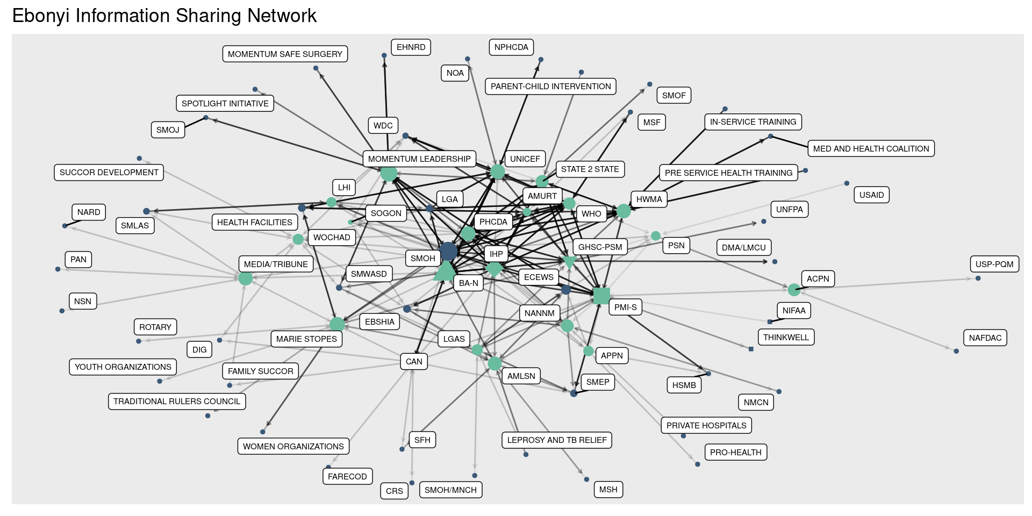
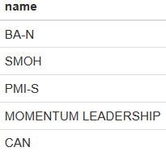
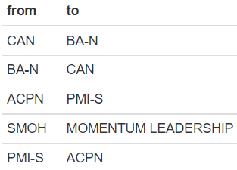
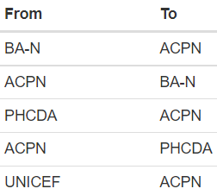
Relationships That Would
Improve Overall Efficiency
Most Central Organizations
Most Central Relationships

Slide 97
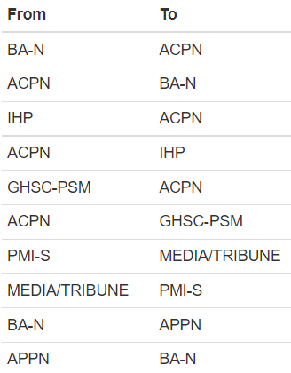
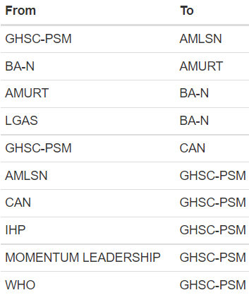
HPN Activity Relationships
That Would Improve Efficiency
HPN Activity Relationships
That Would Improve Government Centrality

Slide 98
Summary points
Density, reciprocity, and efficiency are all higher for information sharing than resource sharing – but there is a lot of both kinds of exchange happening
State MOH, Momentum Leadership, and the Christian Association of Nigeria, along with the HPN Activity IPs, are central to information exchange
New information sharing relationships involving the Association of Private Practicing Nurses and the State Primary Healthcare Development Agency could increase network efficiency
New information sharing relationships (e.g., from PSC to the Association of Medical Lab Scientists) could also increase government centrality

Slide 99
For more information, contact:
Emmanuel Adegbe
eadegbe.fpcape@gmail.com
08036243309
Milissa Markiewicz
milissa@unc.edu
Data for Impact (D4I)
https://www.data4impactproject.org/

Slide 100
This presentation was produced with the support of the United States Agency for International Development (USAID) under the terms of the Data for Impact (D4I) associate award 7200AA18LA00008, which is implemented by the Carolina Population Center at the University of North Carolina at Chapel Hill, in partnership with Palladium International, LLC; ICF Macro, Inc.; John Snow, Inc.; and Tulane University. The views expressed in this publication do not necessarily reflect the views of USAID or the United States government.
www.data4impactproject.org

Slide 101
Malaria Service Availability
All facilities offer malaria diagnostic and treatment services, and 99% provide IPTp.
Percentage of Ebonyi health facilities that offer specific malaria services (N=120)
Malaria diagnosis
Malaria treatment
IPTp

Slide 102
General Service Readiness
GEN-SR: Percentage of Ebonyi health facilities that have essential medicines available (N=120)
GEN-SR: Percentage of Ebonyi health facilities that have basic consumables available (N=120)
71% of facilities have all essential medicines available
Mean percentage of essential medicines available at a facility: 81%
63% of facilities have all basic consumables available
Mean percentage of basic consumables available at a facility: 91%

Slide 103
Malaria Services Availability
100% of facilities in Ebonyi offer malaria services
MA-SA: Percentage of Ebonyi health facilities that offer specific malaria services (N=120)
MA-DT: Percentage of Ebonyi health facilities that offer specific malaria diagnostic services (N=120)

Slide 104
Analytical Approaches
Quantitative Performance Evaluation Design:
  Trend analysis between baseline and endline in each state
  Comparison of trends across the three case study states
Baseline results: descriptive statistics by state
Limitations
Evaluation baseline is not a baseline for individual Activities
Clinical vignette, provider norms, and gender attitudes measurement approaches capture hypothetical reported behaviors, not actual behaviors
Providers may not report everything they would do spontaneously in the vignettes (front of mind responses)
Notes:
The quantitative performance evaluation consists of trend analyses of indicators of interest between baseline and endline in each state and a comparison of trends across the three case study states. This baseline provider survey report presents descriptive statistics by state; we examine baseline differences across the three states using Chi2 tests when applicable.
There are a few limitations to keep in mind in reviewing the results. First, since this is a multi-Activity evaluation different Activities are at different points in their implementation in different states. The results do not represent a baseline for individual Activities. They reflect a starting point of where we are now for the evaluation.
The clinical vignette, provider norms, and gender attitudes sections of the provider instrument assess health worker knowledge, attitudes, and self-reported practices. These measurement approaches capture hypothetical reported behaviors, not necessarily what happens in practice. Provider responses in these sections may also be subject to social desirability bias.
Providers may not spontaneously report everything they would do throughout the vignettes.

Slide 105
Provider Gender Attitudes
13 statements related to RMNH service provision and QOC → EFA resulted in nine-item gender attitude scale (Cronbach’s alpha = 0.74)
Higher score/disagreement indicates more gender equitable attitude, range 1-4
  Ebonyi: 3.1
Distribution of EFA-adjusted provider gender attitudes scores, Ebonyi (N = 354)
Example Statements:
Percent of providers who disagree/strongly disagree with statement, by state
Notes: Vertical dashed lines indicate state-level mean scores.
Doyle K, Kazimbaya S, Levtov R, et al. The relationship between inequitable gender norms and provider attitudes and quality of care in maternal health services in Rwanda: a mixed methods study. BMC Pregnancy and Childbirth. 2021;21(156).
Notes:
We calculated a provider gender attitude score from 13 statements related to reproductive, maternal, and neonatal health service provision and quality of care. Most statements were phrased such that disagreement with them indicated a more equitable attitude and resulted in a higher score. The score was refined using exploratory factor analysis, which resulted in a nine-item gender attitude scale. The calculated score ranges from one to four, with a higher score or disagreement indicating a more gender equitable attitude. The graph on the right presents the score distributions across the three states; Ebonyi had the highest score, indicating the most gender equitable provider attitudes, whereas the scores were lowest in Zamfara.
Examples of the statements we asked are provided at the bottom left of the slide (READ SOME EXAMPLES). The graph indicates the percentage of providers who disagree or strongly disagree with the statement. We see that across all example statements shown Ebonyi providers gave more progressive responses, and providers in Zamfara were typically the least progressive.
Questions inspired by or adapted from the Gender Equitable Men Scale and the International Men and Gender Equality Survey. 14 questions examined attitudes related to RMNH service provision and QOC.
Most statements were phrased such that disagreement with them indicated a more equitable attitude (higher scores), but two questions reverse coded such that agreement (lower score) indicated a more equitable attitude. Reverse coded to calculate score. Excluded statement about adolescents seeking contraceptives as it did not specifically relate to gender.
Next steps will be to undertake factor analysis to refine which questions remain in the score, and generate internal reliability coefficient (Cornbach’s alpha).

Slide 106
Gender-Sensitive Community RMNH QOC Norms
Nine statements: Attitudes and beliefs about gender-sensitive communication, addressing GBV, and promoting individual agency → EFA yielded six-item scale (Cronbach’s alpha = 0.77)
Higher score/disagreement indicates more gender equitable norms, range 1-4
  Ebonyi: 3.3
Distribution of EFA-adjusted LGA Gender Norms Score , Ebonyi (N = 354)
Example Statements:
Percent of providers who disagree/strongly disagree with statement
Notes: Vertical dashed lines indicate state-level mean scores.
Doyle K, Kazimbaya S, Levtov R, et al. The relationship between inequitable gender norms and provider attitudes and quality of care in maternal health services in Rwanda: a mixed methods study. BMC Pregnancy and Childbirth. 2021;21(156).
D4I Family Planning Provider Gender Competency Assessment Tool. (under development)
Notes:
We then asked providers about their perceptions of similar providers in their LGA regarding attitudes and beliefs about gender-sensitive communication, addressing gender-based violence, and promoting individual agency. Again, a higher score or disagreement with the statement indicates a more gender equitable norm, and the score ranges from one to four.
A second EFA was conducted and yielded a six-item gender-sensitive community RMNH QOC scale, with Cronbach’s alpha of 0.77.
We found that Ebonyi providers tended to have higher scores, indicating more gender equitable norms, and scores were again lowest in Zamfara. Example statements are shown on the bottom left of the slide. For example, we found that most providers disagreed with the statement that most providers in their LGA felt gender-based violence was a separate issue outside the realm of health service provision.

