Slide 1
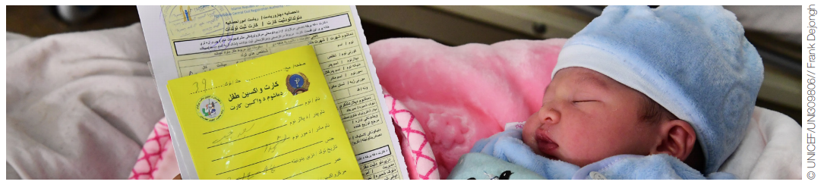

EN-MINI-PRISM Tools
Training
This slide deck is part of the EN-MINI Tools Training Kit, which also includes a Training Manual and other resources
https://www.data4impactproject.org/en-mini-tools/
Every Newborn – Measurement Improvement for Newborn and Stillbirth Indicators
EN-MINI Tools

Slide 2








Training Session 1
EN-MINI Tools
Every Newborn – Measurement
Improvement for
Newborn and stillbirth Indicators
Training content and orientation

Slide 3
Welcome to the EN-MINI-PRISM training!
Session 1 plan
Time | Title and Description | Methods
15 minutes | Activity 1: Icebreaker exercise Participant introductions Engage participants to introduce themselves using an icebreaker game | Icebreaker game
5 minutes | Activity 2: Discussion Participant’s expectations Engage participants to express their expectations about the training | Plenary session Brainstorming
10 minutes | Activity 3: Presentation Training objectives, content, methods, agenda, evaluation process, and rules The facilitator presents Session 1 slides and engages participants in discussing the agenda and setting training rules Values discussion | Present PowerPoint Session 1 Handouts: EN-MINI-PRISM Training manual Copy of entire training slide deck

Slide 4
Session 1, Activity 1
Introductions
Participant introductions
Icebreaker
Notes:
Facilitator’s Note
15 mins for ice-breaker game and participant introductions (now)

Slide 5
Session 1, Activity 2
Discussion
Participants’ expectations
Notes:
Facilitator’s Note
5 mins for participants to express their expectations about the training (now)

Slide 6
EN-MINI-PRISM training objectives
By the end of this training, participants will be able to:
Describe the role and function of Routine Health Information systems (RHIS)
Explain why data quality and data use matters
Understand the EN-MINI-PRISM Tools content and digital data collection tools (SurveyCTO)
Conduct an EN-MINI-PRISM Tools assessment of RHIS performance for newborn and stillbirth indicators
Analyze and use the EN-MINI-PRISM Tools assessment data.
Goal: To develop knowledge, skills, and attitudes to conduct an EN-MINI-PRISM Tool assessment of the performance of routine health information systems (RHIS) for newborn and stillbirth indicators at national, district, and facility levels
Notes:
Activity 3: present following slides on the training objectives, content, methods etc.
Facilitator’s Note
10 mins to run through the rest of session 1 slides
Handout the participants manual

Slide 7
Training schedule
Day 1
Overview of Routine Health Information Systems (RHIS)
Day 2
Day 3
EN-MINI Tools
Data Use (EN-MINI-PRISM Tools 3, 4, 6)
Data Quality (EN-MINI-PRISM Tools 2, 5)
Introduction to Data Use (EN-MINI-PRISM Tool 1)
Introduction to Data Quality

Slide 8
Training schedule
Day 4
EN-MINI-PRISM Tools field practice
Day 5
Days…
EN-MINI-PRISM Tools field practice
Additional days as required
Health facility/ district office
Health facility/ district office

Slide 9
Training methods
Presentation
Group work
Group presentation
Group discussion

Slide 10
Evaluation
Daily evaluation: recap of previous day’s sessions
Training evaluation at the end
Notes:
Facilitator’s Note
Form groups (maximum 3) for recap of previous day’s session.
For each day, assign one group who will recap the previous day’s sessions.
For each day, nominate timekeepers.
Inform attendees that there is a training evaluation at the end of the training.

Slide 11
Session 1, Activity 3
Discussion
Participants set training values and follow them
Notes:
Facilitator’s Note
Ask the participants to set training values. Write them on flip chart and post them on the wall or other place so that those are visible all the time during the training.
Suggest the following agreements may be useful:
Cell phones must be turned off in the classroom.
Speak loudly so that everyone can hear clearly.
Feel free to ask questions and express your opinion.
Speak to the entire group, not just to the trainers.
Only one person speaks at a time.
Keep the question and discussion to the point.

Slide 12
Training Session 2
EN-MINI Tools
Every Newborn – Measurement
Improvement for
Newborn and stillbirth Indicators
Introduction to the
Routine Health Information System (RHIS)

Slide 13
Session 2 objectives
Define the health system and its generic functions
Describe the relationship between the health system and the Routine Health Information System (RHIS)
Explain the use of RHIS data in health system management
Outline the data management processes
Identify and analyze possible constraints in RHIS data management processes
2

Slide 14
Session 2 plan
Time | Title and Description | Methods
20 minutes | Activity 1: Presentation Health system and its six components/building blocks; outcomes of the health system Contribution of HIS to addressing health challenges at the different levels of the health system Present the basic concepts of data collection Explain the roles of the RHIS in management of the health system Data management processes and the core components of a well-functioning RHIS | Lecture; present EN-MINI-PRISM Training Slide set session 2 Discussion, Q&A Handouts: EN-MINI-PRISM Training Manual EN-MINI-PRISM Training Slide set
20 minutes | Activity 2: Group work Brainstorm potential enablers of and barriers to: Assuring HIS data quality HIS information uses Feedback to the wider group with discussion | Present EN-MINI-PRISM Training Slide set session 2 Group Work Plenary Feedback
5 minutes | Activity 3: Discussion Facilitated discussion with Q&A | Discussions

Slide 15
Session 2, Activity 1
Presentation
Overview of the RHIS

Slide 16
Functions and goals of a health system
Functions
(6 building blocks)
Goals/outcomes
I
N
P
U
T
S
Service delivery
Access
Improved health
Human resources
Quality
Responsiveness
Coverage
Information
Commodities
infrastructure
Social and financial
risk protection
Financing
Safety
Improved efficiency
Leadership and governance
Source: World Health Organization (WHO), 2000
Notes:
To understand why we are using the EN-MINI-PRISM tools, it’s helpful to reflect on how these are situated within the wider health system, and what this means for newborns.
Health systems have four fundamental objectives
Improving the health of the population they serve
Responding to people’s needs (the way people are treated and the environment)
Protecting people from the burden of the financial cost of illness
Improving efficiency
The health system has six components, or building blocks: service delivery, health workforce, health information system, medical products, vaccines and technology, health financing, and leadership and governance.
The four functions of the health system that relate to the building blocks are (World Health Report 2000):
Stewardship (oversight)
Creating resources (investment and training)
Financing (collecting, pooling, purchasing)
Delivering services (ensuring access, quality, coverage and safety)
ANNIMATE
The Health Information System (HIS) is an integral part of the health system and refers to any system that captures, stores, manages, or transmits information related to the health of individuals or the activities of organizations, which will improve health care management decisions at all levels of the health system.
A well-functioning HIS is an integrated effort to collect, process, report, and use health information and knowledge to influence policy and decision making, program action, individual and public health outcomes, and research (WHO, 2010).

Slide 17
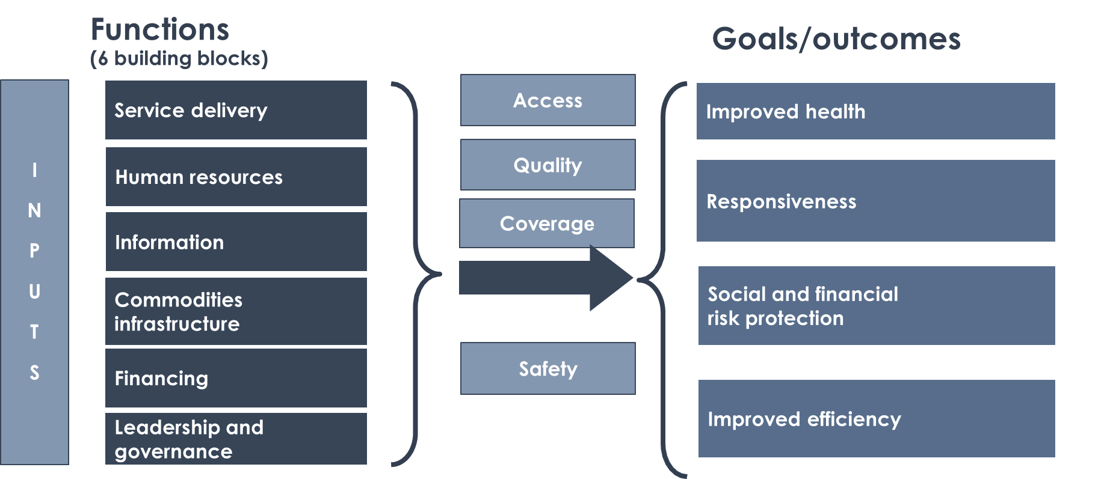
The Performance of Routine Information System Management (PRISM) - Conceptual Model
INPUTS
PROCESSES
OUTPUTS
OUTCOMES
IMPACT
RHIS determinants
Technical factors:
Complexity of reporting forms and procedures
HIS design
Computer software
Information technology complexity
Behavioral factors:
Level of knowledge of content of HIS forms
Data-quality checking skills
Problem-solving for HIS tasks
Competence in HIS tasks
Confidence levels for HIS tasks
Motivation
RHIS processes:
Data collection
Data transmission
Data processing
Data analysis
Data quality check
Feedback
Improved RHIS performance
Data quality
Information use
Improved health system performance
Improved health status
Organizational factors:
Critical management functions & information needs
Governance
Planning
Training
Supervision
Quality
Finance
Promotion of a culture of information
Resource availability
Notes:
The PRISM Framework, is applied to the RHIS structure and processes to provide a detailed PRISM Conceptual Model of RHIS performance elaborating the various determinants at input, processes, output and outcome levels of RHIS.
PRISM = Performance of Routine Information System Management
The EN-MINI_PRISM Assessment is developed based on this PRISM Conceptual Model. We will be talking about this assessment and the PRISM Tools in details in later sessions.
In general, the PRISM Framework provides a systems approach for developing appropriate strategies and interventions for strengthening RHIS.

Slide 18
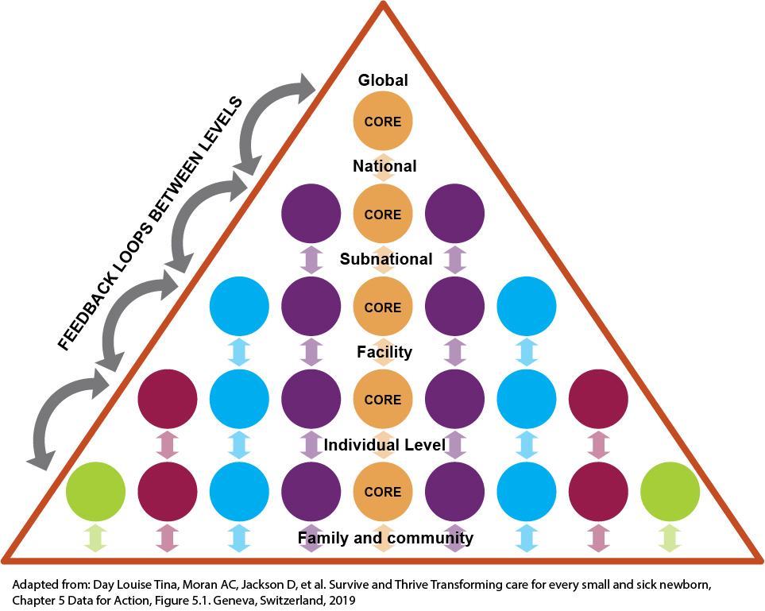
The Performance of Routine Information System Management (PRISM) - Conceptual Model
INPUTS
PROCESSES
OUTPUTS
OUTCOMES
IMPACT
RHIS determinants
Technical factors:
Complexity of reporting forms and procedures
HIS design
Computer software
Information technology complexity
Behavioral factors:
Level of knowledge of content of HIS forms
Data-quality checking skills
Problem-solving for HIS tasks
Competence in HIS tasks
Confidence levels for HIS tasks
Motivation
RHIS processes:
Data collection
Data transmission
Data processing
Data analysis
Data quality check
Feedback
Improved RHIS performance
Data quality
Information use
Improved health system performance
Improved health status
Organizational factors:
Critical management functions & information needs
Governance
Planning
Training
Supervision
Quality
Finance
Promotion of a culture of information
Resource availability
Notes:
The Health Information System (HIS) uses two different data sources: Population-based data or routine health information system (RHIS) data. The EN-MINI-PRISM tools are focused on facility-based RHIS data for newborns.
RHIS data collection refers to data that are collected continuously (daily, patient by patient, monthly, etc.). While processing and reporting are periodic, they are conducted more frequently than annually. Examples of HIS subsystems using continuous data collection are health facility-based subsystems that collect information on patients when they use services. Service statistics are usually aggregated monthly and reported quarterly. Vital registration occurs when a person registers, which may happen at any time.
The EN-MINI-PRISM tools focus on RHIS data

Slide 19
Routine data collection and use by system level
International indicators (Core) to track SDGs and UHC
e.g., impact, coverage indicators
National tracking data
e.g., impact, coverage, service readiness indicators, human resources, equipment/drugs
Sub-national/ District management
e.g., coverage, more detailed service readiness indicators, equipment/drugs
Facility management
e.g., for quality improvement
Individual client care data
e.g., details for clinical decision,
client experience of care
Adapted from: Day LT, Ruysen H, Gordeev VS, et al: “Every Newborn-BIRTH” protocol: observational study validating indicators for coverage and quality of maternal and newborn health care in Bangladesh, Nepal and Tanzania. Journal of Global Health 2019, 9(1).
SDG – Sustainable Development Goals, UHC – Universal Health Coverage
Notes:
In this figure, you can see how different data are needed at different levels of the health system.
Facilitator’s Note
Brainstorm:
What are the different data/information needed at various levels of the health system, i.e., patient level; health service delivery unit level; health system level?
For what purposes are those data/information utilized?
You can note the responses on flip chart and then show the next slide and reconfirm what the participants have said.

Slide 20
Which RHIS data are needed at which level?
TYPE
USE
Policymaking
Strategic planning
Program tracking
Disease surveillance
Technical & logistical support
Aggregated service statistics
Aggregated management data
Aggregated surveillance data
Financial data
Vital registration systems
National
Aggregated service statistics
Aggregated management data
Sentinel sites
Observation checklist
Self-evaluation
Planning (access)
Management (quality/efficiency)
Supervision (performance)
Disease surveillance
Sub-national/
District
Facility registers/ data records
Supply records
Financial records
Aggregated community data
Health unit management
Quality improvement
Work planning/priority setting
Facility
Individual
Client case notes / records
Client management & follow-up
Birth and death records
School records
Community-based distribution logbooks
Drug revolving fund records
Community
Client management & follow-up
Supplies management
Community awareness
Notes:
Facilitator’s Note
After brainstorm, show this side.
Opportunity confirm what the participants have said and clarify misconceptions.

Slide 21
How do RHIS data become information?
At each level
Data element
and data
Information and indicators
Knowledge and use
Data element
(a recorded event)
Data
(aggregation of data elements in the form of numbers, characters, and images)
Information
(data organized in reference to a context
gives the data meaning)
Indicators
(calculated from data elements to measure
impact, coverage of care, quality of care, etc.)
Knowledge
(information analyzed, communicated, and acted upon)
Notes:
Raw data are available at the first stage of information gathering and are not directly useable. For data to be useable, they must be transformed into information that can answer questions of interest for the users. Data elements can be used to calculate indicators measuring contact, content, quality and coverage of newborn care
For example, the KMC register captures a list of newborns with their symptoms, their diagnoses, and the treatments they have received. This information is useful to the care provider, but if the health facility in-charge wants to know the volume of work done in the KMC corner, she or he needs to transform the data into a meaningful summarized measurement (e.g., the number of neonates admitted for KMC for a given period).

Slide 22
Well-functioning information systems
INPUTS
PROCESSES
OUTPUTS
OUTCOMES
IMPACT
RHIS determinants
Technical factors:
Complexity of reporting forms and procedures
HIS design
Computer software
Information technology complexity
Behavioral factors:
Level of knowledge of content of HIS forms
Data-quality checking skills
Problem-solving for HIS tasks
Competence in HIS tasks
Confidence levels for HIS tasks
Motivation
RHIS processes:
Data collection
Data transmission
Data processing
Data analysis
Data quality check
Feedback
Improved RHIS performance
Data quality
Information use
Improved health system performance
Improved health status
Organizational factors:
Critical management functions & information needs
Governance
Planning
Training
Supervision
Quality
Finance
Good data
Good decisions
Responsive & efficient health system
Promotion of a culture of information
Resource availability
Notes:
Data quality matters because:
Reliable information is the foundation of evidence-based decision making across all health system building blocks. It is essential for health system policy development and implementation, governance and regulation, health research, human resource development, service delivery, and financing.
“Health systems need reliable information to be responsive as well as efficient.” ― Margaret Chan, former Director-General, World Health Organization
A well-functioning RHIS supports the delivery of health services, by ensuring the production, analysis, dissemination, and use of reliable and timely information on health determinants, health system performance, and health status.
The data reported by health facilities cannot be interpreted without first knowing how complete they are and examining them for inconsistencies and likely errors. In some cases the data need to be adjusted before they can be meaningfully analyzed.
Resource for desk review of data quality: World Health Organization (WHO). (2015). A toolkit for facility data quality assessment.

Slide 23
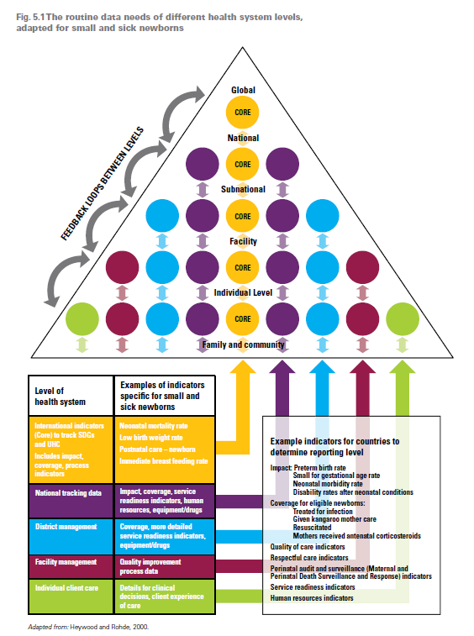

RHIS Data Collection, Flow and Transmission
Data flow/ feedback
D) Electronic HIS
Digital
C) Summary form
Digitized?
B) Tally sheet
Digitized?
A) Register aggregation
EN-BIRTH Validity Study
Notes:
RHIS data collection instruments generally include:
Facility-based records:
Registers
Tally sheets
Electronic data systems (e.g., DHIS 2)
Patient/client records:
Facility-based versus patient-retained
Household records (e.g., family folder)
Record system for integration and continuity of care (e.g., tickler file system)
Electronic data systems
These data are generally then aggregated and transmitted between different health system levels and functions. This will usually include Electronic data transmission (monthly or real-time) using communications technologies (Internet, e-mail, personal digital assistants, etc.)
Facilitators Note
Opportunity for discussion: What is the reality of data transmission in your experience?

Slide 24
Measuring RHIS performance
Improve Newborn Data Quality
Use Newborn Data for Decisions
Accuracy
  Do data reflect what is happening at the facility?
Completeness
  Are all facilities reporting?
  Are all required data elements reported?
Timeliness
  Are facilities reporting by or before deadline?
Analytic report production
Health service performance review and supportive supervision
Revising strategies, developing plans, and setting targets
Mobilizing and shifting resources
Advocacy for more resources
Information dissemination
Adapted from: Day LT, Moran AC, Jackson D, et al. (2019). Survive and Thrive: Transforming care for every small and sick newborn. Chapter 5, Figure 5.1. Geneva, Switzerland.

Slide 25
The PRISM Conceptual Model
INPUTS
Data collection and transmission
    Data collection and reporting guidelines
    Designated staff for data compilation and reporting
    Clear reporting timeframe
Data processing and analysis
    Data processing procedures
    Data comparisons
  Data presentation
Data quality check
    Data quality assurance mechanisms
Feedback mechanisms
PROCESSES
OUTPUTS
OUTCOMES
IMPACT
RHIS determinants
Technical factors:
Complexity of reporting forms and procedures
HIS design
Computer software
Information technology complexity
Behavioral factors:
Level of knowledge of content of HIS forms
Data-quality checking skills
Problem-solving for HIS tasks
Competence in HIS tasks
Confidence levels for HIS tasks
Motivation
RHIS processes:
Data collection
Data transmission
Data processing
Data analysis
Data quality check
Feedback
Improved RHIS performance
Data quality
Information use
Improved health system performance
Improved health status
Organizational factors:
Critical management functions & information needs
Governance
Planning
Training
Supervision
Quality
Finance
Promotion of a culture of information
Resource availability
Notes:
Data collection and transmission
Data collection and reporting guidelines
Designated staff for data compilation and reporting
Clear reporting timeframe
Data quality check
Presence of data quality assurance mechanisms
Data processing and analysis
Data processing procedures
Comparisons of data
Data presentation
Feedback mechanism(s)

Slide 26
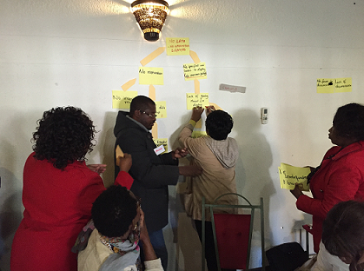
Session 2, Activity 2
Brainstorm
What are enablers and barriers of:
  RHIS data quality?
  Using RHIS data for decision making?
Notes:
Facilitator’s Note
Divide participants into groups
Ask the participants to work together to list potential enablers of and barriers to RHIS data quality and information use.
Allow group work to proceed for 15 minutes, then bring together for plenary discussion asking each group to take it in turns to feedback
Note the responses on flip charts. Facilitate to group the responses as:
Those related to the design of the information system, or data burden, difficulty in using electronic data system, etc.
Those that relate to support from within the organization, such as supply of HIS instruments; lack of computers; no training mechanism; lack of SOPs for data quality assurance or information use; no systematic mechanism to present and disseminate data; no structure to discuss performance based on HIS data; no incentive for data use; no positions for HIS experts
Those that relate to the motivation and skills of the staff
Keep the chart to refer to in later discussions.

Slide 27
Core components of good RHIS management
Governance
  Mission statements, organogram, reporting structures, master facility list, planning structures, financial plans
Infrastructure
  Electricity, phones, Internet, data record room, etc.
Resources
  Human: multipurpose versus specialized
  Physical: printed supplies, hardware, transport, calculators
  Financial: separate budget line item
Procedures
  Policies
  Operational guidelines including quality assurance and feedback
  Capacity building

Slide 28
The PRISM Conceptual Model
INPUTS
PROCESSES
OUTPUTS
OUTCOMES
IMPACT
RHIS determinants
Technical factors:
Complexity of reporting forms and procedures
HIS design
Computer software
Information technology complexity
Behavioral factors:
Level of knowledge of content of HIS forms
Data-quality checking skills
Problem-solving for HIS tasks
Competence in HIS tasks
Confidence levels for HIS tasks
Motivation
RHIS processes:
Data collection
Data transmission
Data processing
Data analysis
Data quality check
Feedback
Improved RHIS performance
Data quality
Information use
Improved health system performance
Improved health status
Organizational factors:
Critical management functions & information needs
Governance
Planning
Training
Supervision
Quality
Finance
Promotion of a culture of information
Resource availability
Notes:
Facilitator Note:
Relate participants responses during the brainstorm back to this PRISM Conceptual Framework & the data pyramid

Slide 29
Session 2, Activity 3
Reflections/questions
Notes:
Facilitators note:
5 mins to answer any questions or consider discussion topics proposed by the participants

Slide 30
Training Session 3
EN-MINI Tools
Every Newborn – Measurement
Improvement for
Newborn and stillbirth Indicators
Introduction to the
Performance of Routine Information Systems (PRISM) Framework
Notes:
Could use this as a cover slide instead

Slide 31
Session 3 objectives
Explain the components and uses of the PRISM framework and conceptual model
Conceptualize the relationship between the PRISM framework and tools and EN-MINI-PRISM Tools adaptation
Demonstrate an understanding of the three determinants of RHIS performance
Identify and understand the factors influencing RHIS performance

Slide 32
Session 3 plan
Time | Title and Description | Methods
20 minutes | Activity 1: Presentation Introduction to the PRISM Framework for assessing RHIS performance PRISM Framework RHIS performance definition PRISM Conceptual Model Examples of factors influencing RHIS performance | Lecture; present EN-MINI-PRISM Training Slide set session 3 Discussion, Q&A Handouts: EN-MINI-PRISM Training Manual EN-MINI-PRISM Training Slide set
10 minutes | Activity 2: Discussion Facilitated discussion with Q&A | Discussion, Q&A
Notes:
Activity 1:
Present the following slides

Slide 33
Session 3, Activity 1
Presentation
Introduction to PRISM

Slide 34
Defining RHIS performance
RHIS performance means both the production of high-quality information and the use of information for decision making.

Slide 35
Defining RHIS performance
Improve Newborn Data Quality
Use Newborn Data for Decisions

Slide 36
The PRISM Conceptual Model
INPUTS
PROCESSES
OUTPUTS
OUTCOMES
IMPACT
RHIS determinants
Technical factors:
Complexity of reporting forms and procedures
HIS design
Computer software
Information technology complexity
Behavioral factors:
Level of knowledge of content of HIS forms
Data-quality checking skills
Problem-solving for HIS tasks
Competence in HIS tasks
Confidence levels for HIS tasks
Motivation
RHIS processes:
Data collection
Data transmission
Data processing
Data analysis
Data quality check
Feedback
Improved RHIS performance
Data quality
Information use
Improved health system performance
Improved health status
Organizational factors:
Critical management functions & information needs
Governance
Planning
Training
Supervision
Quality
Finance
Promotion of a culture of information
Resource availability
Notes:
Opportunity for discussion:
ASK: What is needed to ensure the availability of high-quality data and the effective use of information?
Refer to the brainstorming in previous session where the participants listed the enablers of and barriers to HIS data quality and information use.
Inform the participants that many RHIS reform efforts were adopted to improve the use of information for better health system performance. However, there was no consistent manner in which the RHIS improvement could be measured, and the reforms mostly focused on the visible symptoms rather than taking a systems approach.
The Solution: MEASURE Evaluation, together with its implementing partner, John Snow, Inc., developed a conceptual framework that acknowledges the broader context in which the RHIS operates. It is known as Performance of Routine Information System Management (PRISM) Framework.

Slide 37
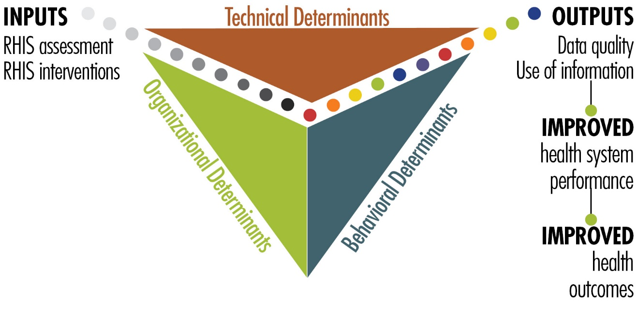
The PRISM Framework
Notes:
The PRISM Framework is based on the premise that the success of the RHIS depends on success in three interrelated areas: technical, organizational, and behavioral conditions (visualized on the slide in blue ink):
Technical determinants
Behavioral determinants
Organizational determinants

Slide 38
Definitions of the PRISM Determinants: Technical Factors
INPUTS
PROCESSES
OUTPUTS
OUTCOMES
IMPACT
RHIS determinants
Technical factors:
Complexity of reporting forms and procedures
HIS design
Computer software
Information technology complexity
Technical factors:
Complexity of reporting forms and procedures
HIS design
Computer software
Information technology complexity
Behavioral factors:
Level of knowledge of content of HIS forms
Data-quality checking skills
Problem-solving for HIS tasks
Competence in HIS tasks
Confidence levels for HIS tasks
Motivation
RHIS processes:
Data collection
Data transmission
Data processing
Data analysis
Data quality check
Feedback
Standard indicators
Trained staff
Well-designed data collection forms
Systems
User-friendly reporting forms
Processes and methods
Improved RHIS performance
Data quality
Information use
Improved health system performance
Improved health status
Organizational factors:
Critical management functions & information needs
Governance
Planning
Training
Supervision
Quality
Finance
Promotion of a culture of information
Resource availability
Notes:
The most obvious determinants of performance relate to the technical aspects of the system. The nuts and bolts of the system are typically where information system developers focus their energy.
Technical determinants may include:
Establishing a standard set of indicators
Ensuring that people are trained to complete the appropriate forms
Designing data collection forms that streamline the amount of data collected
Providing appropriate technology for data analysis, transfer, and presentation
Providing user-friendly forms for reporting results, so that the information is easy to visualize, understand, and interpret

Slide 39
Definitions of the PRISM Determinants: Organizational Factors
INPUTS
PROCESSES
OUTPUTS
OUTCOMES
IMPACT
RHIS determinants
Technical factors:
Complexity of reporting forms and procedures
HIS design
Computer software
Information technology complexity
Behavioral factors:
Level of knowledge of content of HIS forms
Data-quality checking skills
Problem-solving for HIS tasks
Competence in HIS tasks
Confidence levels for HIS tasks
Motivation
RHIS processes:
Data collection
Data transmission
Data processing
Data analysis
Data quality check
Feedback
Improved RHIS performance
Data quality
Information use
Promotion of an information culture
Infrastructure
Resource availability
Roles and responsibilities
Training
Supportive supervision
Improved health system performance
Improved health status
Organizational factors:
Critical management functions & information needs
Governance
Planning
Training
Supervision
Quality
Finance
Organizational factors:
Critical management functions & information needs
Governance
Planning
Training
Supervision
Quality
Finance
Promotion of a culture of information
Resource availability
Notes:
Organizational determinants are also referred to as environmental or systemic issues. These factors influence the context in which data collection, management, and use take place. A culture of information is defined as an organization’s capacity to promote values and beliefs among its members, so that they may collect, analyze, and use information to accomplish the organization’s goals and mission. This requires the organization’s commitment and support. Organizations must commit a range of resources: human, RHIS forms and supplies, and infrastructure (such as utilities, transportation, and information and communications technology [ICT]).

Slide 40
Definitions of the PRISM Determinants: Behavioral Factors
INPUTS
PROCESSES
OUTPUTS
OUTCOMES
IMPACT
RHIS determinants
Technical factors:
Complexity of reporting forms and procedures
HIS design
Computer software
Information technology complexity
Behavioral factors:
Level of knowledge of content of HIS forms
Data-quality checking skills
Problem-solving for HIS tasks
Competence in HIS tasks
Confidence levels for HIS tasks
Motivation
RHIS processes:
Data collection
Data transmission
Data processing
Data analysis
Data quality check
Feedback
Behavioral factors:
Level of knowledge of content of HIS forms
Data-quality checking skills
Problem-solving for HIS tasks
Competence in HIS tasks
Confidence levels for HIS tasks
Motivation
Improved RHIS performance
Data quality
Information use
Improved health system performance
Improved health status
Motivation
Attitudes and values
Skills
Confidence
Sense of responsibility
Empowerment and accountability
Organizational factors:
Critical management functions & information needs
Governance
Planning
Training
Supervision
Quality
Finance
Promotion of a culture of information
Promotion of a culture of information
Resource availability
Notes:
Behavioral determinants:
Finally, we consider the individual behavior of people who are meant to collect, manage, and use data. Making an RHIS work always requires changes in the way people behave. People must be motivated to use data. If they value data, they are more likely to be concerned about its quality. We have heard that health workers and managers must TRUST data enough to make information-based decisions, and not fall back on traditional patterns of decision making (i.e., political and experiential). Well-trained workers must have the confidence to use data to make decisions.

Slide 41
Analyzing a data problem and its causes: an example
  Problem: Data are not being transmitted on time
  Causes:
Technical | Reporting form is complex and requires review of multiple register books
Organizational | No incentive to submit reports on time No standard operating procedure (SOP) on reporting communicated formally
Behavioral | Staff do not have sufficient skill to prepare reports using data from different register books and health cards.

Slide 42
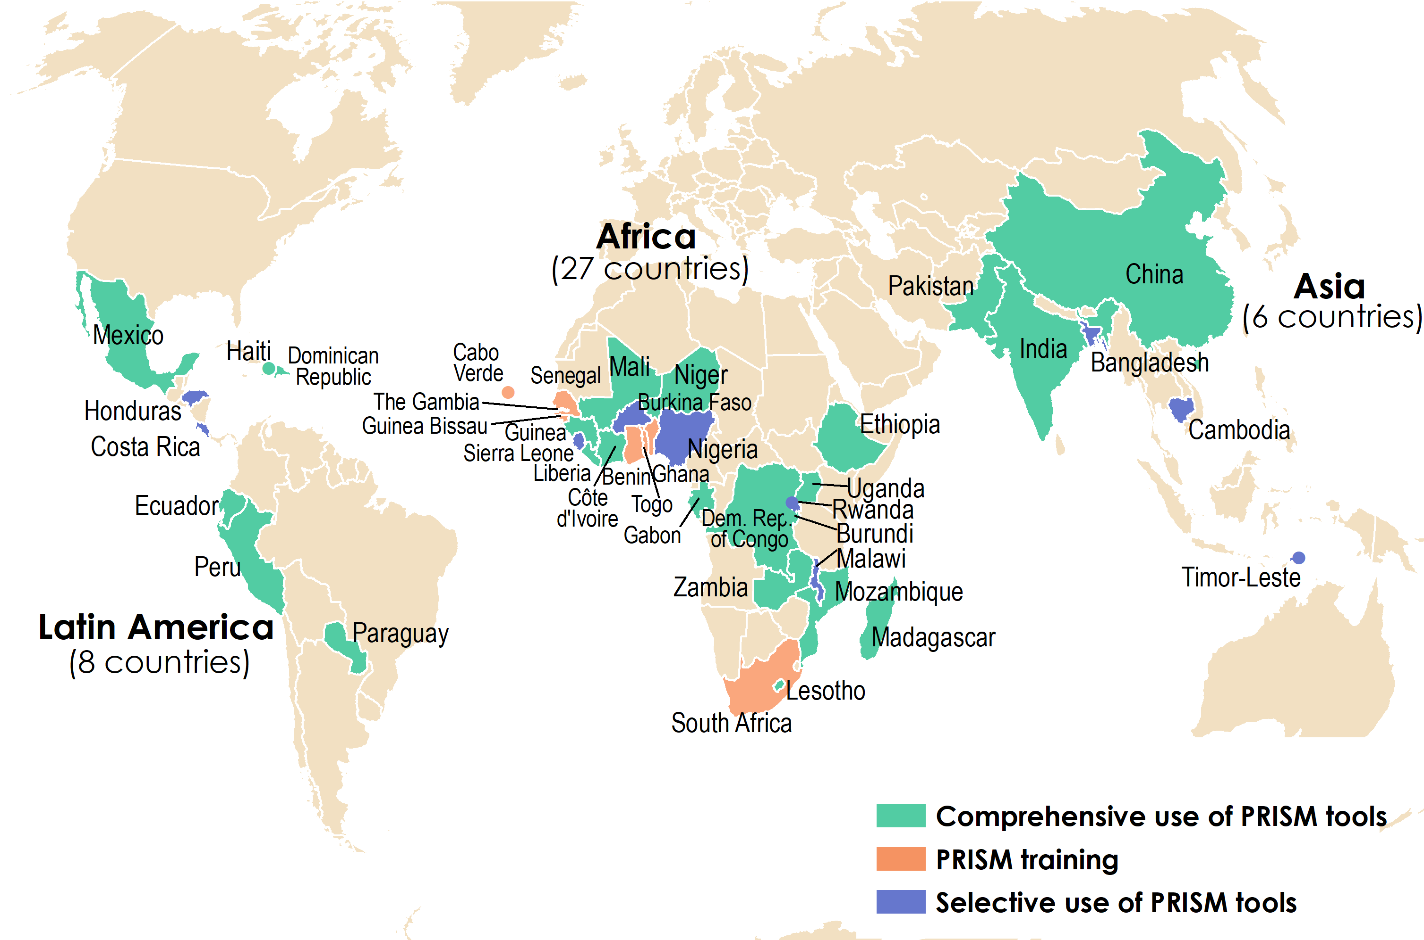
PRISM tools reach 41 countries around the world

Slide 43
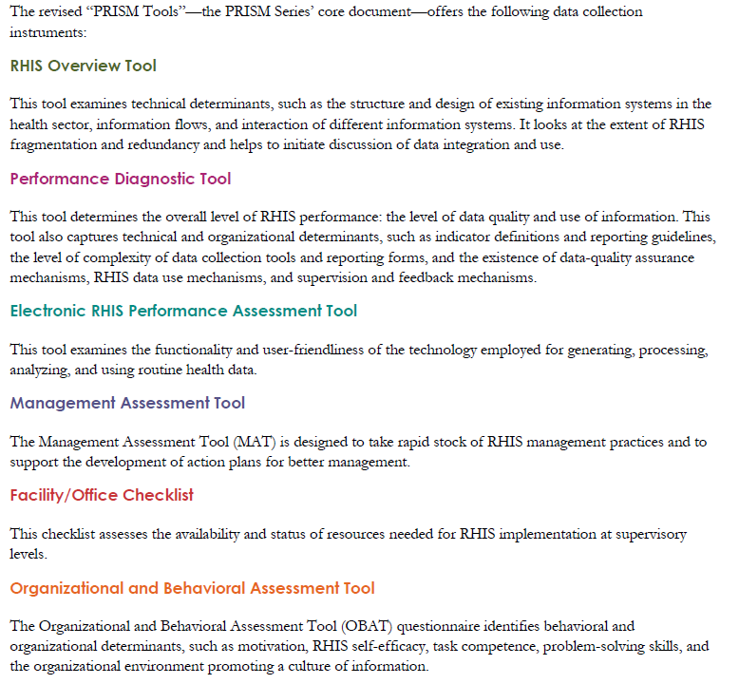
EN-MINI-PRISM
EN-MINI-PRISM adaptation uses priority/ core newborn and stillbirth indicators
User-friendly, automated analysis creates local ownership
Notes:
The PRISM series included 6 comprehensive tools that have already been validated through multiple cycles of use.
Their original focus was on measurement for HIV, malaria, immunization and antenatal care, but given they have such great utility for improving measurement across technical, organizational, and behavioral domains as shown here, we have now adapted PRISM to help improve the use of newborn data.
As we discussed,
EN-MINI-PRISM adaptation uses priority/ core newborn indicators, and
Is user-friendly, with automated analysis that helps create local ownership

Slide 44
Session 3, Activity 2
Reflections/questions
Notes:
Facilitators note:
5 mins to answer any questions or consider discussion topics proposed by the participants

Slide 45
Training Session 4
EN-MINI Tools
Every Newborn – Measurement
Improvement for
Newborn and stillbirth Indicators
Overview of the EN-MINI Tools

Slide 46
Session 4 objectives
Introduction to the EN-MINI tools
How the tools can be used to:
  MAP newborn data
  USE newborn data for decisions
  IMPROVE newborn data quality
Orientation to the EN-MINI tools website and resources
2

Slide 47
Session 4 plan
Time | Title and Description | Methods
10 minutes | Activity 1: Presentation Overview of the EN-MINI-PRISM Tools Present the overview of the EN-MINI Tools Explain how the tools can be used to: MAP newborn data USE newborn data for decisions IMPROVE newborn data quality | Lecture; present EN-MINI-PRISM Training Slide set session 4 Discussion, Q&A Handouts: EN-MINI-PRISM Training Manual EN-MINI-PRISM Training Slide set
10 minutes | Activity 2: Explore website Access the EN-MINI Tools website and resources Explore and orientate to web resources | Link: https://www.data4impactproject.org/en-mini-tools/
10 minutes | Activity 3: Discussion Facilitated discussion with Q&A | Discussion, Q&A
Notes:
Activity 1- present the following slides

Slide 48
Session 4, Activity 1
Presentation
Introduction to EN-MINI Tools

Slide 49
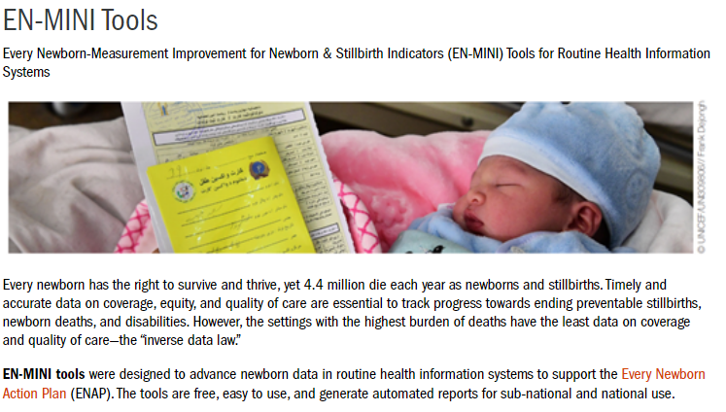
EN-MINI Tools – from the website
Ref: https://www.data4impactproject.org/en-mini-tools/
Notes:
Every newborn has the right to survive and thrive, yet 4.4 million die each year as newborns and stillbirths. Timely and accurate data on coverage, equity, and quality of care are essential to track progress towards ending preventable stillbirths, newborn deaths, and disabilities. However, the settings with the highest burden of deaths have the least data on coverage and quality of care—the “inverse data law.”
EN-MINI tools were designed to advance newborn data in routine health information systems to support the Every Newborn Action Plan (ENAP). The tools are free, easy to use, and generate automated reports for sub-national and national use

Slide 50
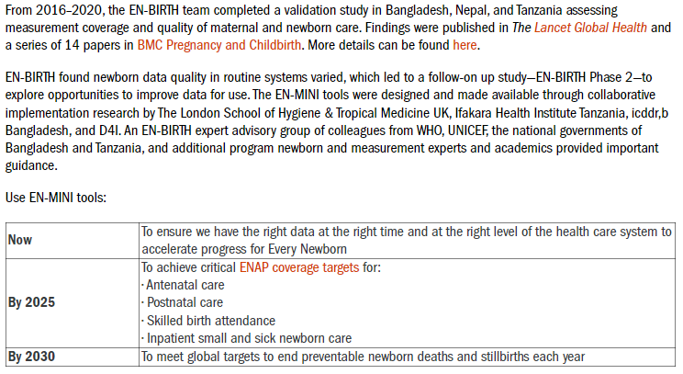
EN-MINI Tools – from the website
Ref: https://www.data4impactproject.org/en-mini-tools/
Notes:
The EN-MINI tools have been designed in support of the Every Newborn Action Plan (ENAP) to count every newborn through measurement, program-tracking, and accountability. More than ninety countries are now tracking progress towards ENAP milestones for 2025. Annual ENAP progress reports demonstrate the benefit of standardized monitoring, highlight success, and identify where further focus is needed.

Slide 51
The PRISM Conceptual Model
INPUTS
PROCESSES
OUTPUTS
OUTCOMES
IMPACT
RHIS determinants
Technical factors:
Complexity of reporting forms and procedures
HIS design
Computer software
Information technology complexity
RHIS Overview
EN-MINI-PRISM Tool 1
Electronic RHIS Assessment
EN-MINI-PRISM Tool 3
Behavioral factors:
Level of knowledge of content of HIS forms
Data-quality checking skills
Problem-solving for HIS tasks
Competence in HIS tasks
Confidence levels for HIS tasks
Motivation
RHIS processes:
Data collection
Data transmission
Data processing
Data analysis
Data quality check
Feedback
Improved RHIS performance
Data quality
Information use
Improved health system performance
Improved health status
Organizational factors:
Critical management functions & information needs
Governance
Planning
Training
Supervision
Quality
Finance
RHIS Performance Diagnostic
EN-MINI-PRISM Tool 2
Management Assessment EN-MINI-PRISM Tool 4
Organizational/Behavioral Assessment
EN-MINI-PRISM Tool 6
Promotion of a culture of information
Resource availability
Facility/Office Assessment
EN-MINI-PRISM Tool 5
Notes:
Facilitator’s Note:
Remind participants that the PRISM Conceptual Model was presented in Session 4 and now we are showing how the PRISM Tools are related to it.
Click 5 times to show the linking of PRISM tools with the model.

Slide 52
Aims and Objectives of the EN-MINI Tools
Map Newborn Data
Map Newborn Data EN-MINI Tool 0
Improve Newborn Data Quality
Use Newborn Data for Decisions
RHIS Performance Diagnostic
EN-MINI-PRISM Tool 2
RHIS Overview
EN-MINI-PRISM Tool 1
Facility/Office Assessment
EN-MINI-PRISM Tool 5
Electronic RHIS Assessment
EN-MINI-PRISM Tool 3
Management Assessment EN-MINI-PRISM Tool 4
Organizational/Behavioral Assessment
EN-MINI-PRISM Tool 6
Adapted from: Day LT, Moran AC, Jackson D, et al. (2019). Survive and Thrive: Transforming care for every small and sick newborn. Chapter 5, Figure 5.1. Geneva, Switzerland.
Notes:
The EN-MINI tools focus on core newborn indicator measurement shown as the yellow data point circles in the center of the data pyramid in Figure 2. EN-MINI tools assess Routine Health Information Systems performance for data collected from the health facility up to sub-national and national levels for tracking.
This figure shows the 7 EN-MINI tools. They will ideally be implemented as a package but can be used individually for your needs.
The tools are organized in three groups:

Slide 53
Aims and Objectives of the EN-MINI Tools
Map Newborn Data
Improve Newborn Data Quality
Use Newborn Data for Decisions
Adapted from: Day LT, Moran AC, Jackson D, et al. (2019). Survive and Thrive: Transforming care for every small and sick newborn. Chapter 5, Figure 5.1. Geneva, Switzerland.
Notes:
The three groups are MAP. USE. IMPROVE

Slide 54
Map Newborn Data
Map Newborn Data
Map Newborn Data EN-MINI Tool 0
Map Newborn Data EN-MINI Tool 0
Improve Newborn Data Quality
Use Newborn Data for Decisions
RHIS Performance Diagnostic
EN-MINI-PRISM Tool 2
RHIS Overview
EN-MINI-PRISM Tool 1
Facility/Office Assessment
EN-MINI-PRISM Tool 5
Electronic RHIS Assessment
EN-MINI-PRISM Tool 3
Management Assessment EN-MINI-PRISM Tool 4
Organizational/Behavioral Assessment
EN-MINI-PRISM Tool 6
Adapted from: Day LT, Moran AC, Jackson D, et al. (2019). Survive and Thrive: Transforming care for every small and sick newborn. Chapter 5, Figure 5.1. Geneva, Switzerland.

Slide 55
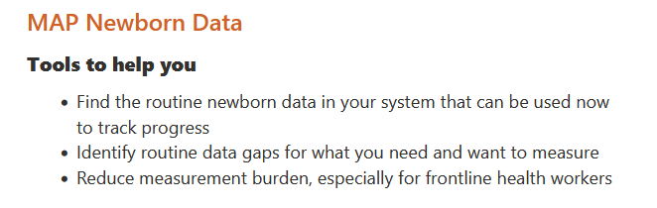
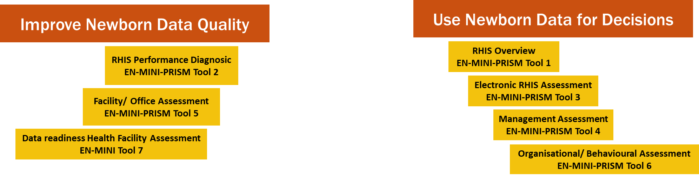
Map Newborn Data
Map Newborn Data EN-MINI Tool 0
Notes:
Under map, the EN-MINI tools will help users:
Find the routine newborn data in your system that can be used now to track progress
Identify routine data gaps for what you need and want to measure
Reduce measurement burden, especially for frontline health workers

Slide 56
Map Newborn Data
Map Newborn Data EN-MINI Tool 0
Improve Newborn Data Quality
Use Newborn Data for Decisions
RHIS Performance Diagnostic
EN-MINI-PRISM Tool 2
RHIS Overview
EN-MINI-PRISM Tool 1
Facility/Office Assessment
EN-MINI-PRISM Tool 5
Electronic RHIS Assessment
EN-MINI-PRISM Tool 3
Management Assessment EN-MINI-PRISM Tool 4
Organizational/Behavioral Assessment
EN-MINI-PRISM Tool 6
Adapted from: Day LT, Moran AC, Jackson D, et al. (2019). Survive and Thrive: Transforming care for every small and sick newborn. Chapter 5, Figure 5.1. Geneva, Switzerland.
Notes:
Now let’s return to the conceptual framework and move around it: To ‘’USE’’.

Slide 57
Map Newborn Data
Map Newborn Data EN-MINI Tool 0
Improve Newborn Data Quality
Use Newborn Data for Decisions
RHIS Performance Diagnostic
EN-MINI-PRISM Tool 2
RHIS Overview
EN-MINI-PRISM Tool 1
Facility/Office Assessment
EN-MINI-PRISM Tool 5
Electronic RHIS Assessment
EN-MINI-PRISM Tool 3
Management Assessment EN-MINI-PRISM Tool 4
Organizational/Behavioral Assessment
EN-MINI-PRISM Tool 6
Adapted from: Day LT, Moran AC, Jackson D, et al. (2019). Survive and Thrive: Transforming care for every small and sick newborn. Chapter 5, Figure 5.1. Geneva, Switzerland.
Notes:
Where you will see there are 4 EN-MINI-PRISM tools

Slide 58
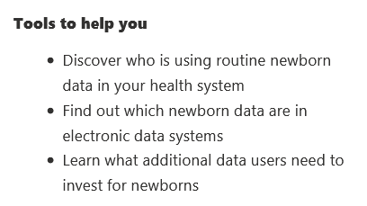
Use Newborn Data for Decisions
RHIS Overview
EN-MINI-PRISM Tool 1
Electronic RHIS Assessment
EN-MINI-PRISM Tool 3
Management Assessment EN-MINI-PRISM Tool 4
Organizational/Behavioral Assessment
EN-MINI-PRISM Tool 6
Notes:
These EN-MINI tools assess Newborn Data USE for decision making via the 4 simple tools shown on the right.
They will help users
Find out which newborn data are in electronic data systems
Discover who is using routine newborn data in the health system, and
Learn what additional data are needed by users to invest for newborns

Slide 59
Map Newborn Data
Map Newborn Data EN-MINI Tool 0
Improve Newborn Data Quality
Use Newborn Data for Decisions
RHIS Performance Diagnostic
EN-MINI-PRISM Tool 2
RHIS Overview
EN-MINI-PRISM Tool 1
Facility/Office Assessment
EN-MINI-PRISM Tool 5
Electronic RHIS Assessment
EN-MINI-PRISM Tool 3
Management Assessment EN-MINI-PRISM Tool 4
Organizational/Behavioral Assessment
EN-MINI-PRISM Tool 6
Adapted from: Day LT, Moran AC, Jackson D, et al. (2019). Survive and Thrive: Transforming care for every small and sick newborn. Chapter 5, Figure 5.1. Geneva, Switzerland.
Notes:
Next is Improve

Slide 60
Map Newborn Data
Map Newborn Data EN-MINI Tool 0
Improve Newborn Data Quality
Use Newborn Data for Decisions
RHIS Performance Diagnostic
EN-MINI-PRISM Tool 2
RHIS Overview
EN-MINI-PRISM Tool 1
Facility/Office Assessment
EN-MINI-PRISM Tool 5
Electronic RHIS Assessment
EN-MINI-PRISM Tool 3
Management Assessment EN-MINI-PRISM Tool 4
Organizational/Behavioral Assessment
EN-MINI-PRISM Tool 6
Adapted from: Day LT, Moran AC, Jackson D, et al. (2019). Survive and Thrive: Transforming care for every small and sick newborn. Chapter 5, Figure 5.1. Geneva, Switzerland.
Notes:
Which includes 2 EN-MINI-PRISM tools

Slide 61
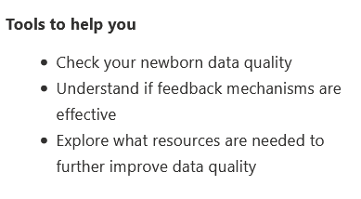
Improve Newborn Data Quality
RHIS Performance Diagnostic
EN-MINI-PRISM Tool 2
Facility/Office Assessment
EN-MINI-PRISM Tool 5
Notes:
These tools are deigned to help you IMPROVE data, they will help users:
Check your newborn data quality
Ascertain if feedback mechanisms are effective
Explore which resources are needed to further improve data quality

Slide 62
Session 4, Activity 2
Access EN-MINI Tools and Resources
https://www.data4impactproject.org/en-mini-tools/
Notes:
Facilitators note:
10 mins for participants to explore the website

Slide 63
Session 4, Activity 3
Reflections/questions
Notes:
Facilitators note:
10 mins facilitated group discussion

Slide 64
Training Session 5
EN-MINI Tools
Every Newborn – Measurement
Improvement for
Newborn and stillbirth Indicators
Assessment Implementation

Slide 65
Session 5 objectives
Describe the EN-MINI-PRISM assessment implementation steps
Understand the criteria for the adaptation of the EN-MINI-PRISM Tools to the local context
Consider and plan the sampling method2

Slide 66
Session 5 plan
Time | Title and Description | Methods
15 minutes | Activity 1: Presentation Assessment implementation Present the steps of EN-MINI-PRISM implementation Explain how to adapt the EN-MINI-PRISM Tools to the local context | Lecture, present EN-MINI-PRISM Training Slide set session 5 Discussion, Q&A Handouts: EN-MINI-PRISM Training Manual EN-MINI-PRISM Training Slide set Optional Handout: PRISM User’s Kit: Preparing and Conducting a PRISM Assessment
10 minutes | Activity 2: Discussion Facilitated discussion with Q&A
15 minutes | Activity 3: Presentation Assessment implementation Sampling method: quick overview of the LQAS method, which is primarily used during PRISM application
5 minutes | Activity 4: Discussion Facilitated discussion with Q&A

Slide 67
Session 5, Activity 1
Presentation
EN-MINI-PRISM Tools Implementation
Notes:
15 minutes

Slide 68
Pre-assessment steps
Establish country leadership, buy-in, and stakeholder engagement/coordination
    Principle outputs:
    HIS Advisory Group
    Assessment management and monitoring Working Group
    Set priorities and plan for the assessment
    Principle products:
    HIS priorities in country context: health program focus (nation-wide vs selected provinces/states) and desired unit of analysis (comprehensive vs focused)
    Customized PRISM Tools
    Assessment Plan: sampling unit, sampling frame, sample size; key informants; assessment schedule; composition of assessment team; assessment team training schedule
Notes:
Facilitators note
Explain how to adapt the EN-MINI-PRISM Tools to the local context noting changes in SurveyCTO may need to be aligned with the automated analysis tool

Slide 69
Steps to conducting an assessment
  Manage and monitor data collection
    Assemble a core team of trained data collectors and supervisors
    Select sites to conduct the assessment; identify key informants to interview
    Inform assessment sites and key informants (preferably through official letters/communication media)
    Arrange logistics for data collection
    Use the tools in order (Overview, Performance Diagnostic, eRHIS Performance, MAT, Office/Facility Checklist, OBAT)
    Supervise data collection; monitor quality of data collected and/or data entered using an electronic data entry tool
    Principle output: Assessment data (raw data)

Slide 70
Decide how to use your team
Use Newborn Data for Decisions
Improve Newborn
Data Quality
Overview | Functionality |  | OBAT Part 1, 2
Overview | Collector 2 | Collector 3 | OBAT Part 1, 2 | Collector 1 | FOC
 | Usability |  | OBAT Part 1, 3, 4 | Tool 2B | FOC
RHIS Overview
EN-MINI-PRISM Tool 1
Electronic RHIS Assessment
EN-MINI-PRISM Tool 3
Management Assessment
EN-MINI-PRISM Tool 4
Organizational/ Behavioral Assessment
EN-MINI-PRISM Tool 6
RHIS Performance Diagnostic
EN-MINI-PRISM Tool 2
Facility/Office Assessment
EN-MINI-PRISM Tool 5
Sub-national / District
Sub-national / District
Facility
Notes:
Facilitator’s Note:
Participants should be provided with the selected mobile devices that the EN-MINI-PRISM data will be collected with
The following sessions provide opportunity to go through each tool in detail.

Slide 71
Post data collection steps
Analyze and assess current RHIS performance
  Apply EN-MINI-PRISM automated analysis plan
  Prepare tables, charts, assessment score matrix, etc.
  Review, verify, and adjust (if anomalies/inconsistencies found)
  Principle product: EN-MINI-PRISM Assessment Report—current RHIS performance and its major determinants; identifying major areas of attention
Translate evidence into policy, strategy, and interventions
  Principle product: RHIS performance improvement plan, policies
Implement the plan and monitor progress

Slide 72
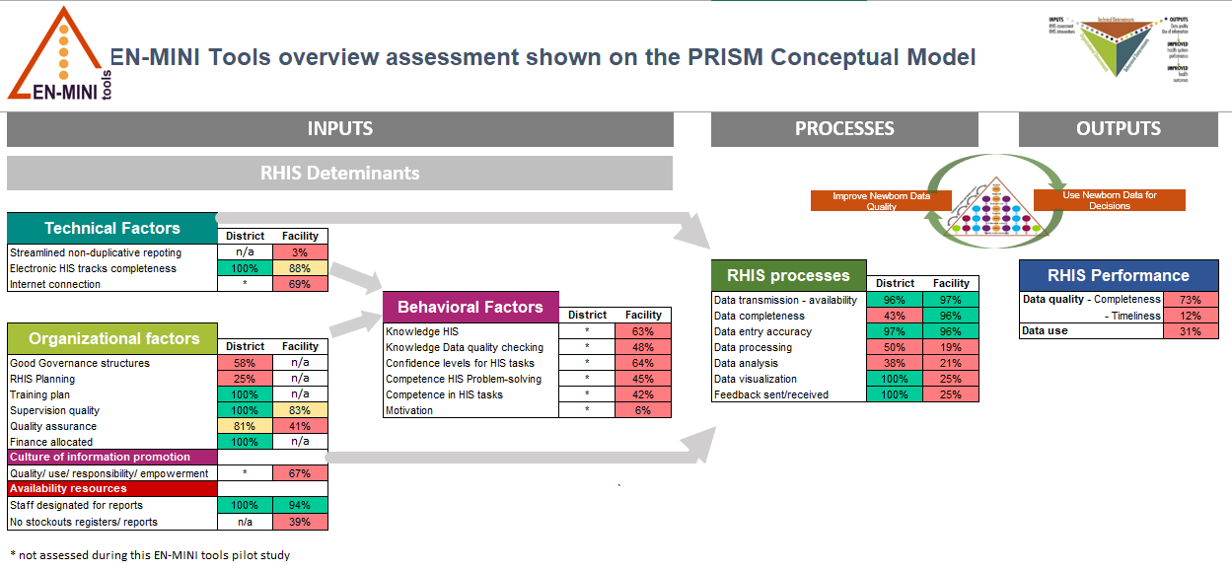
Example from Tanzania’s EN-MINI Assessment

Slide 73
Session 5, Activity 2
Reflections/questions
Notes:
Facilitators note:
10 mins to answer any questions or consider discussion topics proposed by the participants

Slide 74
Session 5, Activity 3
Presentation
EN-MINI-PRISM Sampling Strategies
Notes:
15 minutes

Slide 75
Sampling method
Probability samples are better than nonprobability samples as they are randomly selected and produce unbiased estimates
Two commonly used sampling techniques
Lot Quality Assurance Sampling (LQAS)
  Sample size of 19 for each supervisory area
  Five supervisory areas: total sample size of 95
Probability Proportion to Size (PPS)
  Minimum sample size of 100

Slide 76
Lot Quality Assurance Sampling (LQAS)
LQAS is a sampling method with flexibility, rapidity, and lower cost—relative to other probability survey methods—to assess performance using a smaller sample size
LQAS can:
Be used locally at the “supervision area” level to identify priority areas or indicators that are not reaching average coverage or an established benchmark
Provide an accurate measure of coverage or health system quality at a more aggregate level (e.g., program catchment area or district)
  Produce data for local management decision making and for sharing information across supervision areas
Be used for quality assurance using a “minimal sample”, “maximal security” principle:
  Most frequently used size = <20 per supervision area
  Larger sizes are seldom needed

Slide 77
What a sample of 19 can tell us:
A sample of 19 provides an acceptable level of error for making management decisions
At least 92% of the time, it is good for:
  Identifying whether a coverage benchmark has been reached or whether a supervision area is below the average coverage of a program
  Setting priorities in a supervision area
  Setting priorities among supervision areas with large differences in coverage
  Deciding which are the higher-performing supervision areas to learn from
  Deciding which are the lower-performing supervision areas
  Distinguishing knowledge/practices that have high coverage from those with low coverage
Samples larger than 19 have practically the same statistical precision as samples of 19. They do not result in better information, and they cost more.

Slide 78
What a sample of 19 cannot tell us:
A sample of 19 is not good for:
Calculating exact coverage in a supervision area (but can be used to calculate coverage for an entire program)
Setting priorities among supervision areas with little difference in coverage

Slide 79
Session 5, Activity 4
Reflections/questions
Notes:
Facilitators note:
5 mins to answer any questions or consider discussion topics proposed by the participants

Slide 80
Training Session 6
EN-MINI Tools
Every Newborn – Measurement
Improvement for
Newborn and stillbirth Indicators
Introduction to SurveyCTO

Slide 81
Session 6 objectives
Understand uses of SurveyCTO
Discuss reasons for collecting EN-MINI-PRISM using SurveyCTO
Explore different data collection functions and features of SurveyCTO
Gain an overview of data entry in SurveyCTO
2

Slide 82
Session 6 Plan
Time | Title and Description | Methods
20 minutes | Activity 1: Presentation What SurveyCTO can be used for Reasons for collecting EN-MINI-PRISM using SurveyCTO Data collection functions and features of SurveyCTO Data entry in SurveyCTO Demonstrate how to enter data collected during the PRISM assessment using SurveyCTO (suggest projecting live use of SurveyCTO data entry on big screen) | Lecture, present EN-MINI-PRISM Training Slide set session 6 Discussion, Q&A Handouts: EN-MINI-PRISM Training Manual EN-MINI-PRISM Training Slide set Optional Handout: Using SurveyCTO to collect & enter PRISM Assessment Data Manual
15 minutes | Activity 2: Using SurveyCTO on mobile device Open SurveyCTO on preferred mobile devises, upload and navigate to EN-MINI-PRISM tools | Mobile data collection devices with digital SurveyCTO access
10 minutes | Activity 3: Discussion Facilitated discussion with Q&A | Discussions

Slide 83
Session 6, Activity 1
Presentation
Digital data collection
Notes:
15 minutes

Slide 84

Options for electronic data entry
  SurveyCTO A survey platform for electronic data collection using phones, tablets, or computers
    Forms designed for all EN-MINI-PRISM Tools
    Based on Open Data Kit (or ODK)
    GDPR compliant security features
  Locally build data entry modules using Microsoft Excel, Google Sheets, or another platform
All EN-MINI-PRISM Tools are available for use with SurveyCTO
Notes:
Activity 1: presentation
ANNIMATE
We recommend use of SurveyCTO as all EN-MINI-PRISM tools are adapted for this platform and this will facilitate an automated analysis process.

Slide 85
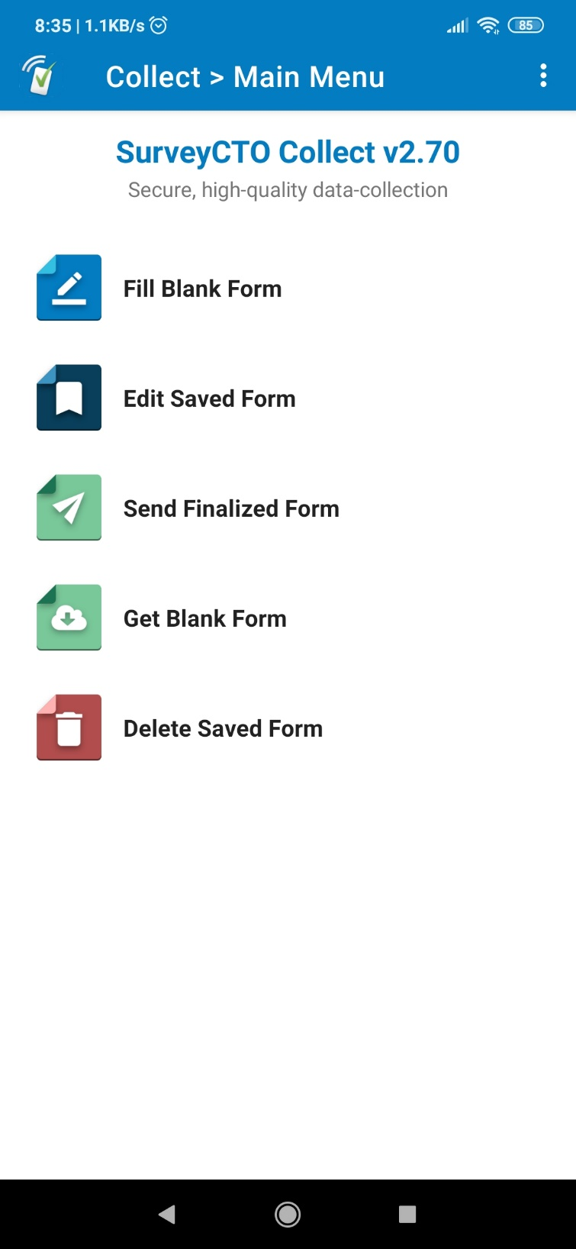
Data Collection EN-MINI-PRISM Tools
How to use the tool: Digital | Enter your data directly on SurveyCTO secure server form
 | Enter data using a smart phone or tablet Enter your data directly on the SurveyCTO secure server Use pre-programmed data collection forms compatible with an automated analysis process
Notes:
To ensure data collection is as simple as possible, and in line with existing PRISM tools, the EN-MINI-PRISM tools have been set up for data entry on the digital platform: SurveyCTO
Data can be entered directly on the SurveyCTO secure server using smart phones or tablets.
Digitized EN-MINI-PRISM tools are coded and ready for use with SurveyCTO.
In addition, data collected using SurveyCTO has been made compatible with an automated analysis process.

Slide 86
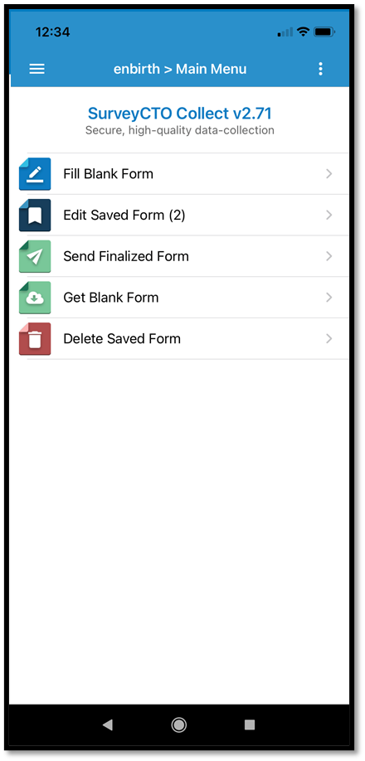
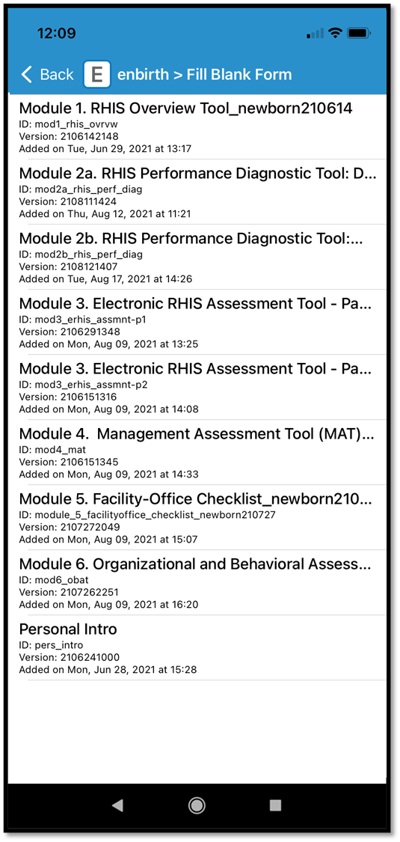
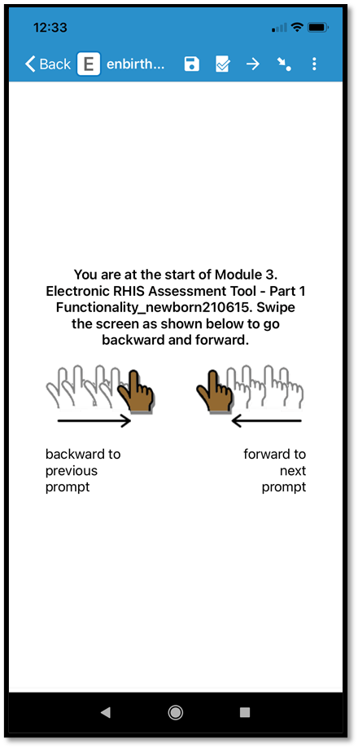
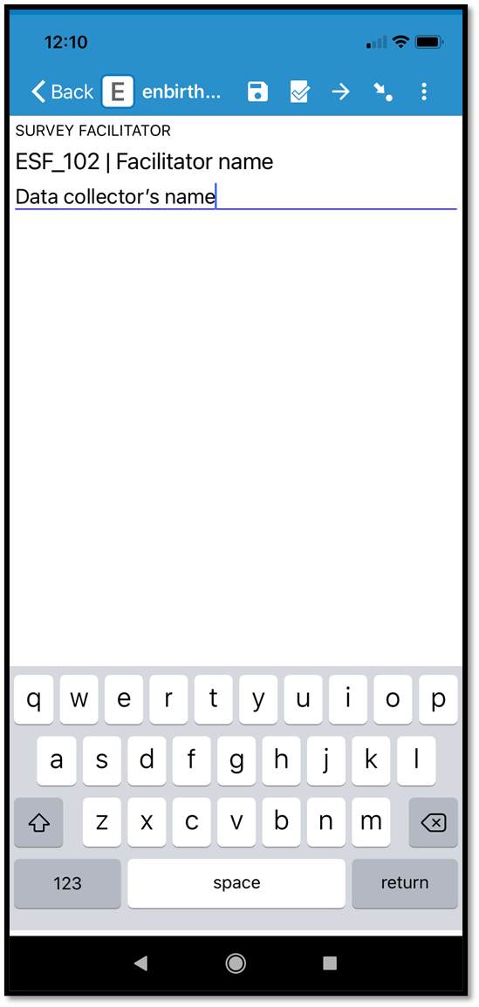
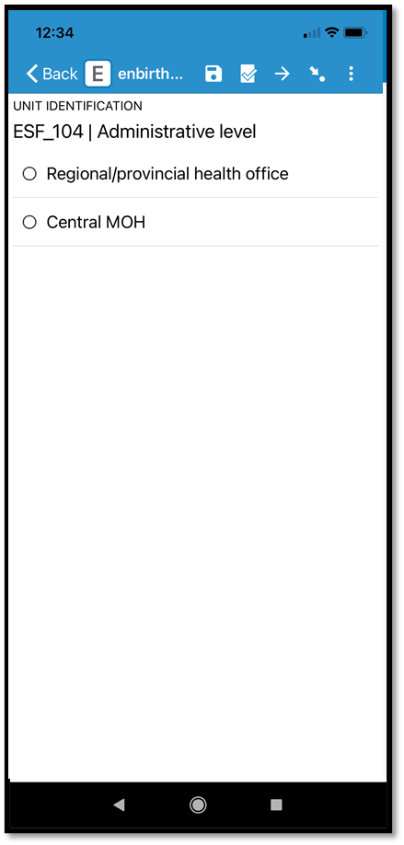
Data collection with
Notes:
SurveyCTO is a software platform based on Open Data Kit (or ODK) and has GDPR compliant security features.
We will go into this in careful detail by each tool shortly, but here you can get a quick feel for how data are entered in practice

Slide 87
Data collection with
Select
Fill Blank Form
Notes:
First.
We select ‘’Fill blank form’’

Slide 88
Data collection with
Choose from blank EN-MINI tools
Notes:
Next we see the full list of the EN-MINI-PRISM tool forms, and can just tap on whichever one we would like to select.
For now let’s use the EN-MINI-PRISM tool 3.

Slide 89
Data collection with
Instructions on how to swipe between screens
Notes:
Users are immediately provided guidance on how to navigate through different sections of the form, which includes intuitive right and left swipe actions to move between different screens and questions.

Slide 90
Data collection with
Enter data
Notes:
Data collectors are required to enter their name and will also be prompted for other details such as their location

Slide 91
Data collection with
Most responses are pre- programmed multiple choice
Notes:
As you can see from this question, data collectors simply tap to select the relevant option.

Slide 92
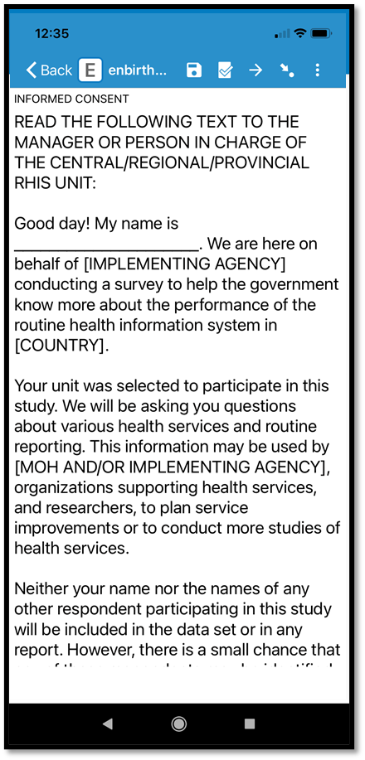
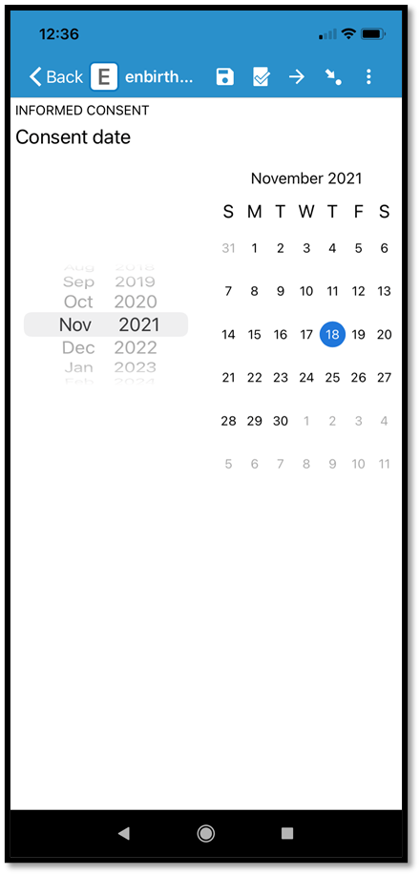
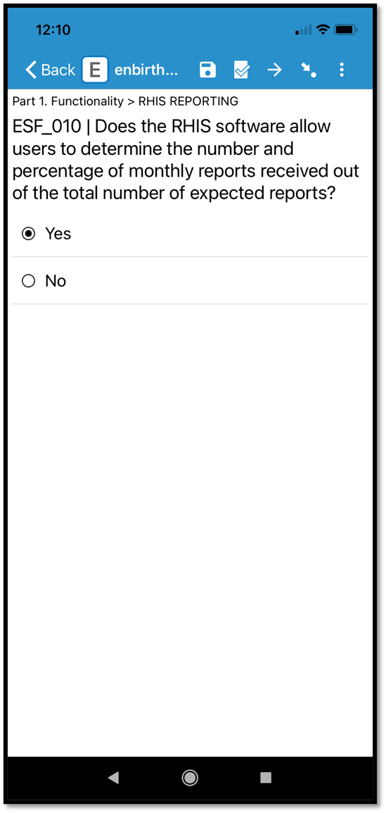
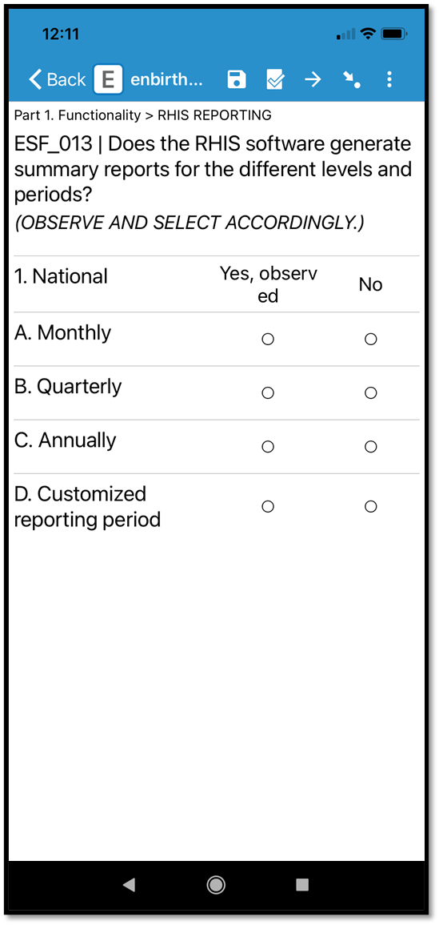
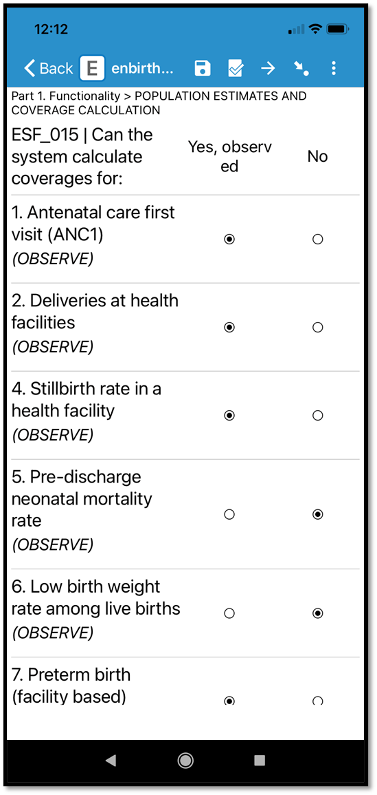
Data collection with
Notes:
Here are some more examples of how different questions formats appear in the platform, and how user-friendly SurveyCTO is for data collectors--even when using a mobile phone
Skip patterns are embedded, in addition to warning prompts for improbable data values.
Facilitators note:
Clicking to advance will show each example in turn.
Demonstrate how to enter data collected during the PRISM assessment using SurveyCTO (suggest to project live use of SurveyCTO data entry on big screen)

Slide 93
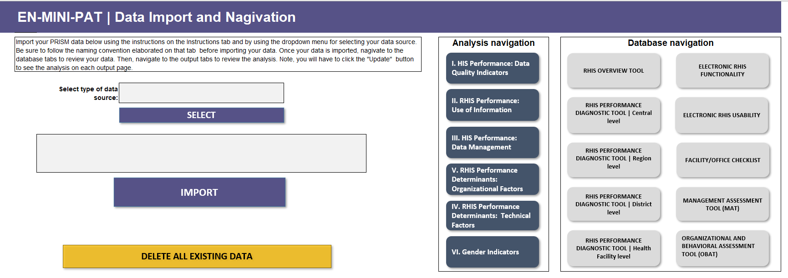
Data Analysis: EN-MINI-PRISM Analysis Tool
Automated data analysis
EN-MINI-PRISM Tool 1
EN-MINI-PRISM Tool 3
EN-MINI-PRISM Tool 2 Central Level
EN-MINI-PRISM Tool 3
C:\My documents\EN-MINI-PRISM data files
EN-MINI-PRISM Tool 2 Region Level
EN-MINI-PRISM Tool 5
EN-MINI-PRISM Tool 2 District level
EN-MINI-PRISM Tool 4
EN-MINI-PRISM Tool 2 Facility Level
EN-MINI-PRISM Tool 6

Slide 94
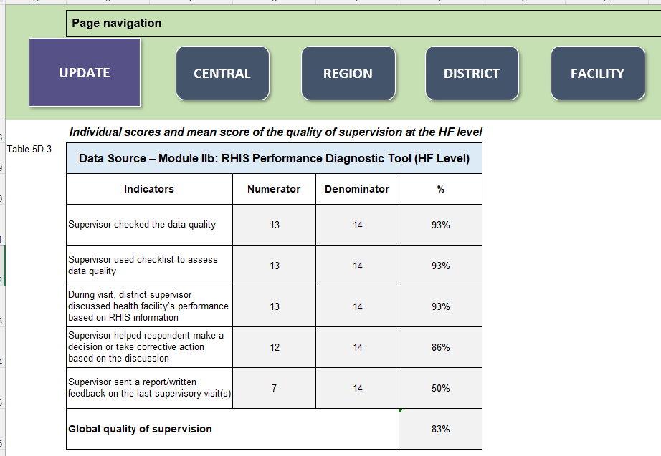
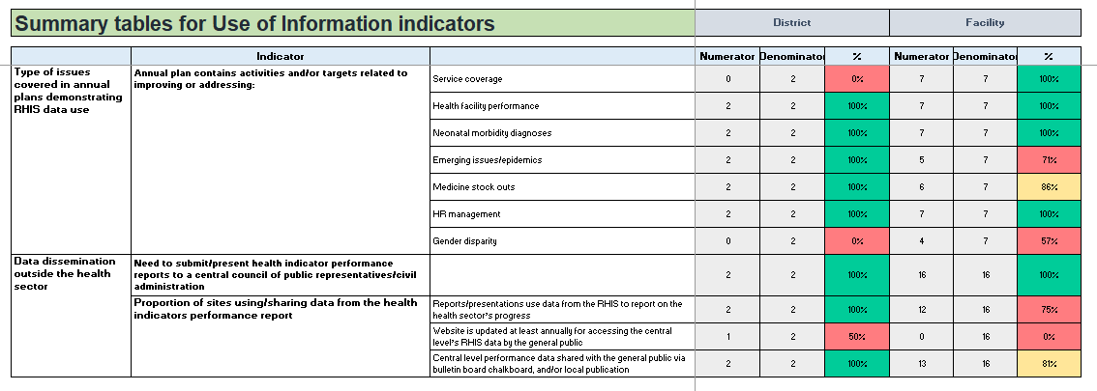
EN-MINI-PRISM Analysis Tool
Detailed tables…………heat-mapped summary tables
Notes:
The EN-MINI PAT generates the standard PRISM analysis adapted for EN-MINI. 287 tables of information which can be used in many different ways to improve routine systems for newborns.
In addition to a simple dashboard summary as shown here.

Slide 95
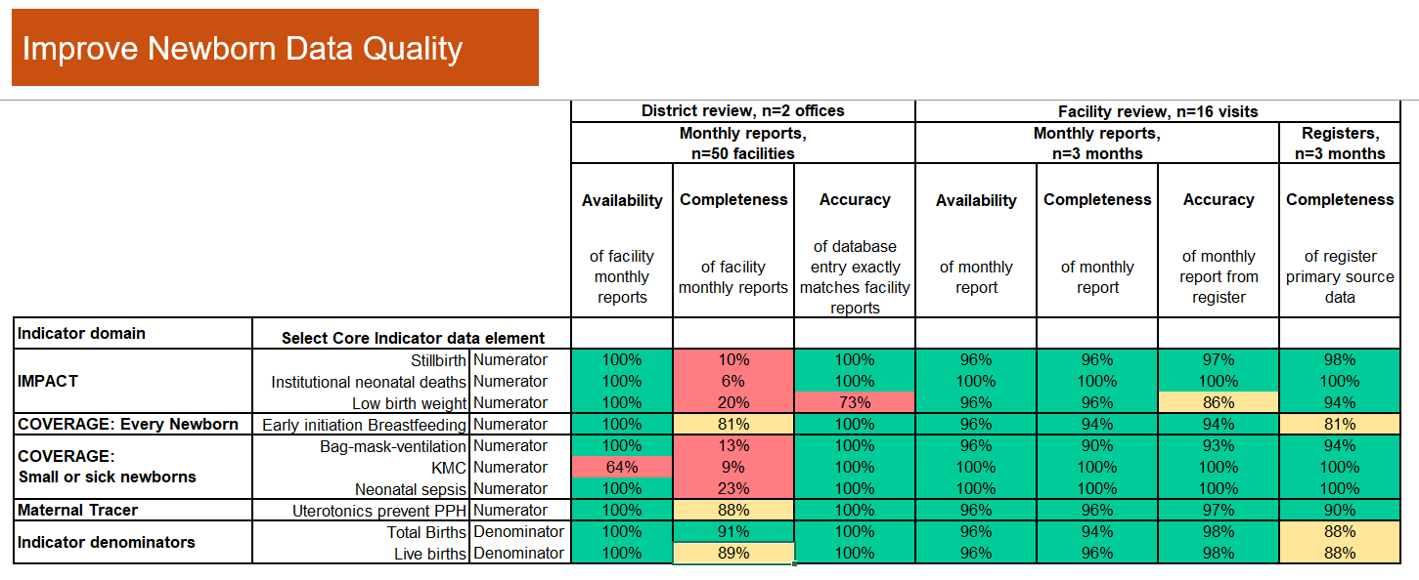
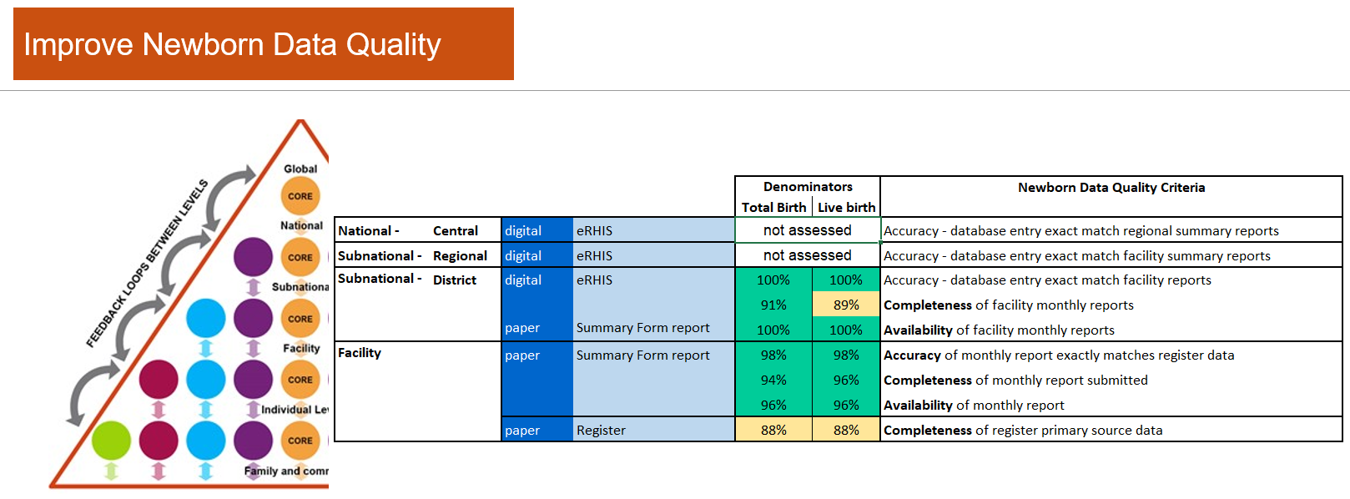
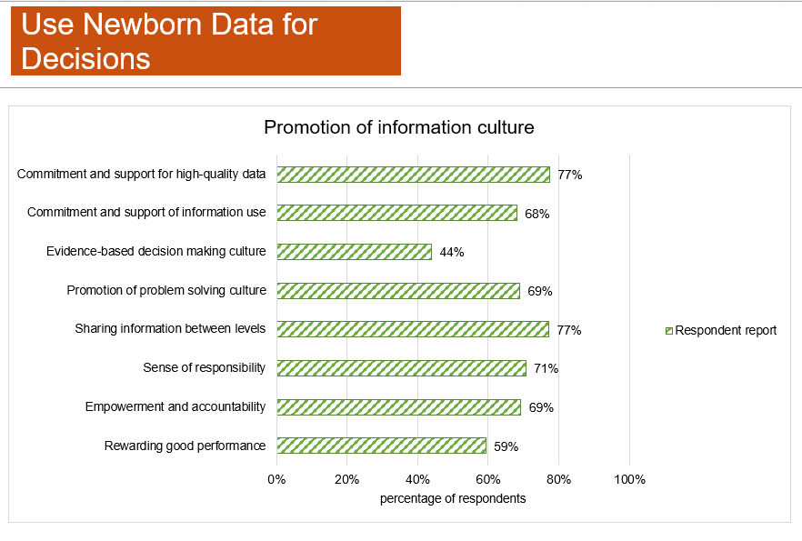
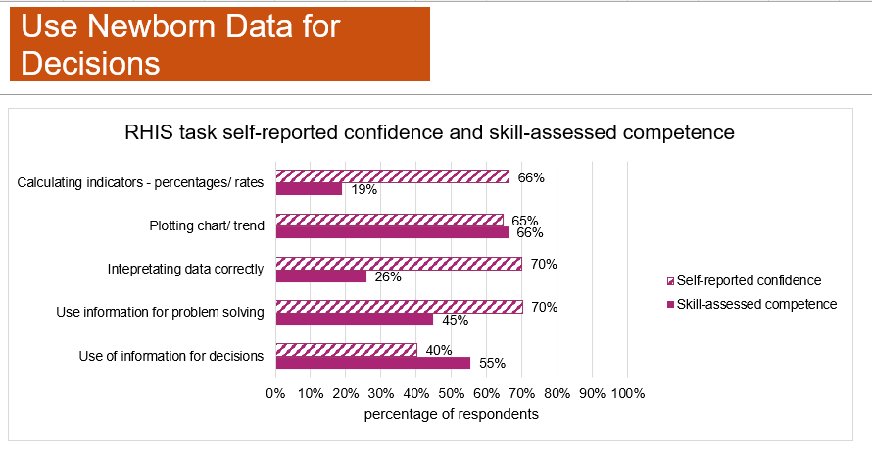
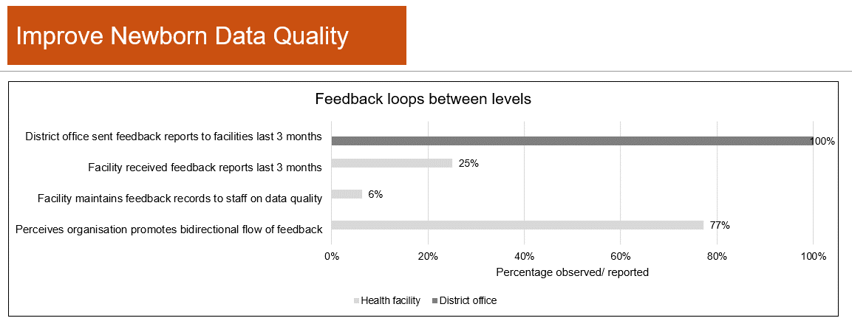
Data Analysis – EN-MINI-PRISM Analysis Tool
Report-ready figures
Notes:
EN-MINI-PRISM tools generate comprehensive overview newborn/stillbirth indicator performance with specific details to guide priority actions

Slide 96
Session 6, Activity 2
Using SurveyCTO on a mobile device
Notes:
Facilitators note:
15 mins to open SurveyCTO on preferred mobile devises, upload and navigate to EN-MINI-PRISM tools

Slide 97
Session 6, Activity 3
Reflections/questions
Notes:
Facilitators note:
10 mins to answer any questions or consider discussion topics proposed by the participants

Slide 98
Training Session 7
Using Newborn Data for Decisions
EN-MINI Tools
Every Newborn – Measurement
Improvement for
Newborn and stillbirth Indicators

Slide 99
Session 7 objectives
Explain the importance of using data to inform program planning and policy development
Appreciate how data use interventions can improve a HIS
Define data demand and data use
Identify barriers for using data/information
2

Slide 100
Session 7 plan
Time | Title and Description | Methods
10 minutes | Activity 1: Presentation Using newborn data for decisions Value of data Data informed decision-making process Data demand and use Determinant of data demand and use | Lecture, present EN-MINI-PRISM Training Slide set session 7 Discussion, Q&A Handouts: EN-MINI-PRISM Training Manual EN-MINI-PRISM Training Slide set
15 minutes | Activity 2: Brainstorm Identify and list the main barriers to using or getting others to use data or information Way forward to establishing culture of information
5 minutes | Activity 3: Discussion Facilitated discussion with Q&A
Notes:
Activity 1: presentation 10 minutes

Slide 101
Session 7, Activity 1
Presentation
Use Newborn Data for Decisions
Notes:
15 minutes

Slide 102
The value of data for newborns and stillbirths
Timely and accurate data on coverage, equity, and quality of care are essential to track progress towards ending preventable stillbirths, newborn deaths, and disabilities. However, the settings with the highest burden of deaths have the least data on coverage and quality of care—the “inverse data law.”

Slide 103
The PRISM Conceptual Model
INPUTS
PROCESSES
OUTPUTS
OUTCOMES
IMPACT
RHIS determinants
Technical factors:
Complexity of reporting forms and procedures
HIS design
Computer software
Information technology complexity
Good data
Good decisions
Responsive & efficient health system
Behavioral factors:
Level of knowledge of content of HIS forms
Data-quality checking skills
Problem-solving for HIS tasks
Competence in HIS tasks
Confidence levels for HIS tasks
Motivation
RHIS processes:
Data collection
Data transmission
Data processing
Data analysis
Data quality check
Feedback
Improved RHIS performance
Data quality
Information use
Improved health system performance
Improved health status
Organizational factors:
Critical management functions & information needs
Governance
Planning
Training
Supervision
Quality
Finance
Promotion of a culture of information
Resource availability

Slide 104
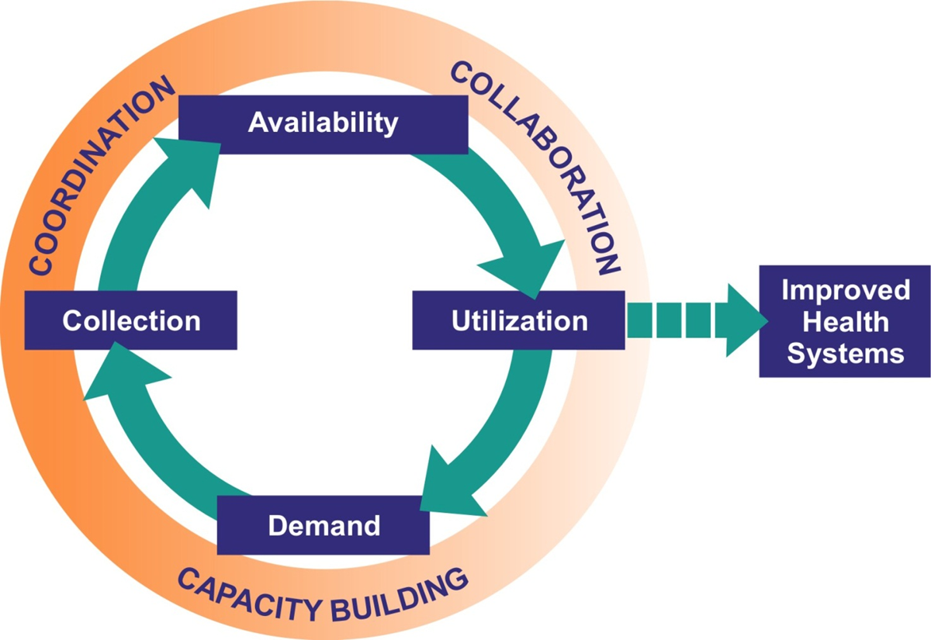
Data-informed decision-making process
INPUTS
PROCESSES
OUTPUTS
OUTCOMES
IMPACT
RHIS determinants
Notes:
The framework presented here illustrates the entire cycle of evidence-informed decision making. This approach illustrates the ideal. This data-informed decision-making process relies on multiple inputs, activities, and systems to function effectively. Even in the best-designed M&E system, you often find that data are not being used as often as they should be. So, there must be other, more fundamental elements in the decision-making context that may affect this process.
In the inner circle of this graphic are the activities that need to take place:
Demand for data to manage a health program or develop a health policy is clearly stated.
This leads to a data collection effort.
The data are analyzed, synthesized, and made available to those who use them to make a decision.
A decision based on data is better than one that is not, and leads to some improvements in the health system.
The outer circle explains the way in which the activities that make up this process get done.
The information or M&E system needs to secure the technical and human capacity to understand the demand for data, and manage, analyze, and distribute the data.
There needs to be coordination among:
Many people with different job functions
At different levels of the health system
With varying levels of understanding about each other’s work
Who together ensure that information is made available and in a format that is easily understood, and can be interpreted and used
Finally, there need to be management systems and organizational support that promote collaboration among those who produce the data and those who use the data, in order for the data-informed decision making process to be complete.

Slide 105
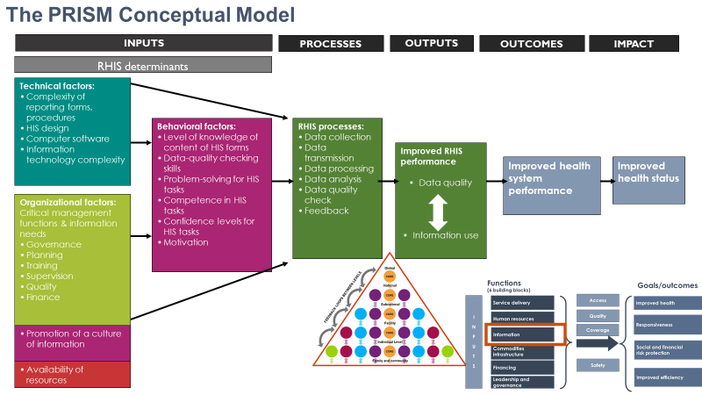
Assessing Data Use with EN-MINI-PRISM
Improve Newborn Data Quality
Use Newborn Data for Decisions
Notes:
Facilitators Note: (5 mins)
Ask why do participants think we should concern ourselves with the demand for data?
Encourage participants to call out their ideas and experiences to facilitate a brief group conversion around this topic

Slide 106
Use Newborn Data for Decisions
Data use
At health policy and management levels, data are used to:
  Create or revise a program or strategic plan
  Develop or revise a policy
  Advocate support for a policy or program
  Allocate resources
  Monitor a program
  Establish accountability
  Strengthen service delivery
  Quality improvement and quality assurance
Health providers use data for clinical care and quality improvement
Notes:
Now, let’s take a minute to discuss exactly what we mean by using data to inform program and policy decision making.
ENGAGE PARTICIPANTS: How do you think data can be used for health programs or policies?
[CLICK ANIMATION]
SAY: Those are some great ideas about how data can be used. Some uses for data that we came up with are to:
Create or revise a program or strategic plan
Develop or revise a policy
Advocate support for a policy or program
Allocate resources
Monitor a program
A common data use approach for each of these tasks is that each review of data is linked to a specific decision-making process.
Using data to populate a report to send to the national level or to a donor is not data use. That is data reporting. The presentation of data at a technical conference is also not data use as we define it. That is data dissemination.
Both data reporting and data dissemination are important precursors to data use, but they are not linked specifically to decision-making processes.

Slide 107
Data demand
  Demand refers to the value the decision maker places on the information, and whether she or he is using it.
  The decision maker demands information if she or he:
    Understands what information is needed to inform the decision
    Proactively seeks out the information needed
Notes:
Data demand starts with a question or problem that a stakeholder has about a type of health service or a particular health problem. To address this question or make a decision, stakeholders need to educate themselves about the available data or a summary of data sources to develop an informed solution.
Therefore, data demand comes from decision makers who specify what kinds of information they need to inform a decision-making process and how to seek it out.
If the information they need to inform a decision doesn’t exist or is not available, they take steps to get it.

Slide 108
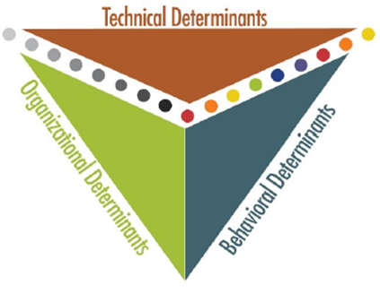
What determines data demand and use?
CULTURE
POLITICS
SOCIETY
Decision making occurs in political, cultural, and social contexts
Notes:
You will remember that the PRISM framework is designed around these three main determinants of data demand and information use.
[CLICK ANIMATION]
However, it’s important to note that these occur within political, cultural, and social contexts. Decision making, the sharing of information, and data collection and reporting all occur within these contexts which inform how the RHIS is experienced and how it functions

Slide 109
Session 7, Activity 2 Brainstorm
Identify and list the main barriers to data use for decision making
Notes:
Facilitators Note: (20 mins)
7.5 mins: Ask participants to work in small groups to identify and list the main barriers to using or getting others to use data or information?
7.5 mins: Encourage a group discussion to provide feedback on their thoughts (noting some potential replies are included on the next slide if required).
Encourage participants to think about the potential ways for establishing culture of information.

Slide 110
Data are often underused due to…
Organizational structures
Lack of a “data culture” among decision makers
Low staff motivation
Lack of technical skills and technology, particularly at local levels
Ad hoc and unsustainable training
Structural constraints: roads, telecommunications
Unclear staff roles and poor flow of information
Poor funding for M&E
Political interference
Notes:
Can share this slide which includes some potential reasons for underuse of data:
Organizational structures can hinder efficient data management processes.
Lack of a “data culture” among decision makers and low staff motivation.
Lack of technical skills and information technology, particularly among staff at local levels.
Training is often ad hoc and not sustainable.
Structural constraints: roads, telecommunication
Unclear staff roles and poor flow of information.
Poor funding for M&E
Political interference

Slide 111
The PRISM Conceptual Model
INPUTS
PROCESSES
OUTPUTS
OUTCOMES
IMPACT
RHIS determinants
Technical factors:
Complexity of reporting forms and procedures
HIS design
Computer software
Information technology complexity
Behavioral factors:
Level of knowledge of content of HIS forms
Data-quality checking skills
Problem-solving for HIS tasks
Competence in HIS tasks
Confidence levels for HIS tasks
Motivation
RHIS processes:
Data collection
Data transmission
Data processing
Data analysis
Data quality check
Feedback
Improved RHIS performance
Data quality
Information use
Improved health system performance
Improved health status
Organizational factors:
Critical management functions & information needs
Governance
Planning
Training
Supervision
Quality
Finance
Promotion of a culture of information
Resource availability
Notes:
Facilitators note:
Relate the discussion and contributions from participants back to this PRISM Conceptual framework

Slide 112
Working toward a culture of information
Commit to and support high-quality data and information use at all program levels
Share information between levels via feedback
Establish information as an integral part of planning, problem-solving, and choosing alternatives
Empower people to ask questions, seek improvements, learn and improve quality through useful information

Slide 113
Session 7, Activity 3
Reflections/questions
Notes:
Facilitators note:
5 mins to answer any questions or consider discussion topics proposed by the participants

Slide 114
Training Session 8
EN-MINI Tools
Every Newborn – Measurement
Improvement for
Newborn and stillbirth Indicators
Data collection using
EN-MINI-PRISM Tools
Notes:
Could use this as a cover slide instead

Slide 115
Session 8 objectives
Describe how the EN-MINI-PRISM Tools are organized
Link each EN-MINI-PRISM tool to the PRISM Conceptual Model and Framework
Explain the purpose of each tool to diagnose RHIS performance and how to use it

Slide 116
Session 8 plan
Time | Title and Description | Methods
20 minutes | Activity 1: Presentation Present the EN-MINI-PRISM Tools for USE newborn data for decisions Explain and discuss the purpose of using the EN-MINI-PRISM Tools Present and explain the linkage between the PRISM Tools and the PRISM Framework (presented in Session 4) | Lecture, present EN-MINI-PRISM Training Slide set session 8 Discussion, Q&A Handouts: EN-MINI-PRISM Training Manual EN-MINI-PRISM Training Slide set EN-MINI-PRISM Paper version Tools 1–6
10 minutes | Activity 2: Discussion Facilitated discussion with Q&A
Notes:
Activity 1: present slides

Slide 117
Session 8, Activity 1
Presentation
Notes:
15 minutes

Slide 118
EN-MINI-PRISM Tools
Map Newborn Data
Map Newborn Data EN-MINI Tool 0
Improve Newborn Data Quality
Use Newborn Data for Decisions
RHIS Performance Diagnostic
EN-MINI-PRISM Tool 2
RHIS Overview
EN-MINI-PRISM Tool 1
Facility/Office Assessment
EN-MINI-PRISM Tool 5
Electronic RHIS Assessment
EN-MINI-PRISM Tool 3
Management Assessment EN-MINI-PRISM Tool 4
Organizational/Behavioral Assessment
EN-MINI-PRISM Tool 6
Adapted from: Day LT, Moran AC, Jackson D, et al. (2019). Survive and Thrive: Transforming care for every small and sick newborn. Chapter 5, Figure 5.1. Geneva, Switzerland.
Notes:
As we discussed yesterday, there are two groups of EN-MINI-PRISM tools, used to IMPROVE and USE newborn data for the following purposes, to:
Establish a baseline for RHIS performance and monitor progress
Identify technical, behavioral, and organizational factors that affect RHIS performance
Aid in designing and prioritizing interventions to improve RHIS performance
Advocate technical and financial support to improve RHIS performance
The tools can be used in combination or alone.

Slide 119
The PRISM Conceptual Model
INPUTS
PROCESSES
OUTPUTS
OUTCOMES
IMPACT
RHIS determinants
Technical factors:
Complexity of reporting forms and procedures
HIS design
Computer software
Information technology complexity
RHIS Overview
EN-MINI-PRISM Tool 1
Electronic RHIS Assessment
EN-MINI-PRISM Tool 3
Behavioral factors:
Level of knowledge of content of HIS forms
Data-quality checking skills
Problem-solving for HIS tasks
Competence in HIS tasks
Confidence levels for HIS tasks
Motivation
RHIS processes:
Data collection
Data transmission
Data processing
Data analysis
Data quality check
Feedback
Improved RHIS performance
Data quality
Information use
Improved health system performance
Improved health status
Organizational factors:
Critical management functions & information needs
Governance
Planning
Training
Supervision
Quality
Finance
RHIS Performance Diagnostic
EN-MINI-PRISM Tool 2
Management Assessment EN-MINI-PRISM Tool 4
Organizational/Behavioral Assessment
EN-MINI-PRISM Tool 6
Promotion of a culture of information
Resource availability
Facility/Office Assessment
EN-MINI-PRISM Tool 5
Notes:
Facilitator’s Note:
Remind participants that the PRISM Conceptual Model was presented in Session 4 and now we are showing how the PRISM Tools are related to it.
Click 6 times to show the linking of PRISM tools with the model.

Slide 120
Use Newborn Data for Decisions
Improve Newborn
Data Quality
RHIS Overview EN-MINI-PRISM Tool 1 | Electronic RHIS Assessment EN-MINI-PRISM Tool 3 | Management Assessment EN-MINI-PRISM Tool 4 | Organizational/ Behavioral Assessment EN-MINI-PRISM Tool 6 | RHIS Performance Diagnostic EN-MINI-PRISM Tool 2 | Facility/Office Assessment EN-MINI-PRISM Tool 5
Overview | Functionality |  | OBAT Part 1, 2
Overview | Usability | MAT | OBAT Part 1, 2 | Tool 2A | FOC
 | Usability |  | OBAT Part 1, 3, 4 | Tool 2B | FOC
National
Sub-national / District
Facility
Notes:
Facilitator’s Note:
Participants should be provided with the selected mobile devices that the EN-MINI-PRISM data will be collected with
The following sessions provide opportunity to go through each tool in detail.

Slide 121
Session 8, Activity 2
Reflections/questions
Notes:
Facilitators note:
10 mins to answer any questions or consider discussion topics proposed by the participants
Also to support turning on of devices and initatial navigation to the SurveyCTO app

Slide 122
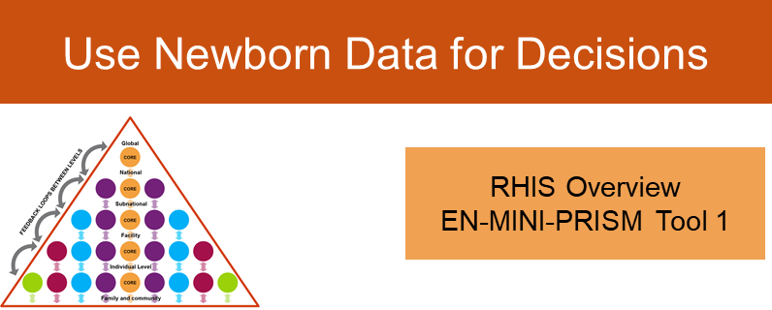
Training Session 9
RHIS Overview
EN-MINI-PRISM Tool 1
EN-MINI Tools
Every Newborn – Measurement
Improvement for
Newborn and stillbirth Indicators

Slide 123
Session 9 plan
Time | Title and Description | Methods
10 minutes | Activity 1: Presentation RHIS Overview EN-MINI-PRISM Tool 1 Present the structure and purpose of the RHIS Overview EN-MINI-PRISM Tool 1 | Lecture, present EN-MINI-PRISM Training Slide set session 9 Discussion, Q&A EN-MINI-PRISM Digital version SurveyCTO forms Handouts: EN-MINI-PRISM Training Manual EN-MINI-PRISM Training Slide set EN-MINI-PRISM Paper version Tools 1–6 and/or EN-MINI-PRISM Paper version individual Tool 1
70 minutes | Activity 2: Practice tool filling Using mobile device of choice for data collection, work through each question in detail and practice entering the data Make notes on your paper copy
10 minutes | Activity 3: Discussion Facilitated discussion with Q&A
Notes:
Activity 1: present slides (10 mins)

Slide 124
Session 9, Activity 1
Presentation
Notes:
15 minutes

Slide 125
Use Newborn Data for Decisions
RHIS Overview
EN-MINI-PRISM Tool 1
RHIS Overview
EN-MINI-PRISM Tool 1
Uses | Examines technical determinants, including the structure and design of existing information systems for newborns, information flows, and interaction of different information systems. It looks at the extent of RHIS fragmentation and redundancy and helps to initiate discussion of data integration and use.
Users | Teams of newborn program stakeholders, and RHIS technical experts and national/subnational policymakers, working to improve newborn data for action
Notes:
Use this tool to:
Determine the current level of RHIS performance at health facility and district or higher levels
Regularly monitor RHIS performance
The tool measures the status of:
RHIS performance
(data quality and information use)
RHIS data management

Slide 126
Use Newborn Data for Decisions
Improve Newborn
Data Quality
Overview | Functionality |  | OBAT Part 1, 2
Overview | Usability | MAT | OBAT Part 1, 2 | Tool 2A | FOC
 | Usability |  | OBAT Part 1, 3, 4 | Tool 2B | FOC
RHIS Overview
EN-MINI-PRISM Tool 1
Electronic RHIS Assessment
EN-MINI-PRISM Tool 3
Management Assessment
EN-MINI-PRISM Tool 4
Organizational/ Behavioral Assessment
EN-MINI-PRISM Tool 6
RHIS Performance Diagnostic
EN-MINI-PRISM Tool 2
Facility/Office Assessment
EN-MINI-PRISM Tool 5
National
Sub-national / District
Facility
Notes:
Facilitator’s Note:
Participants should be provided with the selected mobile devices that the EN-MINI-PRISM data will be collected with
The following sessions provide opportunity to go through each tool in detail.

Slide 127
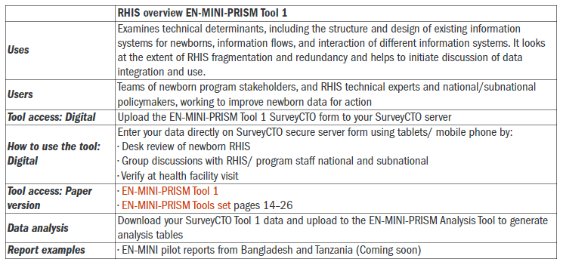

Slide 128
Session 9, Activity 2
Practice using
Use Newborn Data for Decisions
RHIS Overview
EN-MINI-PRISM Tool 1
Notes:
Facilitator’s Note:
Using mobile device of choice for data collection, work through each question in detail and practice entering the data
Encourage participants to ask clarifying questions, and address those questions
Make notes on your paper copy
Demonstrate how to enter data collected during the PRISM assessment using SurveyCTO (suggest to project live use of SurveyCTO data entry on big screen)

Slide 129
Session 9, Activity 3
Reflections/questions
Notes:
Facilitators note:
10 mins to answer any questions or consider discussion topics proposed by the participants

Slide 130

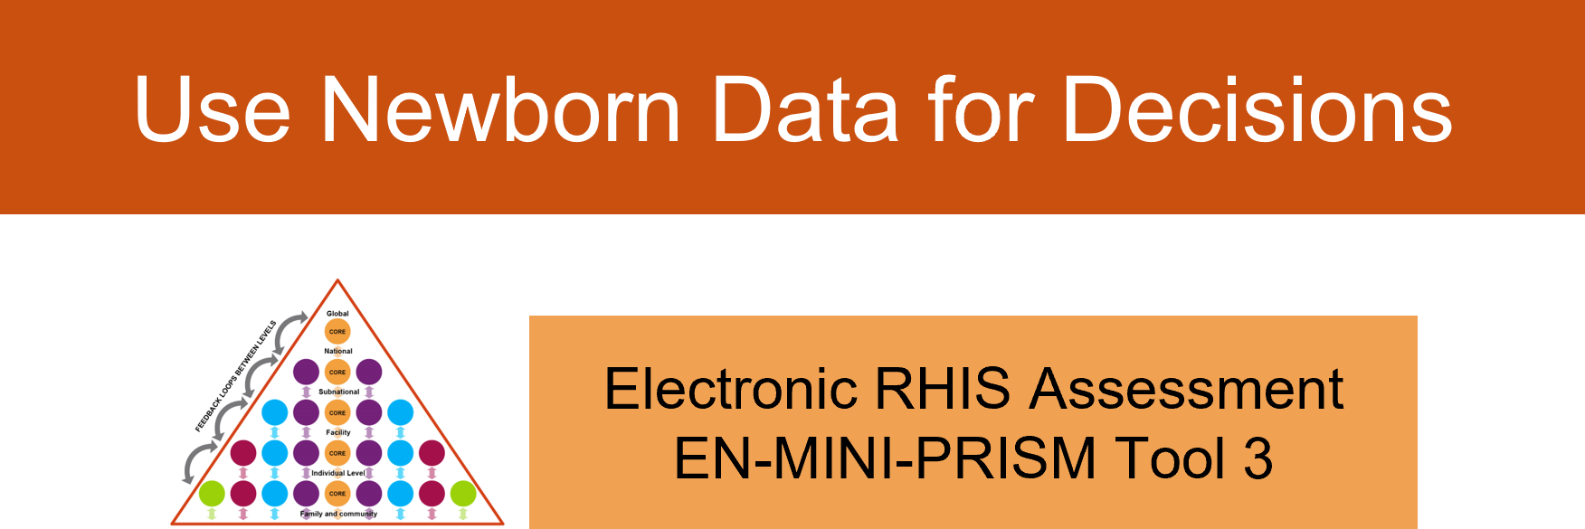
Training Session 10
EN-MINI Tools
Every Newborn – Measurement
Improvement for
Newborn and stillbirth Indicators

Slide 131
Session 10 plan
Time | Title and Description | Methods
10 minutes | Electronic RHIS Assessment EN-MINI-PRISM Tool 3 Activity 1: Presentation Present the structure and purpose of the Electronic RHIS Assessment EN-MINI-PRISM Tool 3 | Lecture, present EN-MINI-PRISM Training Slide set session 10 Discussion, Q&A EN-MINI-PRISM Digital Version SurveyCTO forms Handouts: EN-MINI-PRISM Training Manual EN-MINI-PRISMTraining Slide set EN-MINI-PRISM Paper version Tools 1–6 and/or EN-MINI-PRISM Paper version individual Tool 3
70 minutes | Activity 2: Practice tool filling Using mobile device of choice for data collection, work through each question in detail and practice entering the data Make notes on your paper copy
10 minutes | Activity 3: Discussion Facilitated discussion with Q&A
Notes:
Activity 1: present slides

Slide 132
Session 10, Activity 1
Presentation
Notes:
15 minutes

Slide 133
Electronic RHIS Assessment EN-MINI-PRISM Tool 3
Uses | Examines functionality and user-friendliness of technology for generating, processing, analyzing, and using routine health data
Users | Teams of newborn program stakeholders, and RHIS technical experts and national/subnational policymakers working to improve newborn data for action
Notes:
EN-MINI-PRISM Tool 3 assesses the functionality and user-friendliness of the existing electronic systems for generating, processing, analyzing, and using routine newborn health data
The tool measures functions as part of the RHIS process and technical factors, such as:
Unique identifiers for the health facility (master facility list)
Aggregate report generation
Coverage calculation using population estimates
Data integration (interoperability)
Data disaggregation by sex and age
Data analysis and visualization

Slide 134
Use Newborn Data for Decisions
Improve Newborn
Data Quality
Overview | Functionality |  | OBAT Part 1, 2
Overview | Usability | MAT | OBAT Part 1, 2 | Tool 2A | FOC
 | Usability |  | OBAT Part 1, 3, 4 | Tool 2B | FOC
RHIS Overview
EN-MINI-PRISM Tool 1
Electronic RHIS Assessment
EN-MINI-PRISM Tool 3
Management Assessment
EN-MINI-PRISM Tool 4
Organizational/ Behavioral Assessment
EN-MINI-PRISM Tool 6
RHIS Performance Diagnostic
EN-MINI-PRISM Tool 2
Facility/Office Assessment
EN-MINI-PRISM Tool 5
National
Sub-national / District
Facility
Notes:
Facilitator’s Note:
Participants should be provided with the selected mobile devices that the EN-MINI-PRISM data will be collected with
The following sessions provide opportunity to go through each tool in detail.

Slide 135
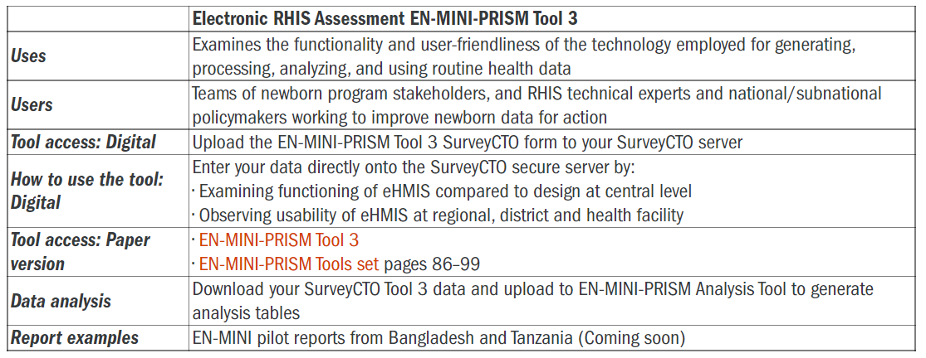
Ref: https://www.data4impactproject.org/en-mini-tools/

Slide 136

Every Newborn Action Plan Indicators
Current Status |  | Core Indicators | Additional indicators
Definitions clear but quantity & consistency of data lacking | IMPACT | 1. Maternal mortality ratio
 |  | 2. Stillbirth rate | Intrapartum stillbirth rate
 |  | 3. Neonatal mortality rate | Low birth weight rate
 |  |  | Preterm birth rate Small for gestational age Neonatal morbidity rates Disability after neonatal conditions
Contact point definitions clear but data on content of care are lacking | COVERAGE Care for all mothers and newborns | 4. Skilled attendant at birth 5. Early postnatal care for mothers & babies 6. Essential newborn care (tracer, early breastfeeding) | Antenatal Care Exclusive breastfeeding to 6 months
Gaps in definitions, requiring validation and feasibility testing for HMIS use | COVERAGE Complications and extra care | 7. Neonatal resuscitation 8. Kangaroo mother care | Caesarean section rate
 |  | 9. Treatment of serious neonatal infections 10. Antenatal corticosteroid use | Chlorhexidine cord cleansing
 | INPUT Service readiness for Quality of Care | Emergency Obstetric Care
 |  | Care of Small and Sick Newborns Quality of care with measurable norms and standards
 | Counting | Birth Registration | Death registration, cause of death
Adapted from Every Newborn Action Plan. WHO, 2014. www.everynewborn.org and Mason et al Lancet 2014
Notes:
This table summarises indicators classified by IMPACT, COVERAGE, INPUT

Slide 137
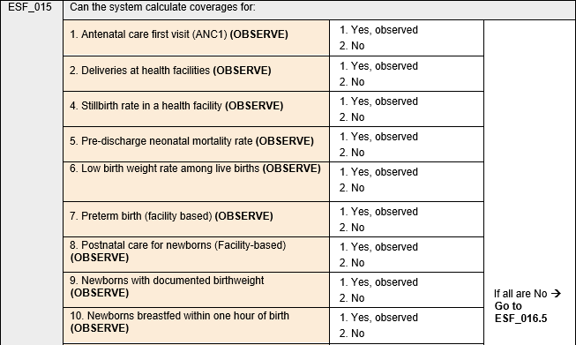
Examples from EN-MINI-PRISM Tool 3
Notes:
Here you can see some example questions from the EN-MINI-PRISM tool 3, such as:
If the right data are being collected in electronic systems to calculate prioritised newborn indicators (such as stillbirth rate, neonatal mortality and others shown here)
In this slide you can see how these questions appear in the both the paper tool and in SurveyCTO (both available on the website).

Slide 138
Session 10, Activity 2
Practice using
Notes:
Facilitator’s Note:
Using mobile device of choice for data collection, work through each question in detail and practice entering the data
Encourage participants to ask clarifying questions, and address those questions
Make notes on your paper copy
Demonstrate how to enter data collected during the PRISM assessment using SurveyCTO (suggest to project live use of SurveyCTO data entry on big screen)

Slide 139
Session 10, Activity 3
Reflections/questions
Notes:
Facilitators note:
10 mins to answer any questions or consider discussion topics proposed by the participants

Slide 140
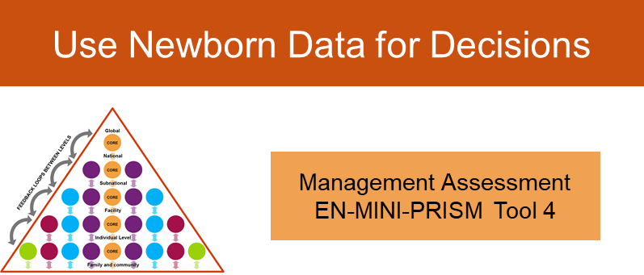
Training Session 11
EN-MINI Tools
Every Newborn – Measurement
Improvement for
Newborn and stillbirth Indicators
Management Assessment EN-MINI-PRISM Tool 4

Slide 141
Session 11 plan
Time | Title and Description | Methods
10 minutes | Management Assessment EN-MINI-PRISM Tool 4 (MAT) Activity 1: Presentation Present the structure and purpose of the Management Assessment EN-MINI-PRISM Tool 4 (MAT) | Lecture, present EN-MINI-PRISM Training Slide set session 11 Discussion, Q&A EN-MINI-PRISM Digital Version SurveyCTO forms Handouts: EN-MINI-PRISM Training Manual EN-MINI-PRISM Training Slide set EN-MINI-PRISM Paper version Tools 1–6 and/or EN-MINI-PRISM Paper version individual Tool 4
40 minutes | Activity 2: Practice tool filling Using mobile device of choice for data collection, work through each question in detail and practice entering the data Make notes on your paper copy
10 minutes | Activity 3: Discussion Facilitated discussion with Q&A

Slide 142
Session 11, Activity 1
Presentation
Notes:
15 minutes

Slide 143
Management Assessment EN-MINI-PRISM Tool 4
Uses | It takes rapid stock of RHIS management practices and supports the development of action plans for better management.
How to use the tool: Digital | From RHIS plans, reports, Standard Operating Procedures; training plans and manuals; supervision tools, feedback reports/notes; financial plans/reports
Notes:
The Management Assessment Tool (EN-MINI-PRISM Tool 4) takes rapid stock of RHIS management practices and helps support the development of action plans for better management.
This tool is mainly applied through a desk review or observation of relevant documents, such as an office organogram, HIS/RHIS or health sector plans and reports, SOPs, training plan and manuals, supervision tools, etc.
RHIS governance is assessed by examining organizational arrangements, vision, role, and functions with regard to the HIS/RHIS; the presence of SOPs that form part of the organizational culture of the health sector; and a description of who is doing what, how, and with what resources to manage and maintain the RHIS.
RHIS planning is assessed by collecting data on the availability of a copy of a multiyear national or subnational plan, and targets for improving data quality and the regular use of information. Please note that some countries may not have a separate HIS/RHIS strategy but describe the HIS/RHIS vision, plan, and targets in the broader health sector plan or strategic document.
This tool also captures evidence of ongoing RHIS-related trainings through the review of relevant documents, such as, RHIS training needs assessment report, training plan/schedule, and training manual.
For assessing RHIS related supervision, data on RHIS supervision guidelines/checklists, a supervision plan, and feedback report is collected using this tool.
This tool also helps to examine government and donors’ investment in the process of the production of health information (e.g., to cover RHIS supply, training, and supervision costs).

Slide 144
Use Newborn Data for Decisions
Improve Newborn
Data Quality
Overview | Functionality |  | OBAT Part 1, 2
Overview | Usability | MAT | OBAT Part 1, 2 | Tool 2A | FOC
 | Usability |  | OBAT Part 1, 3, 4 | Tool 2B | FOC
RHIS Overview
EN-MINI-PRISM Tool 1
Electronic RHIS Assessment
EN-MINI-PRISM Tool 3
Management Assessment
EN-MINI-PRISM Tool 4
Organizational/ Behavioral Assessment
EN-MINI-PRISM Tool 6
RHIS Performance Diagnostic
EN-MINI-PRISM Tool 2
Facility/Office Assessment
EN-MINI-PRISM Tool 5
National
Sub-national / District
Facility
Notes:
Facilitator’s Note:
Participants should be provided with the selected mobile devices that the EN-MINI-PRISM data will be collected with
The following sessions provide opportunity to go through each tool in detail.

Slide 145
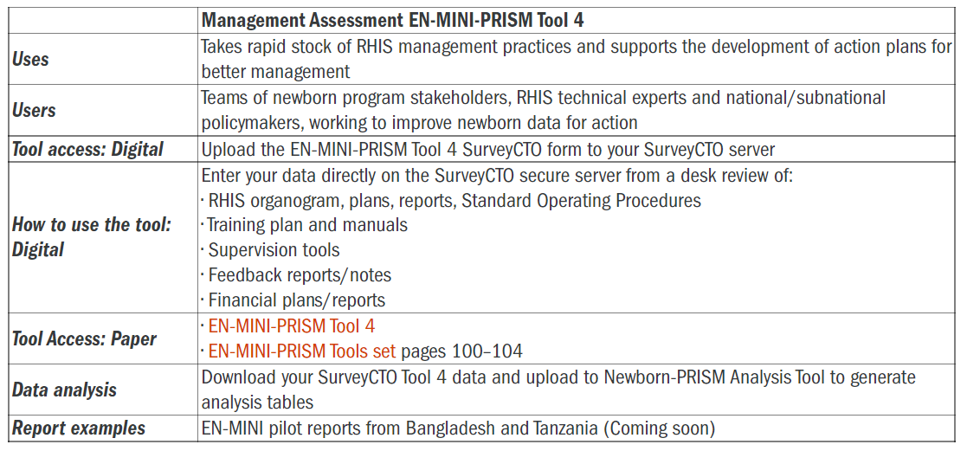
Ref: https://www.data4impactproject.org/en-mini-tools/

Slide 146
Session 11, Activity 2
Practice using
Notes:
Facilitator’s Note:
Using mobile device of choice for data collection, work through each question in detail and practice entering the data
Encourage participants to ask clarifying questions, and address those questions
Make notes on your paper copy
Demonstrate how to enter data collected during the PRISM assessment using SurveyCTO (suggest to project live use of SurveyCTO data entry on big screen)

Slide 147
Session 11, Activity 3
Reflections/questions
Notes:
Facilitators note:
10 mins to answer any questions or consider discussion topics proposed by the participants

Slide 148
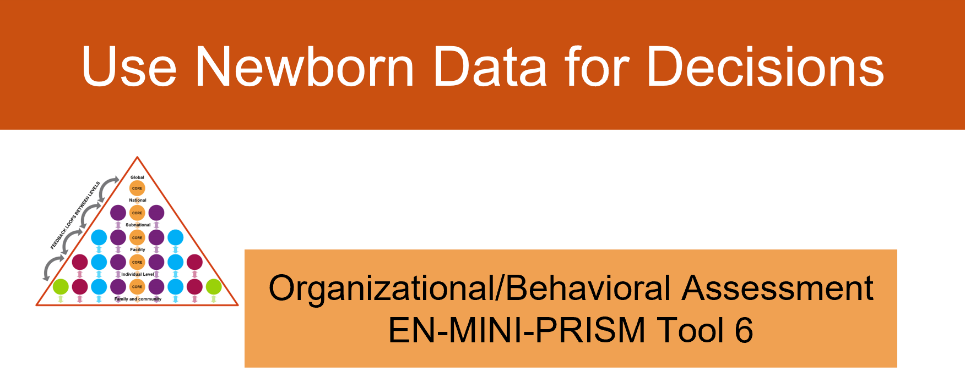
Training Session 12
EN-MINI Tools
Every Newborn – Measurement
Improvement for
Newborn and stillbirth Indicators
Organizational/Behavioral Assessment
EN-MINI-PRISM Tool 6

Slide 149
Session 12 plan
Time | Title and Description | Methods
10 minutes | Activity 1: Presentation Organizational and Behavioral Assessment EN-MINI-PRISM Tool 6 (OBAT) Present the structure and purpose of the Organizational and Behavioral Assessment EN-MINI-PRISM Tool 6 (OBAT) Present the scoring guide | Lecture, present EN-MINI-PRISM Training Slide set session 12 Discussion, Q&A EN-MINI-PRISM Digital Version SurveyCTO forms Handouts: EN-MINI-PRISM Training Manual EN-MINI-PRISM Training Slide set EN-MINI-PRISM Paper version Tools 1–6 and/or EN-MINI-PRISM Paper version individual Tool 6 EN-MINI-PRISM Tool 6 Scoring guide
60 minutes | Activity 2: Practice tool filling Using mobile device of choice for data collection, work through each question in detail and practice entering the data Make notes on your paper copy Practice application of the scoring guide
10 minutes | Activity 3: Presentation Present the scoring guide
60 minutes | Activity 4: Practice tool filling Practice application of the scoring guide
10 minutes | Activity 5: Discussion Facilitated discussion with Q&A
Notes:
Activity 1: present slides (10 mins)

Slide 150
Session 12, Activity 1
Presentation
Notes:
15 minutes

Slide 151
Organizational/ Behavioral Assessment EN-MINI-PRISM Tool 6
Uses | Identifies motivation, RHIS self-efficacy, task competence, problem-solving skills, and if organizational environment promotes a culture of information.
How to use the tool: Digital | Survey and self-assessments by sub-national/ national programme and data managers facility health workers and managers individually plus novel small group discussion how they would approach one of the case studies on poor data quality as a team together
Notes:
The Organizational and Behavioral Assessment EN-MINI-PRISM Tool 6 can be used to learn what additional data are needed by users to invest for newborns.
This tool identifies behavioral and organizational determinants, such as motivation, RHIS self-efficacy, task competence, problem-solving skills, and if the organizational environment promotes a culture of information.
Because this module includes working case studies, the data are collected using paper copies of EN-MINI-PRISM tool 6. However, results can still be easily uploaded to SurveyCTO as part of the automated analysis process.
This tools includes confidential surveys and self-assessments with facility health workers and managers, and both sub-national and national, program and data managers.
In addition, a new small group discussion with respondents has been added. This creates a unique opportunity to explore how participants would approach a case study on poor data quality, and aims to promote data use as an integral part of team working.

Slide 152
Use Newborn Data for Decisions
Improve Newborn
Data Quality
Overview | Functionality |  | OBAT Part 1, 2
Overview | Usability | MAT | OBAT Part 1, 2 | Tool 2A | FOC
 | Usability |  | OBAT Part 1, 3, 4 | Tool 2B | FOC
RHIS Overview
EN-MINI-PRISM Tool 1
Electronic RHIS Assessment
EN-MINI-PRISM Tool 3
Management Assessment
EN-MINI-PRISM Tool 4
Organizational/ Behavioral Assessment
EN-MINI-PRISM Tool 6
RHIS Performance Diagnostic
EN-MINI-PRISM Tool 2
Facility/Office Assessment
EN-MINI-PRISM Tool 5
National
Sub-national / District
Facility
Notes:
Facilitator’s Note:
Participants should be provided with the selected mobile devices that the EN-MINI-PRISM data will be collected with
The following sessions provide opportunity to go through each tool in detail.

Slide 153
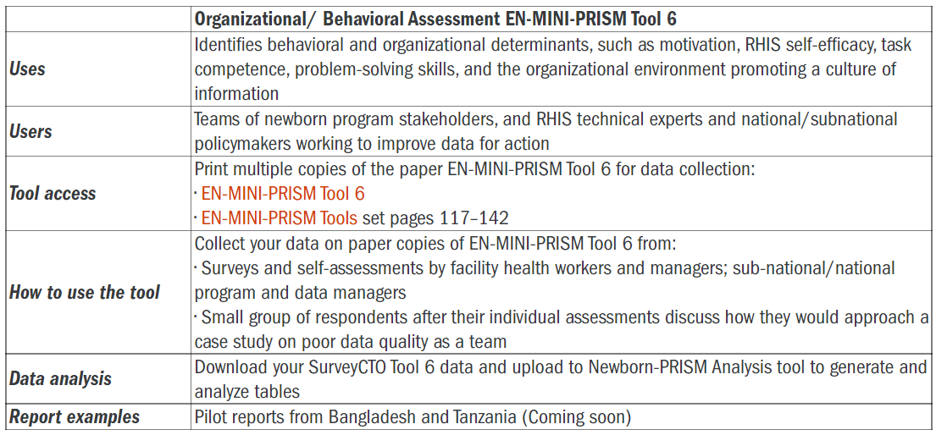
Ref: https://www.data4impactproject.org/en-mini-tools/

Slide 154
Who should fill out the tool?
OBAT | Who? | What? (sections)
Part 1 | Staff and management at all levels | Respondent background Promotion of a culture of information RHIS knowledge Perception of competence to perform RHIS tasks
Part 2 | Staff and management at district and higher levels | Competence to perform RHIS tasks
Part 3 | Health facility in charge | Competence to perform RHIS tasks
Part 4 | Data management staff in the health facility | Competence to perform RHIS tasks
Notes:
The culture of information is defined as “the capacity and control to promote values and beliefs among members of an organization for collection, analysis, and use of information to accomplish its goals and mission.”
As part of understanding behavioral factors, this tool aims to quantify staff motivation, knowledge, and skill to perform RHIS tasks.
This tool assesses someone’s perception of the organization through a rating scale, while the behavioral factors are estimated by responses to problems given in a written test.

Slide 155
Individual behavior
Behavioral assessment:
  Confidence level for carrying out RHIS tasks
  Knowledge of the rationale for the RHIS and methods for data quality checks
  Skills in data quality assurance, data analysis, interpretation, problem-solving, and use
  Motivation to perform RHIS tasks
Notes:
This tool is a self-assessment tool that looks at behavioral and organizational factors that affect RHIS performance such as:
Do staff have the necessary knowledge, skills, problem-solving ability, confidence, and motivation?
Does the organization promote a culture that values information quality and use? Does comparing these factors with RHIS performance identify gaps and opportunities for improvements?

Slide 156
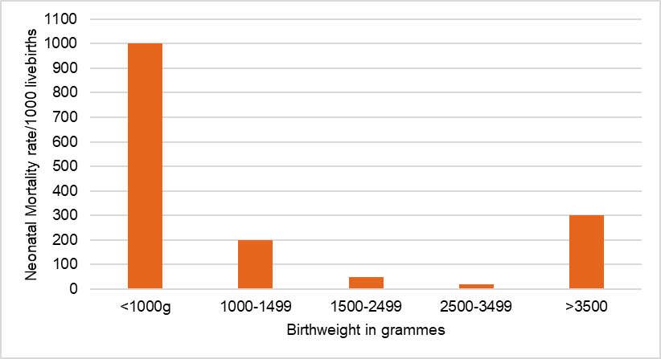
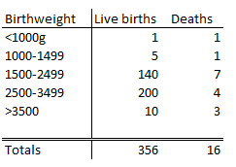
Example from EN-MINI-PRISM Tool 6
Neonatal mortality rates per 1000 livebirths, by birthweight categories
Kateria Hospital, Jan–Mar 2020
Notes:
Here you can see an example case study from the EN-MINI-PRISM tool 6.
This is designed for implementation with the facility in-charge or any staff responsible for the analysis and interpretation of health facility data.
Participants are asked to look at the graph and confidentially work through some data literacy exercises such as
Considering what this graph tells us about the birthweight mix for neonatal deaths this hospital
Calculating the overall neonatal mortality rate.
Assessing how many neonatal deaths must be prevented to achieve a target rate of 12 or less deaths per 1000 livebirths
Identifying in which birthweight category the hospital would most need to improve, to meet said target
And even thinking through some potential uses for these data at the facility and community level

Slide 157
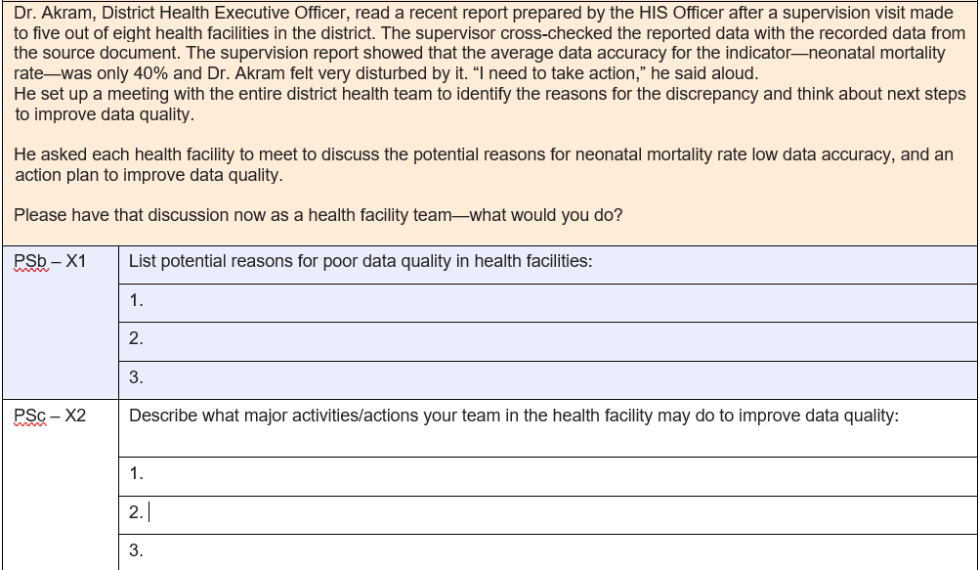
Example from EN-MINI-PRISM Tool 6
Notes:
Here is an example of the group-work exercise now included to promote data use as an integral part of team working.

Slide 158
Session 12, Activity 2
Practice using
Notes:
Facilitator’s Note:
Using mobile device of choice for data collection, work through each question in detail and practice entering the data
Encourage participants to ask clarifying questions, and address those questions
Make notes on your paper copy
Demonstrate how to enter data collected during the PRISM assessment using SurveyCTO (suggest to project live use of SurveyCTO data entry on big screen)

Slide 159
Session 12, Activity 3 Presentation
EN-MINI Tool 6 scoring guide
Notes:
Facilitators note:
10 mins
Orientate participants to how to find scoring guide from web pages and ensure printed copy available to annotate

Slide 160
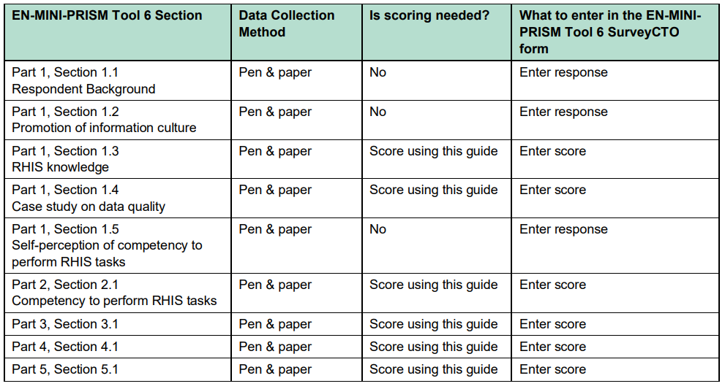
Which sections need to be scored
Notes:
EN-MINI-PRISM Tool 6 data are collected using pen and paper. The EN-MINI-PRISM tools have been set up for digital data collection using SurveyCTO and a standardized automated analysis. Please see the full EN-MINI-PRISM tool version for further details.
Some responses to the EN-MINI-PRISM Tool 6 questions need to be entered from the paper response sheet directly onto the EN-MINI-PRISM Tool 6 SurveyCTO form. Other responses require scoring by the data collection team using this guide. The score is then entered into the EN-MINI-PRISM Tool 6 SurveyCTO form as shown in this table.

Slide 161
Notes:
In this guide, each question to be scored is shown in italics with its scoring algorithm directly below as shown here

Slide 162
Session 12, Activity 4
Practice scoring tool
Notes:
Facilitator’s Note:
Practice using the scoring guide to assess and score a sample of tool 6 data, entre scores on SurveyCTO
Use paper copy of score guide and navigate to digital version
(60 minutes)

Slide 163
Session 12, Activity 5
Reflections/questions
Notes:
Facilitators note:
10 mins to answer any questions or consider discussion topics proposed by the participants

Slide 164
Training Session 13
EN-MINI Tools
Every Newborn – Measurement
Improvement for
Newborn and stillbirth Indicators
Improve Newborn Data Quality

Slide 165
Session 13 objectives
Describe the data quality concept and definition
Explain the dimensions of data quality
Understand and explain the importance of and responsibilities for maintaining the quality of data across the different RHIS management levels
Define, calculate, and interpret the main data quality metrics
Identify the main types of data quality problems
2

Slide 166
Session 13 plan
Time | Title and Description | Methods
20 minutes | Activity 1: Presentation Introduction to data quality Present the data quality concept and definition Present the dimensions of data quality Present the data quality performance metrics Accuracy (explain if there is any overreporting or underreporting) Reporting completeness (availability of reports) Data completeness (reports with data elements filled out) Timeliness | Lecture, present EN-MINI-PRISM Training Slide set session 13 Discussion, Q&A Handouts: EN-MINI-PRISM Training Manual
15 minutes | Activity 2: Discussion Discuss common threats to data quality Explore the importance of and responsibilities for maintaining the quality of data across the different RHIS management levels | Discussion, Q&A
20 minutes | Activity 3: Presentation Present the data quality performance metrics Accuracy (explain if there is any overreporting or underreporting) Reporting completeness (availability of reports) Data completeness (reports with data elements filled out) Timeliness | Lecture, present EN-MINI-PRISM Training Slide set session 13
5 minutes | Activity 4: Discussion Facilitated discussion with Q&A | Discussion, Q&A
Notes:
Activity 1: presentation (20 minutes)

Slide 167
Session 13, Activity 1
Presentation
Notes:
15 minutes

Slide 168
What is data quality?
Data quality is often defined as “fitness for use.”
This means:
Data are fit for their intended uses in operations, decision making, and planning.
Data reflect real value or true performance.
Data meet reasonable standards when checked against the criteria for quality.

Slide 169
Importance of data quality
Data provide evidence.
Quality data provide strong evidence that can be trusted, enabling providers and managers to optimize healthcare coverage, quality, and services.
Quality data helps to:
  Form an accurate picture of health needs, programs, and services in specific areas
  Inform appropriate planning and decision making (such as staffing requirements and planning healthcare services)
  Inform the effective and efficient allocation of resources
  Support ongoing monitoring by identifying best practices and areas where support and corrective measures are needed

Slide 170
Dimensions of data quality
Completeness and timeliness of data: Availability of reports and of complete data (up-to-date, available on time, and found to be correct/accurate)
Internal consistency of reported data: Plausibility of reported results, trends over time, and consistency between related indicators and potential outliers
External consistency with other data sources: Level of agreement between two sources of data measuring the same health indicator
External comparisons of population data: Consistency between denominators from different sources used to calculate health indicators
Notes:
Elaborate the definition of each dimension of data quality.

Slide 171
Session 13, Activity 2 Discussion
What are the common problems affecting data quality across system levels?
Notes:
Facilitators note:
15 minutes:
Either in wider class discussion with whole group, or in small groups- encourage participants to brainstorm and discuss some potential challenges they anticipate with data quality.
Bring the group together and here their ideas, then can present next slide to confirm what they have said and fill any gaps.

Slide 172
Common problems affecting data quality across system levels
Lack of guidelines for filling out the main data sources and reporting forms.
Data management operational processes are not documented.
Personnel are not trained in the use of data sources and reporting forms.
Misunderstanding about how to compile data, use tally sheets, and prepare reports.
Data collection and reporting forms are not standardized; different groups have their own formats.
Math errors occur during data consolidation from data sources, affecting report preparation.
There is no review process before a report’s submission to the next level.
There are parallel data systems to collect the same indicator.

Slide 173
Completeness & timeliness of data
Completeness of reports
Reports submitted through the system are available and adequate for the intended purpose
All entities that are supposed to report are actually reporting
Completeness of data reported
Data relevant to selected indicators are complete in the submitted reports
Timeliness of reports
Reports are submitted/received on time through the levels of the information system data flow
Data relevant to selected indicators are available in the source documents
Notes:
Activity 3: Presentation (20 minutes)

Slide 174
Reporting performance
# total reports available or received
Completeness of reports (%) =
Completeness of data reported (%) =
Reporting timeliness (%) =
# total reports expected
# reports that are complete*
# total reports available or received
* reports contain the data elements of selected indicators filled out
# reports submitted or received on time
# total reports available or received
Notes:
Reporting performance: review of timeliness, completeness of data, and availability/completeness of reports
For the three indicators, we are using the total number of reports expected as the denominator to assign an automatic weight among them.
Usually, the calculation is made as described below:
Completeness of reports (%) = # total reports available or received / # total reports expected
Completeness of data reported (%) = # reports that are complete / # total reports available or received
Timeliness (%) = # reports submitted or received on time / # total reports available or received

Slide 175
Core components of data quality
Data accuracy
Consistency of reported data and original records
Outliers
Data value in a series of values is extreme in relation to the other values in the series
Consistent trend
Indicator comparisons
Relationship between program indicators is consistent with predictable or expected relationship
The plausibility of reported results for selected program indicators
Data accuracy trend over time
Notes:
Internal consistency of data examines:
Consistency of reported data and original records: This involves an assessment of the reporting accuracy for selected indicators through the review of source documents in health facilities. This element of internal consistency is measured by a data verification exercise which requires a record review to be conducted in a sample of health facilities. It is the only dimension of data quality that requires additional collection of primary data.
Presence of outliers: This examines if a data value in a series of values is extreme in relation to the other values in the series.
Consistency over time: The plausibility of reported results for selected program indicators is examined in terms of the history of reporting of the indicators. Trends are evaluated to determine whether reported values are extreme in relation to other values reported during the year or over several years.
Consistency between indicators: Program indicators which have a predictable relationship are examined to determine whether the expected relationship exists between those indicators. In other words, this process examines whether the observed relationship between the indicators, as depicted in the reported data, is that which is expected.

Slide 176
Data accuracy: Verification factor
Numerator: Recounted data
  Overreporting: <100%
  Underreporting: >100%
Denominator: Reported data
Suggested range of acceptability:
100% +/- 10%
(90-110%)
Notes:
Data verifications: quantitative comparison of recounted to reported data.
The verification factor is calculated by dividing the recounted number by the reported number, giving you a percentage.
***Facilitator note: Ask participants what 85% would mean? How about 125%?

Slide 177
Session 13, Activity 4
Reflections/questions
Notes:
Facilitators note:
5 mins to answer any questions or consider discussion topics proposed by the participants

Slide 178

Training Session 14
EN-MINI Tools
Every Newborn – Measurement
Improvement for
Newborn and stillbirth Indicators
RHIS Performance Diagnostic
EN-MINI-PRISM Tool 2

Slide 179
Session 14 plan
Time | Title and Description | Methods
15 minutes | Activity 1: Presentation RHIS Performance Diagnostic EN-MINI-PRISM Tools 2a & 2b Present the structure and purpose of the RHIS Performance Diagnostic EN-MINI-PRISM Tools 2a & 2b | Lecture, present EN-MINI-PRISM Training Slide set session 14 Discussion, Q&A EN-MINI-PRISM Digital Version SurveyCTO forms Handouts: EN-MINI-PRISM Training Manual EN-MINI-PRISM Training Slide set EN-MINI-PRISM Paper version Tools 1–6 and/or EN-MINI-PRISM Paper version individual Tools 2a and 2b Sample routine registers, summary forms
60 minutes | Activity 2: Practice filling Tool 2a Using mobile device of choice for data collection, work through each question in detail and practice entering the data Make notes on your paper copy
60 minutes | Activity 3: Practice filling Tool 2b Using mobile device of choice for data collection, work through each question in detail and practice entering the data Make notes on your paper copy
15 minutes | Activity 4: Discussion Facilitated discussion with Q&A
Notes:
Activity 1: presentation (5 minutes)

Slide 180
Session 14, Activity 1
Presentation
Notes:
15 minutes

Slide 181
RHIS Performance Diagnostic
EN-MINI-PRISM Tool 2
Uses | Determines RHIS performance: Data quality – register/ report Technical and organizational determinants e.g., reporting guidelines Supervision and feedback mechanisms Complexity of data collection tools/ forms Data-quality assurance mechanisms

Slide 182
Use Newborn Data for Decisions
Improve Newborn
Data Quality
Overview | Functionality |  | OBAT Part 1, 2
Overview | Usability | MAT | OBAT Part 1, 2 | Tool 2A | FOC
 | Usability |  | OBAT Part 1, 3, 4 | Tool 2B | FOC
RHIS Overview
EN-MINI-PRISM Tool 1
Electronic RHIS Assessment
EN-MINI-PRISM Tool 3
Management Assessment
EN-MINI-PRISM Tool 4
Organizational/ Behavioral Assessment
EN-MINI-PRISM Tool 6
RHIS Performance Diagnostic
EN-MINI-PRISM Tool 2
Facility/Office Assessment
EN-MINI-PRISM Tool 5
National
Sub-national / District
Facility
Notes:
Facilitator’s Note:
Participants should be provided with the selected mobile devices that the EN-MINI-PRISM data will be collected with
The following sessions provide opportunity to go through each tool in detail.

Slide 183


Slide 184


EN-MINI-PRISM Tool 2 example question

Slide 185
Session 14, Activity 2
Practice Tool 2a using
Notes:
Facilitator’s Note:
Using mobile device of choice for data collection, work through each question in detail and practice entering the data
Encourage participants to ask clarifying questions, and address those questions
Make notes on your paper copy
Demonstrate how to enter data collected during the PRISM assessment using SurveyCTO (suggest to project live use of SurveyCTO data entry on big screen)
(60 minutes)

Slide 186
Session 14, Activity 2
Practice Tool 2b using
Notes:
Facilitator’s Note:
Using mobile device of choice for data collection, work through each question in detail and practice entering the data
Encourage participants to ask clarifying questions, and address those questions
Make notes on your paper copy
Demonstrate how to enter data collected during the PRISM assessment using SurveyCTO (suggest to project live use of SurveyCTO data entry on big screen)
(60 minutes)

Slide 187
EN-MINI-PRISM Analysis Tool
EN-MINI-PRISM Tool 1
EN-MINI-PRISM Tool 3
Automated data analysis
EN-MINI-PRISM Tool 2 Central Level
EN-MINI-PRISM Tool 3
C:\My documents\EN-MINI-PRISM data files
EN-MINI-PRISM Tool 2 Region Level
EN-MINI-PRISM Tool 5
EN-MINI-PRISM Tool 2 District level
EN-MINI-PRISM Tool 4
EN-MINI-PRISM Tool 2 Facility Level
EN-MINI-PRISM Tool 6
Notes:
EN-MINI-PRISM data collected on the SurveyCTO platform Hattie showed is uploaded into the EN-MINI-PAT.

Slide 188


Example results from Tanzania
IMPROVE Newborn Data Quality
Month
Month
April
April
May
May
June
June
Completeness of facility reporting at district level is 100%
Average timeliness of facility reporting at district level (3 months) is 7%

Slide 189
EN-MINI-PRISM Analysis Tool
Example results from Tanzania pilot study
Data quality domains for newborn and stillbirth denominators

Slide 190

EN-MINI-PRISM Analysis Tool
Example results from Tanzania pilot study
Factors to improve routine data quality from EN-MINI-PRISM tools

Slide 191
EN-MINI-PRISM Analysis Tool
Example results from Tanzania pilot study
Notes:
The EN-MINI PAT generates the standard PRISM analysis adapted for EN-MINI. 287 tables of information which can be used in many different ways to improve routine systems for newborns.
In addition to a simple dashboard summary as shown here.

Slide 192
Session 14, Activity 4
Reflections/questions
Notes:
Facilitators note:
5 mins to answer any questions or consider discussion topics proposed by the participants

Slide 193

Training Session 15
EN-MINI Tools
Every Newborn – Measurement
Improvement for
Newborn and stillbirth Indicators
Facility/Office Assessment
EN-MINI-PRISM Tool 5

Slide 194
Session 15 plan
Time | Title and Description | Methods
5 minutes | Facility/Office Assessment EN-MINI-PRISM Tool 5 Activity 1: Presentation Present the structure and purpose of the Facility/Office Assessment EN-MINI-PRISM Tool 5 | Lecture, present EN-MINI-PRISM Training Slide set session 15 Discussion, Q&A EN-MINI-PRISM Digital Version SurveyCTO forms Handouts: EN-MINI-PRISM Training Manual EN-MINI-PRISM Training Slide set EN-MINI-PRISM Paper version Tools 1–6 and/or EN-MINI-PRISM Paper version individual Tool 5
30 minutes | Activity 2: Practice filling Tool 5 Using mobile device of choice for data collection, work through each question in detail and practice entering the data Make notes on your paper copy
10 minutes | Activity 3: Discussion Facilitated discussion with Q&A
Notes:
Activity 1: presentation 5 minutes

Slide 195
Session 15, Activity 1
Presentation
Notes:
15 minutes

Slide 196
Facility/ Office assessment EN-MINI-PRISM Tool 5
Improve Newborn Data Quality
Facility/Office Assessment
EN-MINI-PRISM Tool 5
Uses | Assesses the availability and status of resources needed for RHIS implementation at supervisory levels.
How to use the tool: Digital | Key Informant interviews with district RHIS unit director, health facility manager and data manager Office inventory visit/ tour, desk review and observations.
Notes:
Use this tool to:
Understand the Resource availability and their condition at health facilities, district offices, and at higher levels
Identify systemic resource issues at any level of the system
The checklist measures the availability of:
Equipment (computers, printers, backup units, etc.)
Utilities (electricity, backup power, Internet, etc.)
Registers and forms (RHIS supplies)
Human resources (adequately trained personnel and the type of RHIS training received)

Slide 197
Use Newborn Data for Decisions
Improve Newborn
Data Quality
Overview | Functionality |  | OBAT Part 1, 2
Overview | Usability | MAT | OBAT Part 1, 2 | Tool 2A | FOC
 | Usability |  | OBAT Part 1, 3, 4 | Tool 2B | FOC
RHIS Overview
EN-MINI-PRISM Tool 1
Electronic RHIS Assessment
EN-MINI-PRISM Tool 3
Management Assessment
EN-MINI-PRISM Tool 4
Organizational/ Behavioral Assessment
EN-MINI-PRISM Tool 6
RHIS Performance Diagnostic
EN-MINI-PRISM Tool 2
Facility/Office Assessment
EN-MINI-PRISM Tool 5
National
Sub-national / District
Facility
Notes:
Facilitator’s Note:
Participants should be provided with the selected mobile devices that the EN-MINI-PRISM data will be collected with
The following sessions provide opportunity to go through each tool in detail.

Slide 198


Slide 199
Session 15, Activity 2
Practice using
Improve Newborn Data Quality
Facility/Office Assessment
EN-MINI-PRISM Tool 5
Notes:
Facilitator’s Note:
Using mobile device of choice for data collection, work through each question in detail and practice entering the data
Encourage participants to ask clarifying questions, and address those questions
Make notes on your paper copy
Demonstrate how to enter data collected during the PRISM assessment using SurveyCTO (suggest to project live use of SurveyCTO data entry on big screen)
(60 minutes)

Slide 200
Session 15, Activity 3
Reflections/questions
Notes:
Facilitators note:
10 mins to answer any questions or consider discussion topics proposed by the participants

Slide 201
Training Session 16
Recap
EN-MINI Tools
Every Newborn –
Measurement
Improvement for
Newborn and stillbirth Indicators

Slide 202
Session 16 plan
Time | Title and Description | Methods
15 minutes | Activity 1: Presentation Present and discuss recap session slides Repeat any slides or content requested by participants | Lecture, present EN-MINI-PRISM Training Slide set session 16 Discussion, Q&A Handouts: EN-MINI-PRISM Training Manual EN-MINI-PRISM Training Slide set EN-MINI-PRISM Paper version Tools 1–6 and/or EN-MINI-PRISM Paper version individual Tool 5
15 minutes (or as needed) | Activity 2: Discussion Facilitated discussion with Q&A

Slide 203
Session 16, Activity 1
Presentation
Notes:
Activity 1
Presentation of recap slides (15 minutes)

Slide 204
Functions and goals of a health system
Functions
(6 building blocks)
Goals/outcomes
I
N
P
U
T
S
Service delivery
Access
Improved health
Human resources
Quality
Responsiveness
Coverage
Information
Commodities
infrastructure
Social and financial
risk protection
Financing
Safety
Improved efficiency
Leadership and governance
Source: World Health Organization (WHO), 2000
Notes:
To understand why we are using the EN-MINI-PRISM tools, it’s helpful to reflect on how these are situated within the wider health system, and what this means for newborns.
Health systems have four fundamental objectives
Improving the health of the population they serve
Responding to people’s needs (the way people are treated and the environment)
Protecting people from the burden of the financial cost of illness
Improving efficiency
The health system has six components, or building blocks: service delivery, health workforce, health information system, medical products, vaccines and technology, health financing, and leadership and governance.
The four functions of the health system that relate to the building blocks are (World Health Report 2000):
Stewardship (oversight)
Creating resources (investment and training)
Financing (collecting, pooling, purchasing)
Delivering services (ensuring access, quality, coverage and safety)
ANNIMATE
The Health Information System (HIS) is an integral part of the health system and refers to any system that captures, stores, manages, or transmits information related to the health of individuals or the activities of organizations, which will improve health care management decisions at all levels of the health system.
A well-functioning HIS is an integrated effort to collect, process, report, and use health information and knowledge to influence policy and decision making, program action, individual and public health outcomes, and research (WHO, 2010).

Slide 205
The Performance of Routine Information System Management (PRISM) - Conceptual Model
INPUTS
PROCESSES
OUTPUTS
OUTCOMES
IMPACT
RHIS determinants
Technical factors:
Complexity of reporting forms, procedures
HIS design
Computer software
Information technology complexity
Behavioral factors:
Level of knowledge of content of HIS forms
Data-quality checking skills
Problem-solving for HIS tasks
Competence in HIS tasks
Confidence levels for HIS tasks
Motivation
RHIS processes:
Data collection
Data transmission
Data processing
Data analysis
Data quality check
Feedback
Improved RHIS performance
Data quality
Information use
Improved health system performance
Improved health status
Organizational factors:
Critical management functions & information needs
Governance
Planning
Training
Supervision
Quality
Finance
Promotion of a culture of information
Availability of resources
Notes:
The PRISM Framework, is applied to the RHIS structure and processes to provide a detailed PRISM Conceptual Model of RHIS performance elaborating the various determinants at input, processes, output and outcome levels of RHIS.
PRISM = Performance of Routine Information System Management
The PRISM Assessment is developed based on this PRISM Conceptual Model. We will be talking about this assessment and the PRISM Tools in details in later sessions.
In general, the PRISM Framework provides a systems approach for developing appropriate strategies and interventions for strengthening RHIS.
In the next slide is an example of how one RHIS problem can be related to technical, organization and/or behavioral factors.

Slide 206
The PRISM Conceptual Model
INPUTS
PROCESSES
OUTPUTS
OUTCOMES
IMPACT
RHIS determinants
Technical factors:
Complexity of reporting forms, procedures
HIS design
Computer software
Information technology complexity
Behavioral factors:
Level of knowledge of content of HIS forms
Data-quality checking skills
Problem-solving for HIS tasks
Competence in HIS tasks
Confidence levels for HIS tasks
Motivation
RHIS processes:
Data collection
Data transmission
Data processing
Data analysis
Data quality check
Feedback
Improved RHIS performance
Data quality
Information use
Improved health system performance
Improved health status
Organizational factors:
Critical management functions & information needs
Governance
Planning
Training
Supervision
Quality
Finance
Promotion of a culture of information
Availability of resources
Notes:
The Health Information System (HIS) uses two different data sources: Population-based data or routine health information system (RHIS) data. The EN-MINI-PRISM tools are focused on facility-based RHIS data for newborns.
RHIS data collection refers to data that are collected continuously (daily, patient by patient, monthly, etc.). While processing and reporting are periodic, they are conducted more frequently than annually. Examples of HIS subsystems using continuous data collection are health facility-based subsystems that collect information on patients when they use services. Service statistics are usually aggregated monthly and reported quarterly. Vital registration occurs when a person registers, which may happen at any time.
The EN-MINI-PRISM tools focus on RHIS data

Slide 207
Use Newborn Data for Decisions
Improve Newborn
Data Quality
Overview | Functionality |  | OBAT Part 1, 2
Overview | Usability | MAT | OBAT Part 1, 2 | Tool 2A | FOC
 | Usability |  | OBAT Part 1, 3, 4 | Tool 2B | FOC
RHIS Overview
EN-MINI-PRISM
Tool 1
Electronic RHIS Assessment
EN-MINI-PRISM Tool 3
Management Assessment
EN-MINI-PRISM Tool 4
Organizational/ Behavioral Assessment
EN-MINI-PRISM Tool 6
RHIS Performance Diagnostic
EN-MINI-PRISM Tool 2
Facility/Office Assessment
EN-MINI-PRISM Tool 5
National
Sub-national / District
Facility
Notes:
Facilitator’s Note:
Participants should be provided with the selected mobile devices that the EN-MINI-PRISM data will be collected with
The following sessions provide opportunity to go through each tool in detail.

Slide 208
Aims and Objectives of the EN-MINI Tools
Map Newborn Data
Map Newborn Data EN-MINI Tool 0
Improve Newborn Data Quality
Use Newborn Data for Decisions
RHIS Performance Diagnostic
EN-MINI-PRISM Tool 2
RHIS Overview
EN-MINI-PRISM Tool 1
Facility/Office Assessment
EN-MINI-PRISM Tool 5
Electronic RHIS Assessment
EN-MINI-PRISM Tool 3
Management Assessment EN-MINI-PRISM Tool 4
Organizational/Behavioral Assessment
EN-MINI-PRISM Tool 6
Adapted from: Day LT, Moran AC, Jackson D, et al. (2019). Survive and Thrive: Transforming care for every small and sick newborn. Chapter 5, Figure 5.1. Geneva, Switzerland.
Notes:
The EN-MINI tools focus on core newborn indicator measurement shown as the yellow data point circles in the center of the data pyramid in Figure 2. EN-MINI tools assess Routine Health Information Systems performance for data collected from the health facility up to sub-national and national levels for tracking.
This figure shows the 7 EN-MINI tools. They will ideally be implemented as a package but can be used individually for your needs.
The tools are organized in three groups:

Slide 209
Session 16, Activity 2
Reflections/questions
Notes:
Facilitators note:
10 mins to answer any questions or consider discussion topics proposed by the participants

Slide 210
How to access the EN-MINI-PRISM Tools
This slide deck is part of the EN-MINI-PRISM Tools Training Kit, which also includes a Training Manual.
The EN-MINI-PRISM Tools are available on the D4I website, here: https://www.data4impactproject.org/

