Slide 1
Data Quality Conceptual Framework and Dimensions
Name, Data for Impact
Meeting or event
Date

Slide 2
Objectives:
Understand the data quality conceptual framework tailored for FP.
Define the dimensions of data quality.
Identify the steps for assessing, improving, and maintaining data quality.
Understand why data quality is important for the data use and decision-making process.

Slide 3
A Conceptual Framework for FP Data Quality
Systematic Approach to Monitoring Data Quality in Family Planning
DECISIONS
Interpretability of FP data signals
Systems that incentivise data quality with data availability
Analytics that inform at the level and the frequency needed
INFORMATION SYSTEMS
Rationalized indicators focusing on programme priorities Valid measurement of FP indicators and concepts
Robust systems checks to flag data entry errors and outliers
Automated Feedback loops
TARGETED DATA QUALITY REVIEWS
Curriculum and Training on applying standardized methods- National
Leveraging systems investments over ad-hoc supportive supervision
Efficient use of Monitoring Resources focusing on issues/areas of highest need
PEOPLE
Dedicated staff time at National levels for FP Data
Routine mechanisms that include FP Data Quality Review
Capacity to identify and prioritize for data quality action

Slide 4
Improving Data Quality in FP: Tools
Service Statistics to Estimated Modern Use (SS to EMU) tool: Excel-based tool that is typically applied at the national level and can be applied subnationally.
  Value: Can identify where problems in data quality are occurring and for which methods.
  Value: Currently being used for FP2020 by Track20-supported countries and government technical staff.
DHIS2 FP Generic Module: Comprehensive environment to review data quality and its linkage to performance.
  Value: Contains the SS to EMU tool approach.
  Value: Available to embed in the DHIS2.
  Value: Strengthens the health management information system (HMIS) and reduces the resource burden for data quality.
RDQA for assessing sources of poor data quality: Facility-based tool
  Value: Standardized approach to routine data quality at the facility level.

Slide 5
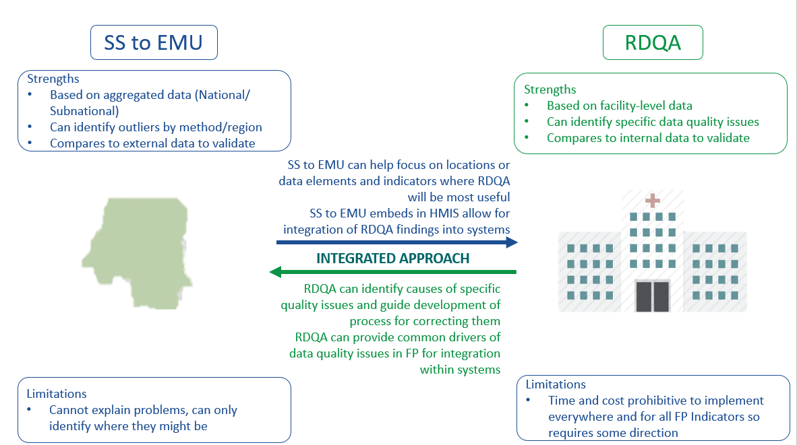
Leveraging opportunities in existing tools
These tools provide information at different levels and depths.
SS to EMU tool and the FP Generic Module can identify where in-depth reviews are most needed.
RDQAs can provide in-depth information on the nature and drivers of poor data quality.
Combining both allows programs to efficiently target scarce data quality resources AND improve outcomes.

Slide 6
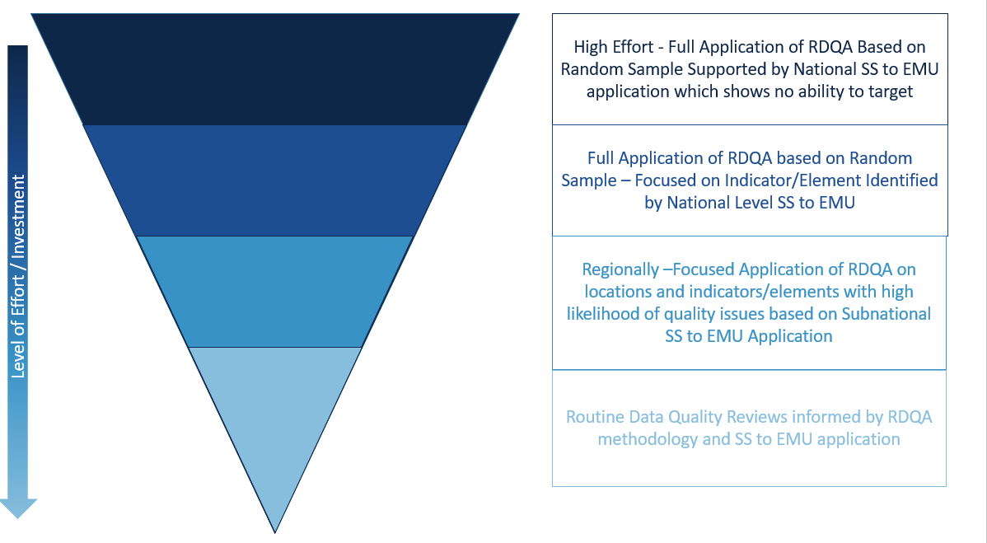
How to describe the way that the two tools interact along the continuum of data quality assessment

Slide 7
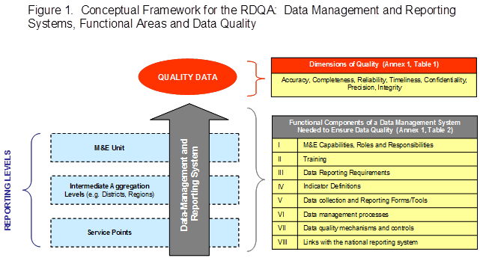
Data Quality Conceptual Framework Using RDQA

Slide 8
Data Quality Dimensions for Systems and RDQA Application
DIMENSIONS
RDQAs cannot occur everywhere given resource constraints.
Data quality should be applied to the FP information system to ensure that data elements and indicators in the system can produce quality data as constructed.
The same dimensions are used during a RDQA.
Accuracy - they measure what they are intended to measure
Completeness - collected comprehensively
Reliability - repeated measurements using the same procedures get the same results
Timeliness - up-to-date & available on time
Confidentiality - clients’ data are not disseminated
Precision - have sufficient detail to use for decision making
Integrity - protected from bias or manipulation
Validity - considered accurate—they measure what they are intended to measure
Timeliness - means that the data are sufficiently current and frequent to inform management’s decision making. They are received by the established deadline.
Completeness - Comprehensive data collection; percentage of all fields in the data collection form filled in; percentage of all expected reports received.

Slide 9
Data Quality Dimensions
Validity
  Considered accurate—they measure what they are intended to measure.
Timeliness
  Data are sufficiently current and frequent to inform management’s decision making.
  They are received by the established deadline.
Completeness
  Comprehensive data collection
  Percentage of all fields on the data collection form filled in.
  Percentage of all expected reports actually received.

Slide 10
Key Steps to Guarantee Data Quality
  Standard data collection tools and reporting forms
  Steps addressing quality challenges
  Specific reporting timelines
  Description of roles and responsibilities
  Storage policy that allows for retrieval of data
  Functioning information systems, including FP
  Skilled HMIS staff at the different levels of the health system
  Clear definitions of indicators
  Documented data review procedures
Factors that affect data quality at all levels of the information system

Slide 11
Good FP data are needed to:
Plan, develop, and maintain FP services.
Influence decision making on the quality of the FP service and care continuum.
Evaluate the performance of FP services over time and by location.
Consider future needs of the FP program and interventions.
Monitor FP service achievements against standards and targets.
Improve the use of FP services in a community.
Determine staffing requirements and plan FP services.

Slide 12
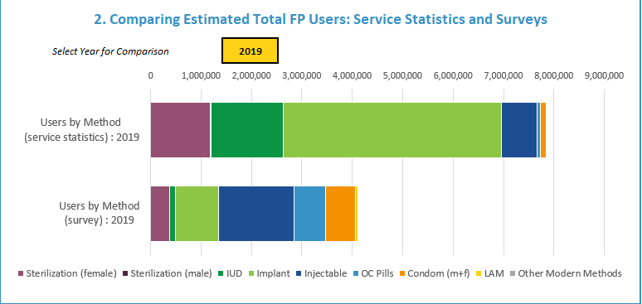
Group Exercise
Identify where RDQA should take place
These bar graphs compare the distribution of users according to HMIS data and for the same year from a DHS survey. What does this tell you about which methods need more review?
What do you notice immediately about trends from commodities data? How will you determine if the trend and spike in 2014 reflect accuracy?

Slide 13
Group Exercise
Once Geographies and Methods Are Identified ‒ Facility-Level RDQA
Scenarios:
Angela visited a health facility after having unprotected intercourse with her boyfriend, fearing possible pregnancy. She requested counseling and advice from a FP provider. After the counseling session, the provider and Angela agree that she should take an emergency contraceptive pill.
Paul, a young boy schooling and residing in Ajegunle, Lagos asked for a condom from a FP provider. He was referred to the STI unit and received 12 condoms.
Angela’s boyfriend named Adamu visited the same facility that Angela visited 30 minutes after her to request an emergency contraceptive pill. He told the FP provider that he had unprotected sex with his girlfriend and he was not ready to be a father. The provider gave Adamu an emergency contraceptive pill to give to his girlfriend.
During the reporting period, the data manager was asked to give a report of FP users at the facility. From the scenarios above:
  How many FP users should the data manager report for the period?
  How did you determine the number of FP users?

