Slide 1
Introduction to Family Planning Data Quality
Name, Data for Impact
Meeting or event
Date

Slide 2
Objectives
Understand the importance of good family planning (FP) data and information.
Identify the sources and categories of FP data and information.
Be able to define and calculate indicators and data elements.
Determine problems associated with FP data quality.
Describe the concept of the integrated approach to FP data quality assessment.

Slide 3
How to describe good FP data and information?
Complete and comprehensible records in data collection tools.
Good compilation and aggregation of records in the reporting forms.
Complete aggregated reports available.
Records accurately reflect aggregated data reported in the system.
Timely aggregated data are reported.
There are consistent data trends.
Good understanding of data elements and indicator definitions.

Slide 4
How to define and calculate indicators?
Clear and precise definitions of data elements and indicators:
  Refer to the data record filing guidelines
  Data dictionary
Formulas are factors (e.g., 1; 100; 1,000; 100,000)
Numerator and denominator
Both expressions based on one or more data elements.

Slide 5
Sources of FP Data and Information
Individual client records in FP data sources:
  Registers
  Files
  Electronic systems
Aggregated data in periodic reports:
  Daily
  Weekly
  Monthly
  Quarterly
  Annually
Transformed data:
  Ratio
  Rate
  Proportion
Data visualization:
  Graphs
  Tables
  Maps

Slide 6
What are the FP data quality problems?
Misunderstanding the definition of data elements and/or indicators
Data record errors
Errors from the aggregation of FP data
Incomplete and inconsistent data (including missing data)
Delays in data reporting
Duplicated data

Slide 7
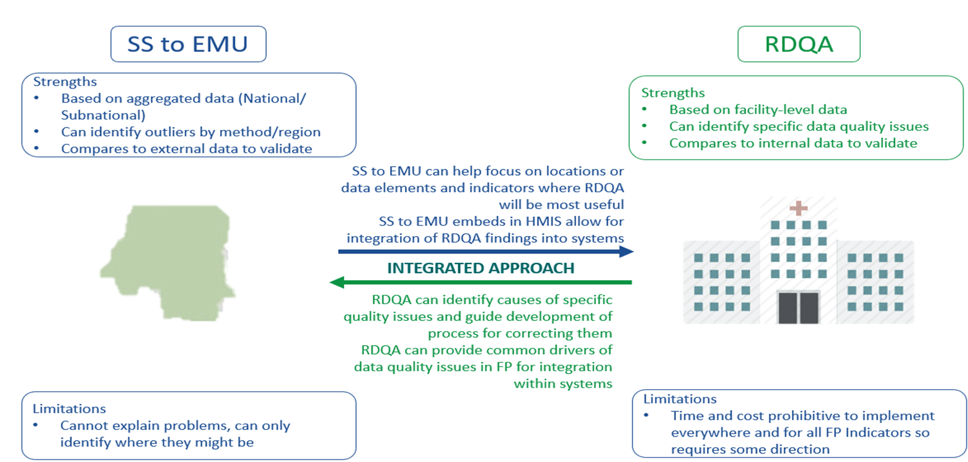
FP Data Quality Assessment Integrated Approach

