Slide 1
Data Quality Analysis and Development of a Plan of Action
Name, Data for Impact
Meeting or event
Date

Slide 2
Objectives:
Understand the bar graphs and summary tables generated by the RDQA tool.
Define the data verification factor (VF) and interpret what it means in terms of indicator data quality.
Develop a plan of action based on the data verification results.

Slide 3
Accuracy, Timeliness, and Completeness of Districts

Slide 4
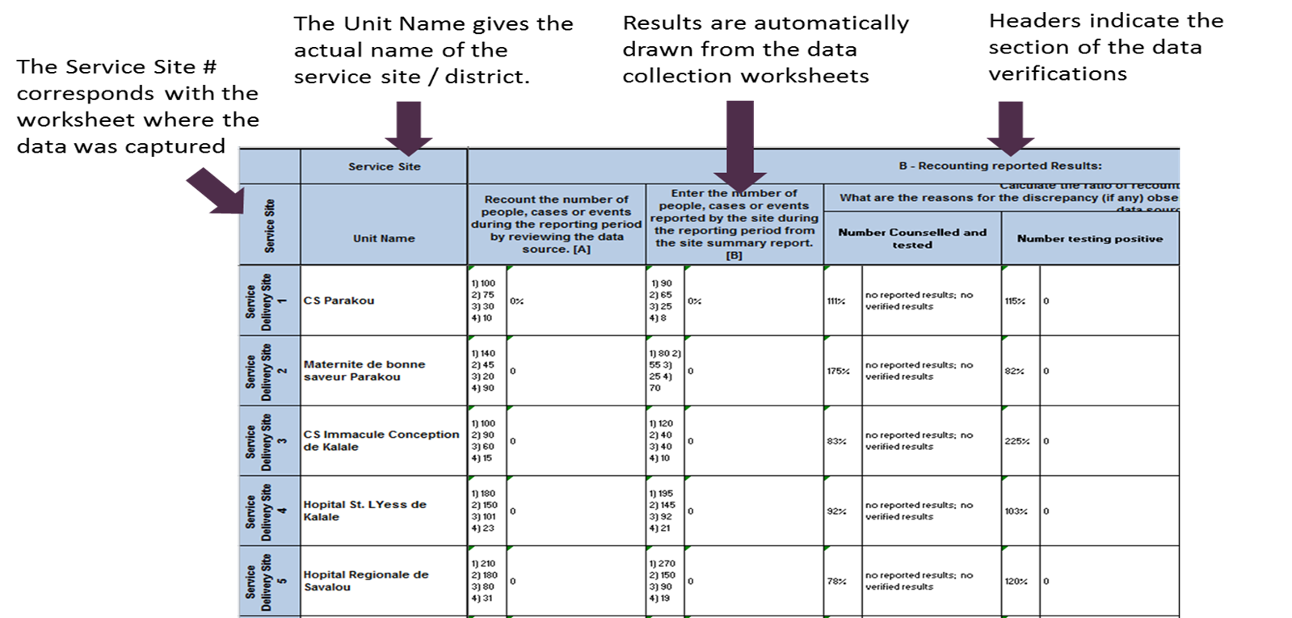
Summary Table

Slide 5
Average VF across sites: Extent to which reported results could be verified for the selected reporting period and indicators.
Average across sites excluding zero reporting sites: Exclude results from sites that scored zero on validation due to missing source documents.
Weighted average VF: weights the VF on volume of services. Influence a site’s VF has on the average is proportional to the volume.
Average 1 – Abs (VF) across sites: Over- and underreporting together can cancel each other out, which makes the VF tend toward 1, or perfect agreement between recounted and reported.
Data Verification Factor

Slide 6
After data verification at each site:
  Determine data quality issues.
  Propose solutions.
  Designate a responsible person to oversee and address the data quality issues.
  Determine solution implementation deadlines.
  Designate a person or a committee to monitor plan of action implementation.
Plan of Action

Slide 7
Group Exercise
Review, discuss, and interpret results.
Prepare a plan of action.

